Slide 1
Algebra
Introducing The Four Arithmetic Functions and
Reduction to find “X”

Slide 2

The Four Arithmetic Functions
Algebra is mathematics where numbers are quite often replaced by letters. The letters can have any value given to them, so their value can vary – they are called “variables”
Numbers are quite often used to support the variables, but because numbers have fixed values they are called “constants”. Constants are used to do arithmetic operations on variables such as multiply or divide them etc.
Numbers added together give constant results, 1 + 1 can only be 2 (except in some circumstances but we won’t worry about these yet).

Slide 3
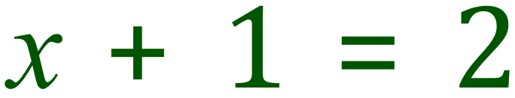
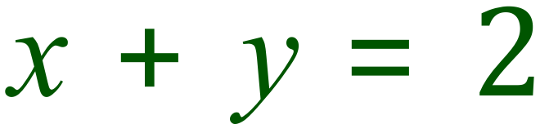
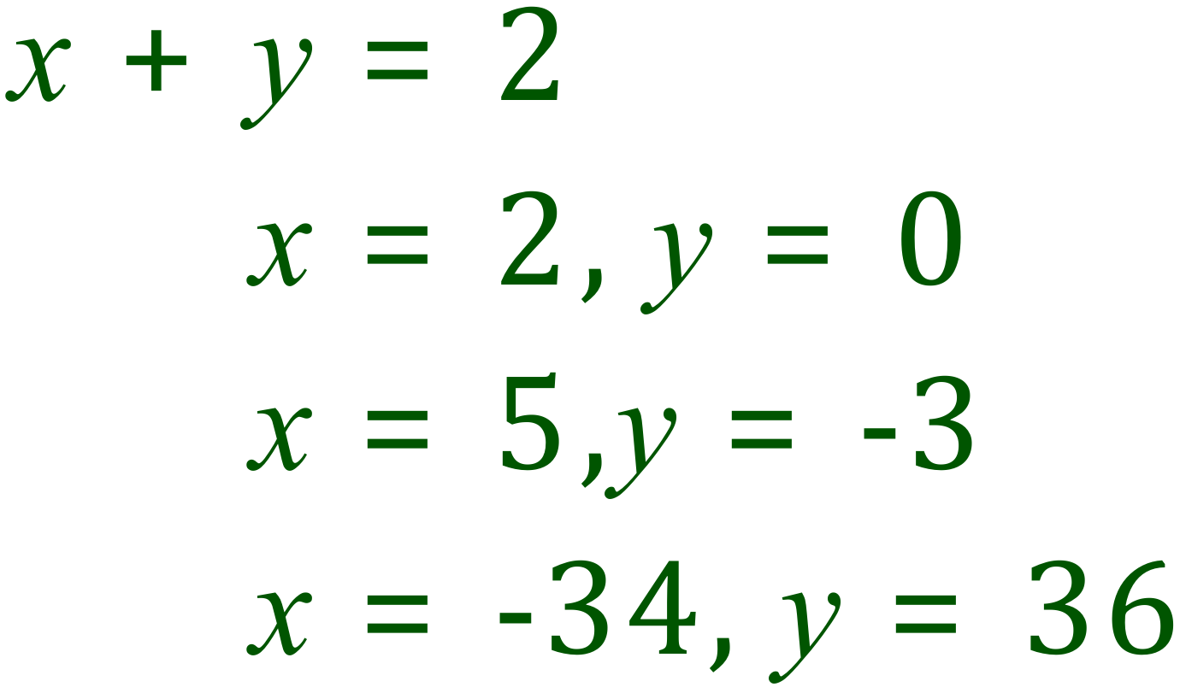
The Four Arithmetic Functions
This is an algebraic expression, we are adding a variable “x” to a constant “1” to obtain a constant “2”. There can only be one value for “x” that will satisfy this equation, x = 1.
This time we have a problem, how can we say what the value of “x” and “y” are?
“x” and “y” can have ANY value provided that they add up to 2.
If we are given a problem like this, we usually have two equations and can work out exact values for “x” and “y” but as this stands …… exact values aren’t possible.

Slide 4
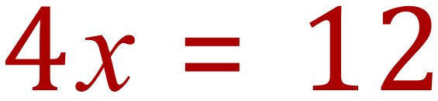
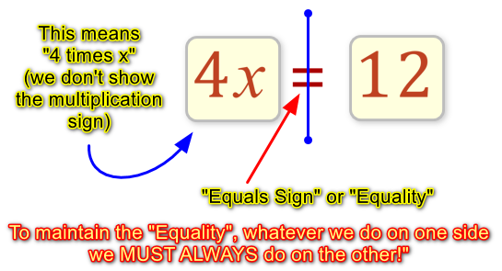
Algebraic Manipulation – Getting “x” On Its Own
This can be tricky, but if you follow a set of rules you will always get the right result. First of all we will look at a simple example.
You must learn how to interpret the question, so ask yourself “what is it saying?”. Well ….. There is a certain value which we can give to “x” which will make the equation true. Before we see what that is, let’s break the equation into its components and learn a few rules.
Sometimes it helps to break the expression up like this, but its not always easy, what about 256x ??
OK – let’s find out the value for “x” ……….

Slide 5
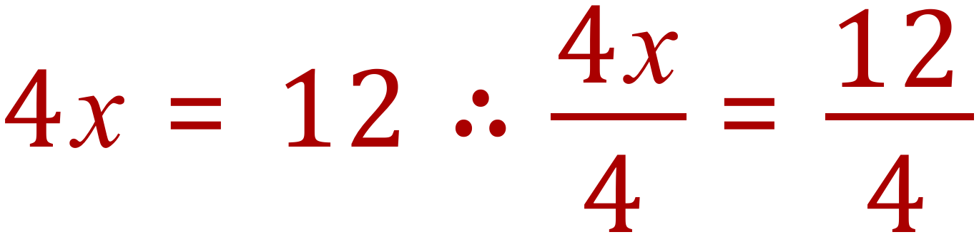
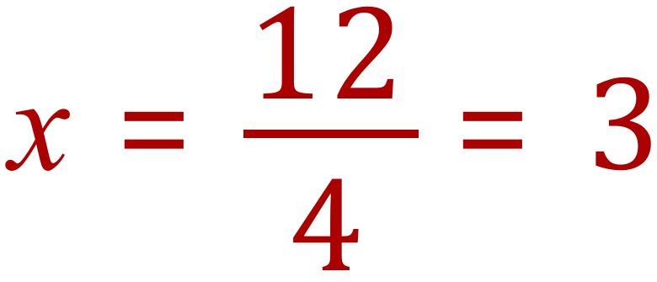
Algebraic Manipulation – Getting “x” On Its Own
We use “reduction” to get “x” on its own, what that means is we use whichever arithmetic operations we need to “chip away” at the expression for “x” until it is on its own. We do this in steps, as many as we need.
Step 1 – Divide BOTH sides (remember!!) by 4
Step 2 – the “4” at the top will cancel out the “4” on the bottom, because if you multiply something by 4 then divide it by 4, you end up back where you started !!

Slide 6
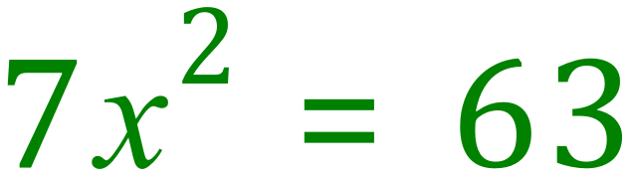
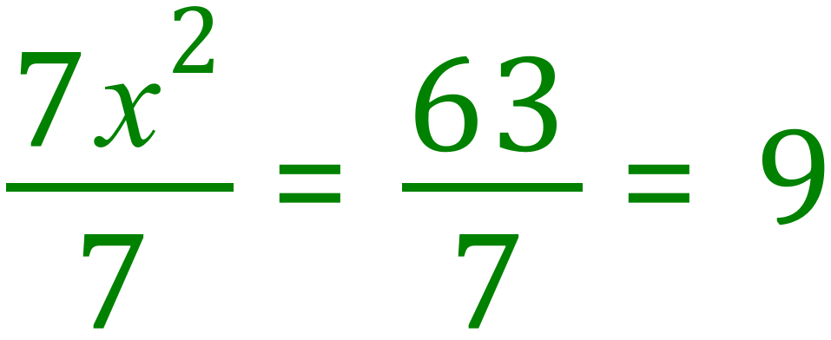
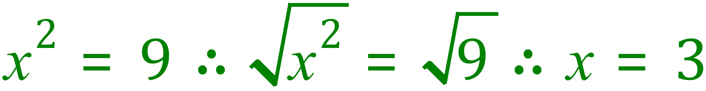
More Complicated Expressions
Step 1 – Divide BOTH sides (remember!!) by 7
Step 2 – Take the SQUARE ROOT of BOTH SIDES:

Slide 7
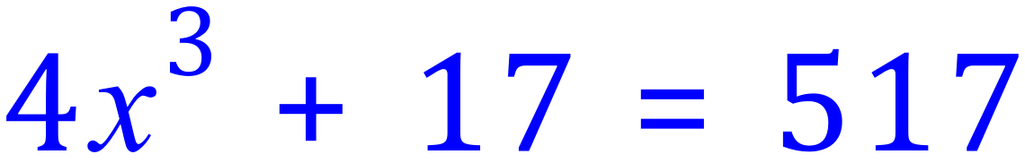
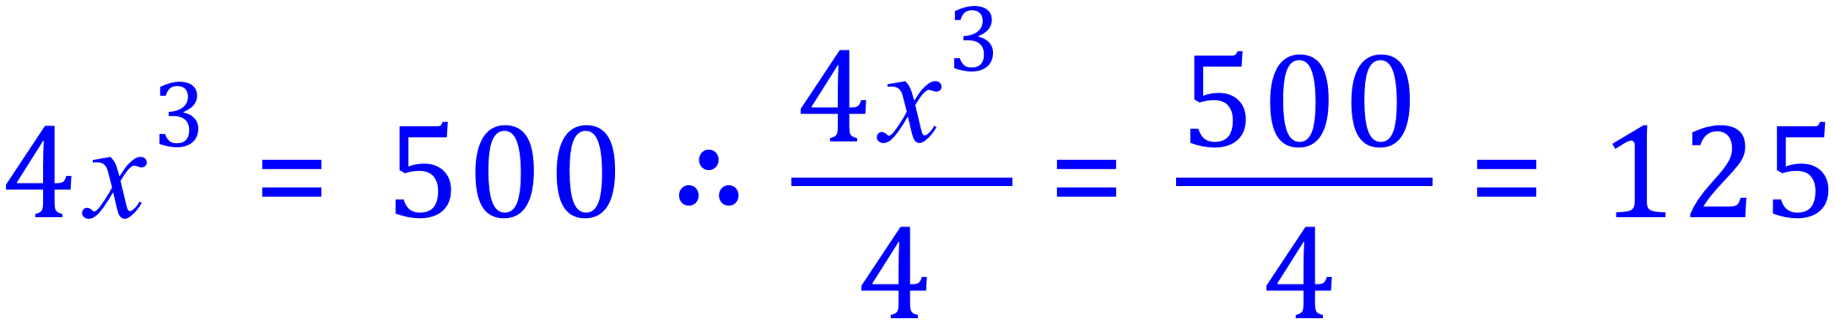
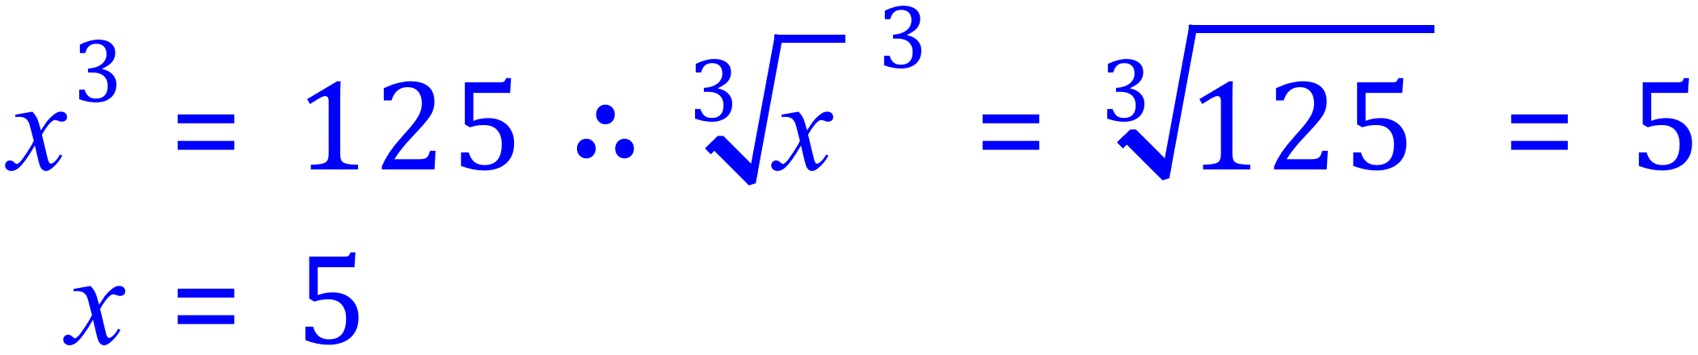
More Complicated Expressions
DON’T PANIC – this example is NO HARDER than any of the others IF you follow the rules:
Step 1: SUBTRACT 17 from BOTH sides (remember!!)
Step 2: DIVIDE BOTH sides (remember!!) by 4:
Step 3: Take the CUBE ROOT of BOTH sides (remember!!):

Slide 8
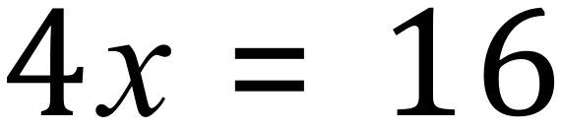
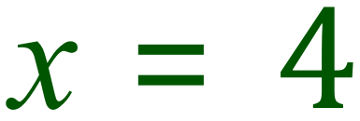

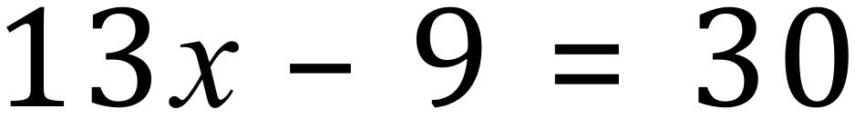
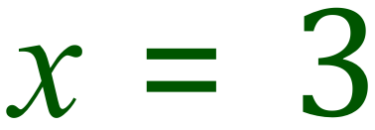
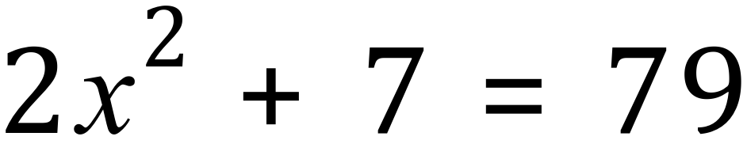
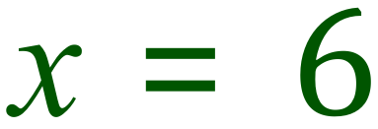
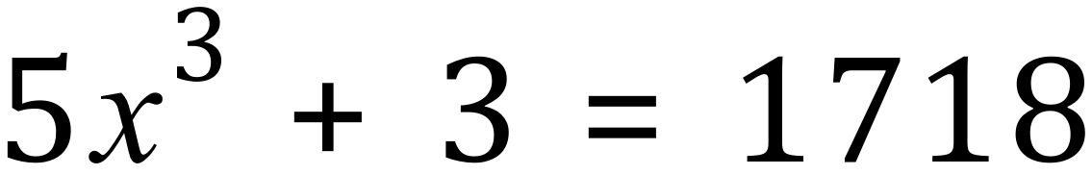
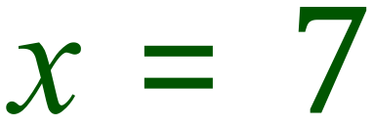
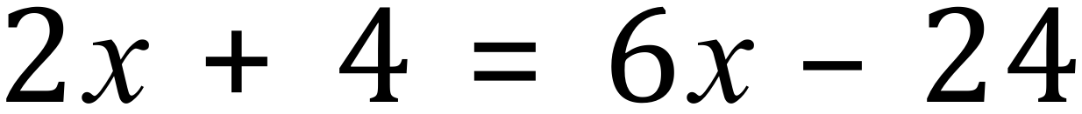
Your Turn !

