Slide 1
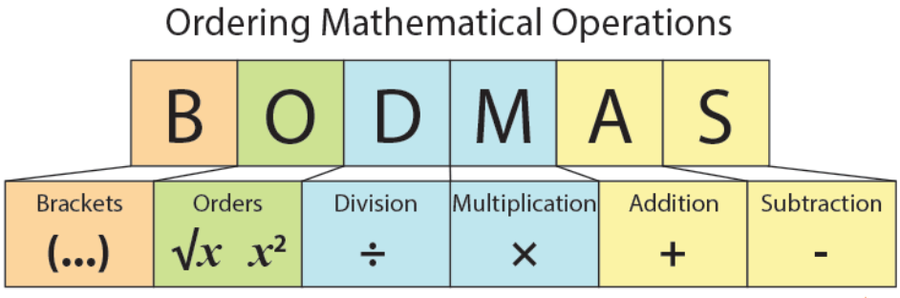

Slide 2
In mathematics, there is often a specific order in which operations should be performed to arrive at the correct answer.

Slide 3
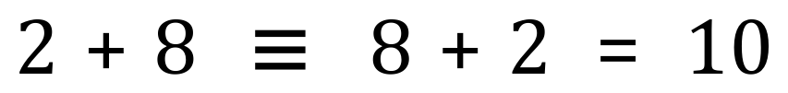
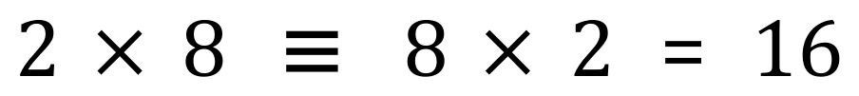
Some operations can be performed in any order, such as addition and multiplication:

Slide 4
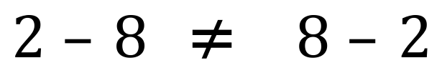
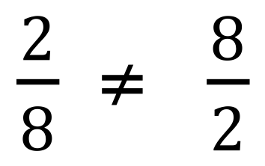
Division and subtraction have to be performed in a specific way:

Slide 5
Addition and Multiplication are COMMUTATIVE
Subtraction and Division are not COMMUTATIVE

Slide 6
When we have more than one operation or operator, there is an order in which they must be performed.
This is remembered using the mnemonic BODMAS

Slide 7

B
O
D
M
A
S
rackets
Although this looks like a “linear” hierarchy, going downwards in importance, there is a quirk which you MUST remember.
rders
ivision
Even though they appear to be equal on this new diagram, Division and Multiplication MUST be performed from left to right, as must Addition and Subtraction.
ultiplication
ddition
ubtraction

Slide 8
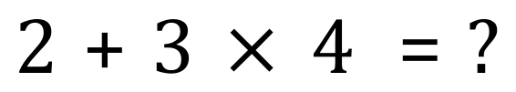
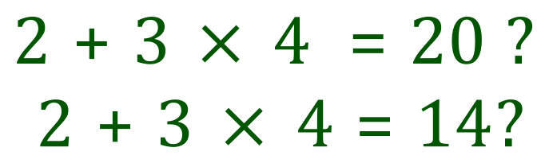

What is the answer here?

Slide 9
What is the answer here?
(
(

Slide 10
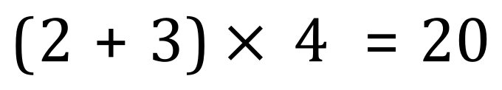
Multiplication is performed before addition, try this in your calculator to prove it to yourself if you like.
This time, 20 is the correct answer. The brackets have changed the operation order.

Slide 11
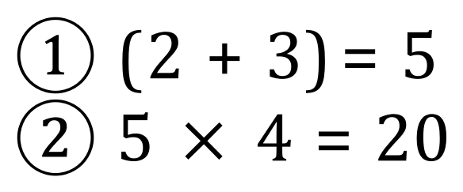
Bracketed expressions take priority over multiplication so the addition is done first, then the multiplication.

Slide 12
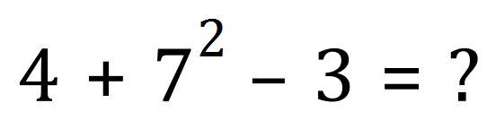
Orders – also known as “Index” / “Indices” or “Exponents” / “Powers” etc are also a special case.

Slide 13
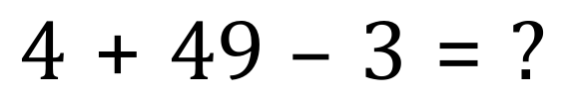
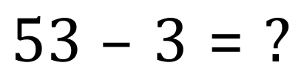
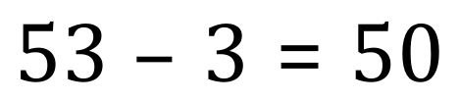

Slide 14
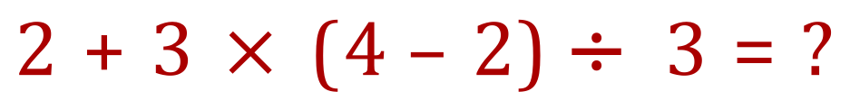
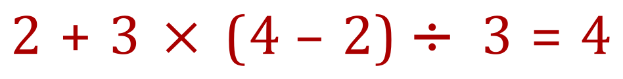
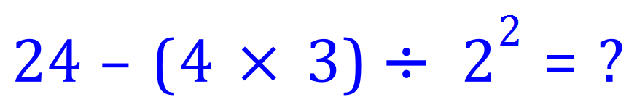
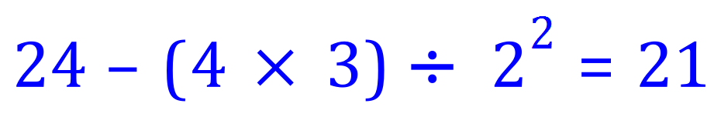

Slide 15
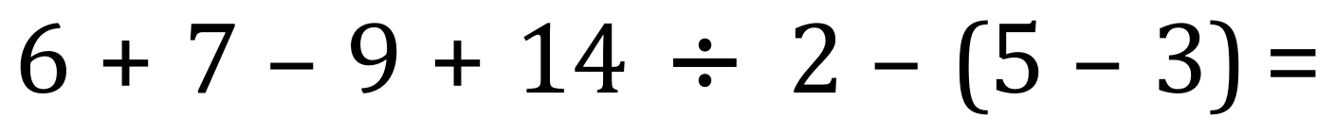

Slide 17
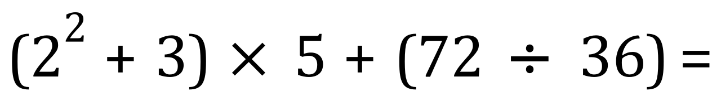
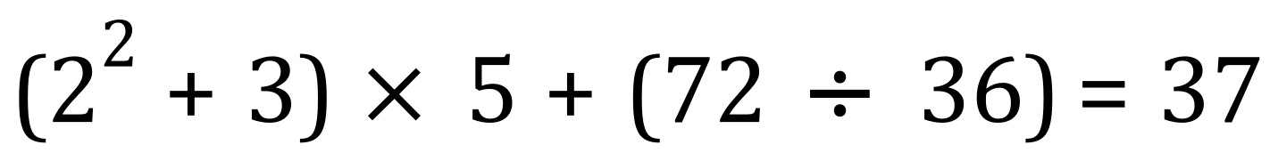

Slide 18
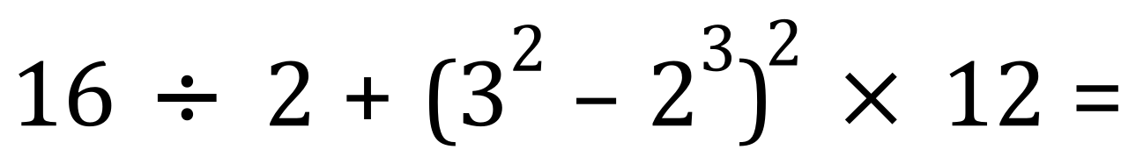
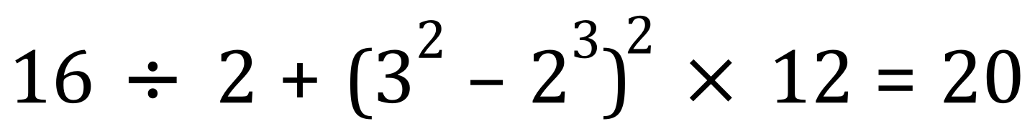

Slide 19
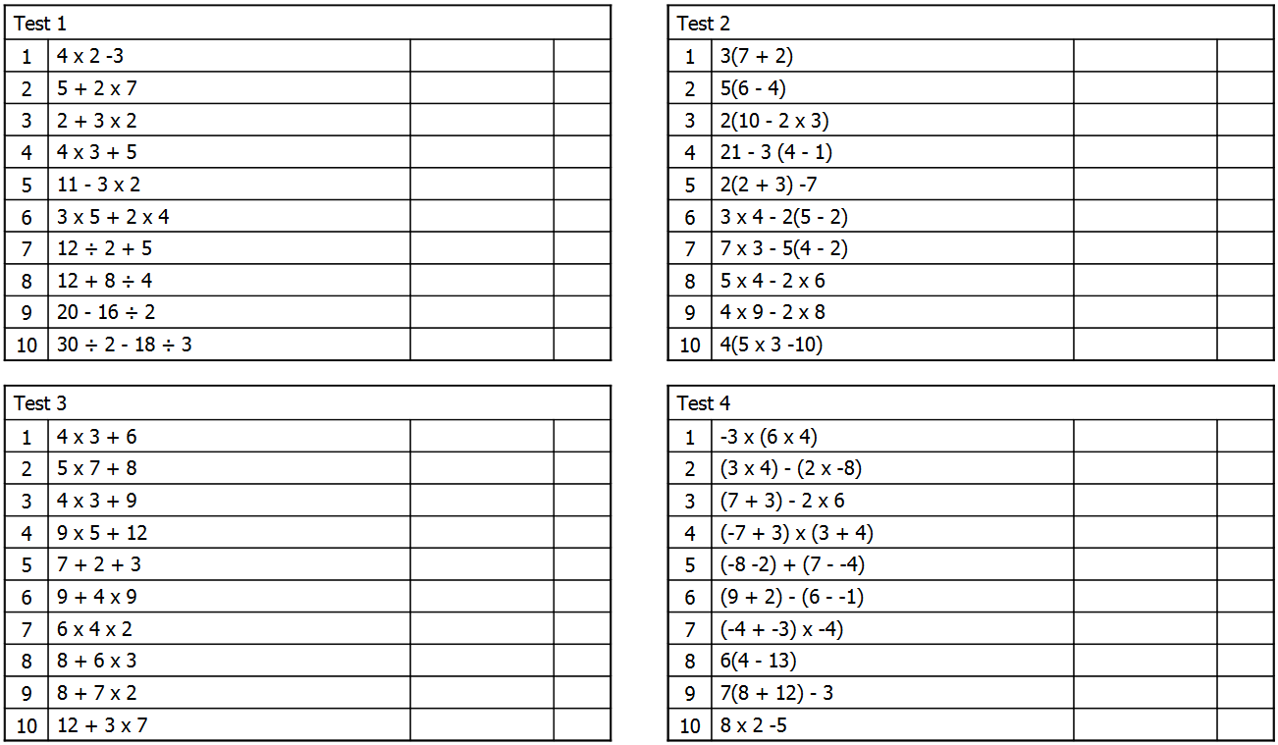
5
27
19
10
8
8
17
12
5
3
23
6
11
11
14
8
12
20
9
20
18
-72
43
28
21
-2
57
-28
12
1
45
4
48
28
26
-54
20
137
33
11

