Slide 1
Chemical Bonding
Ionic, Covalent, Metallic

Slide 2
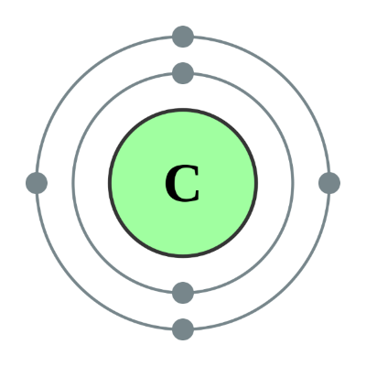
Chemical Bonding
We now know that atoms contain protons and neutrons and electrons. The protons and neutrons live inside the nucleus and the electrons orbit around the nucleus.
Exactly how are the electrons arranged in an atom?
What do they do?
Physicists say that “it's all about the nucleus”
Chemists say that “it's all about the electrons”
In this presentation we will take a chemist’s eye view of the atom and study a fundamental objective - how atoms join together to make compounds.

Slide 3
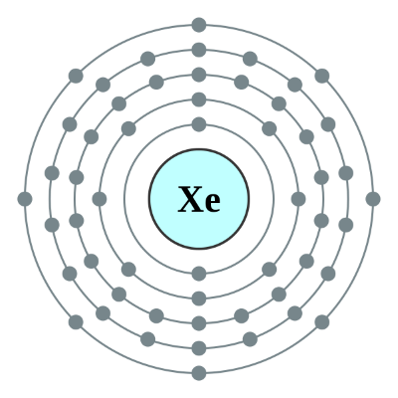
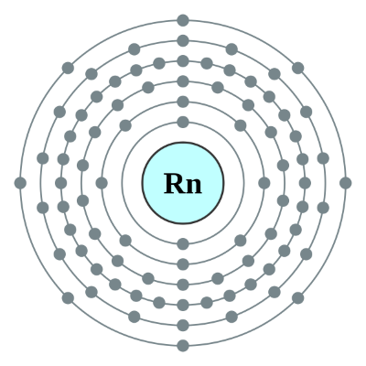
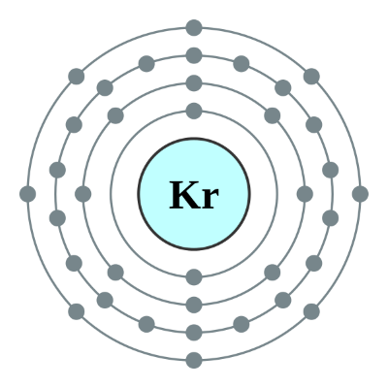
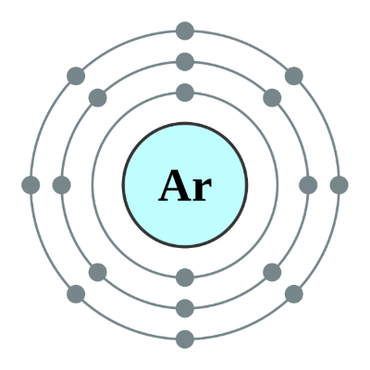
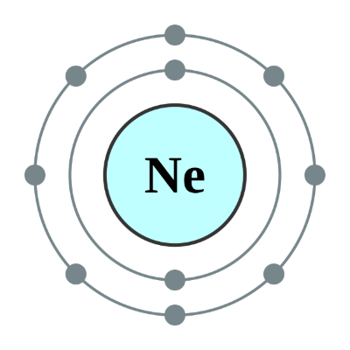
Electron Loss or Gain
The Group 8 elements (discussion usually confined to Neon to Radon) have FULL outer shells of electrons. In all of the cases mentioned, a full shell = 8 electrons.
This electronic configuration gives these atoms a very stable existence, they neither wish to GAIN or LOSE electrons as their OUTER shell is FULL.
They are MONATOMIC and do NOT form compounds (except Xenon which can be made to)

Slide 4
Electron Transfer or Sharing
The Group 8 elements are the envy of the atomic world, and elements with partially completed OUTER shells want to get the same stability, they are willing to SHARE, RECEIVE or even GIVE AWAY electrons to get there.
This is the basis of ATOMIC (CHEMICAL) BONDING.
Atoms which GIVE or RECEIVE electrons form IONIC bonds.
Atoms which SHARE electrons form COVALENT bonds.
Atoms which SHARE electrons to form a ‘cloud’ of spare electrons form METALLIC bonds.

Slide 5
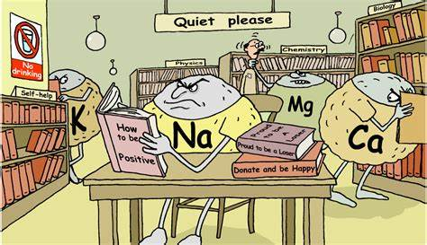
Electron Transfer - IONIC BONDING

Slide 6
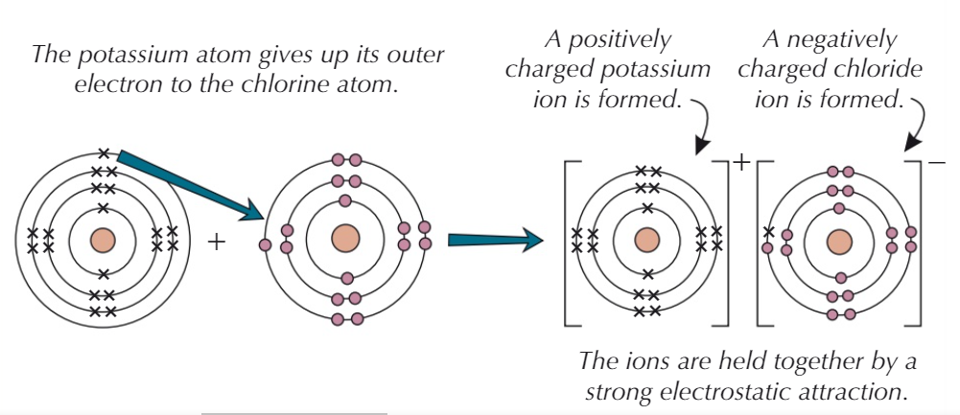
Electron Transfer - IONIC BONDING
IONIC bonds usually occur between METALS and NONMETALS. These elements lie to the left and right of the Periodic Table respectively and so are already quite near a “stable 8” arrangement with few electrons to lose or gain.

Slide 7
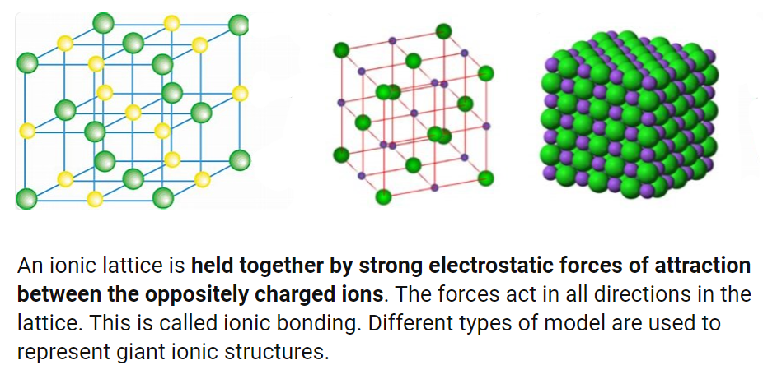
Electron Transfer - IONIC BONDING

Slide 8
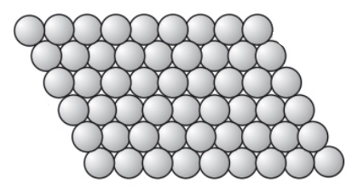
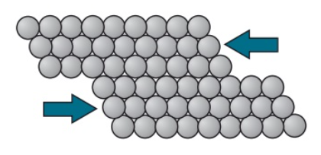
Electron Transfer - METALLIC BONDING
Metals stay together in large ionic formations, or STRUCTURES and are very well organised, the structure is said to be REGULAR.
Atoms of the same metal can usually slide (in layers) over the top of each other which gives the properties of MALLEABILITY and DUCTILITY.
MALLEABLE - Can be beaten into very thin sheets (eg: Gold)
DUCTILE - Can be drawn out into wire (eg: Copper)

Slide 9
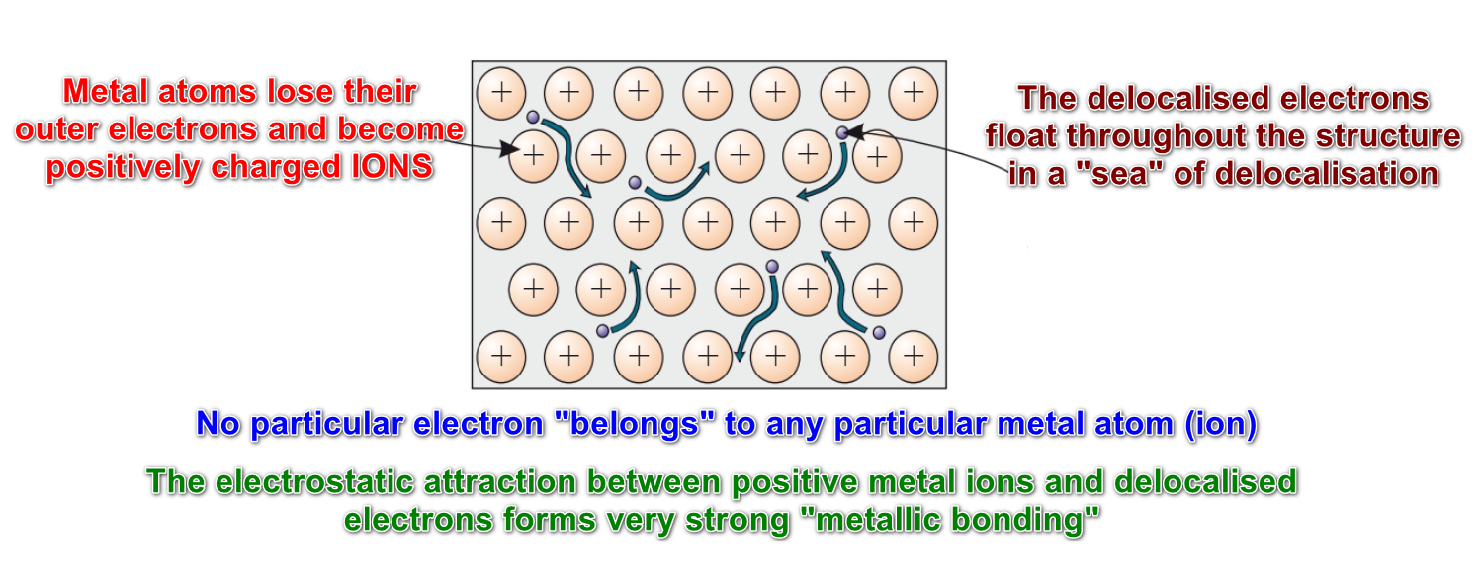
Electron Transfer - METALLIC BONDING

Slide 10
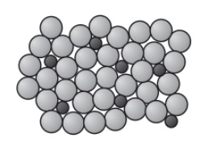
Alloys
Metals in their PURE form are too soft to be of use in some settings, to make them HARDER and STRONGER they are usually mixed with certain amounts of other metals to make ALLOYS.
Layers of metal atoms / ions in the ALLOY are now irregular because of the different physical sizes of the atoms in the mix, the layers will no longer “slide” and the ALLOY is now harder.

Slide 11

Electron Sharing - COVALENT BONDING
Elements which “share” electrons to make molecules bond COVALENTLY.
Atoms (as we have already seen) aim to complete their outer shell of electrons and can achieve this by “sharing”. In this amicable arrangement each atom “believes” that it has complete ownership of the shared pair, so its desire to obtain the “stable 8” is achieved.
In a DIATOMIC Hydrogen molecule, each atom shares an electron with the other. Both atoms believe that they “own” BOTH electrons and so have a full outer shell (in the case of Hydrogen this is “2”

Slide 12
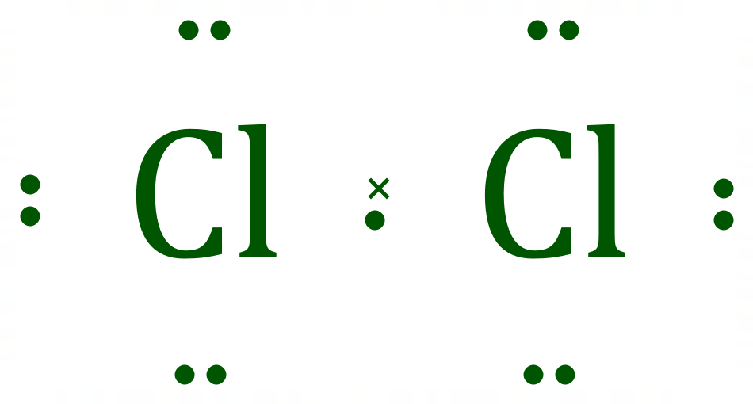
Electron Sharing - COVALENT BONDING
Chlorine is a DIATOMIC gas. As soon as a Chlorine atom forms from a chemical reaction (eg: the electrolysis of sodium chloride) it quickly “partners” with another Chlorine atom to form a covalently bonded molecule.

Slide 13
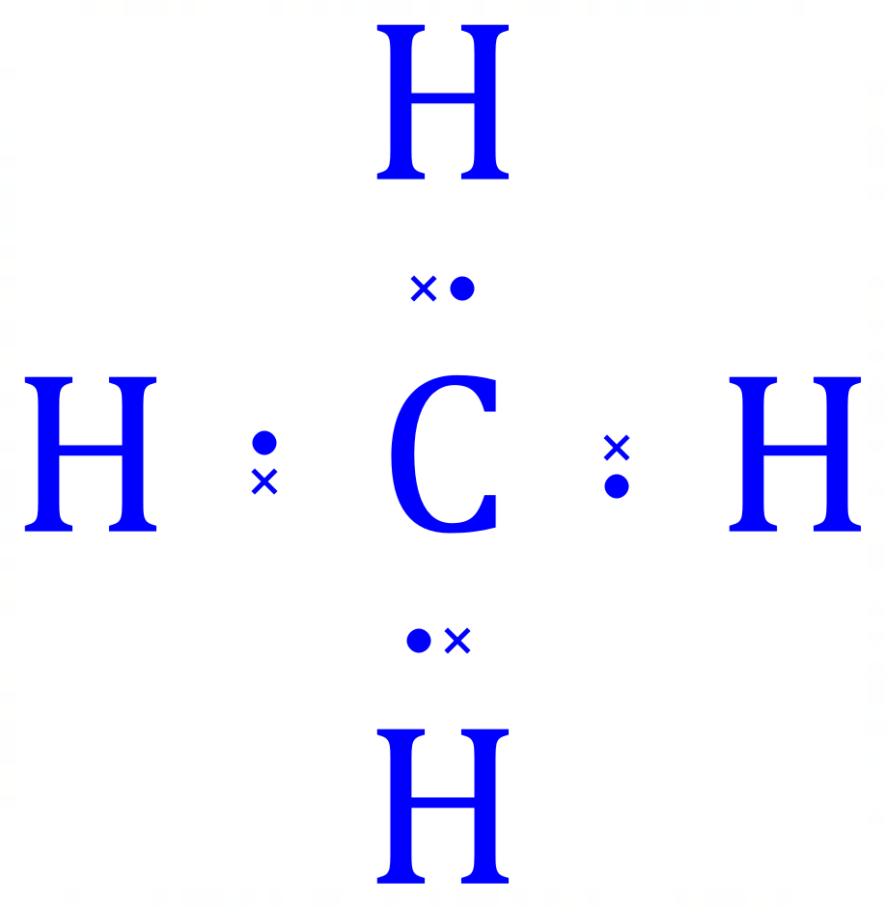
Electron Sharing - COVALENT BONDING
Carbon has 4 electrons in its outer shell, a long way from the “stable 8” it would like.
This is METHANE which is the gas used domestically for Gas Fires, Cookers etc.
Each H believes that it “owns” 2 electrons and the C in the middle believes that it has a full outer shell of 8 electrons.
Ideal COVALENT sharing !
Hydrogen has 1 electron in its outer shell, only needing 1 more for a full outer shell (NB: 2)

Slide 14
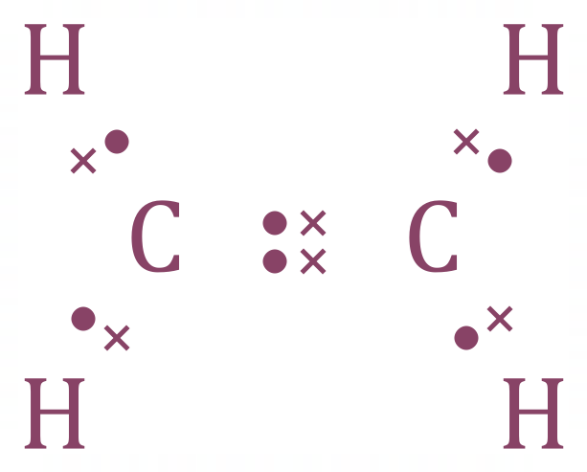
Electron Sharing - COVALENT BONDING
Covalent Bonding isn’t restricted to single electrons, and the electrons don’t have to come from all of the participating atoms:
In ETHENE (Ethylene) each Carbon provides 2 electrons making a C=C DOUBLE BOND, as usual each Hydrogen provides 1 electron to share with one of the Carbon atoms for C-H single bonds.

Slide 15
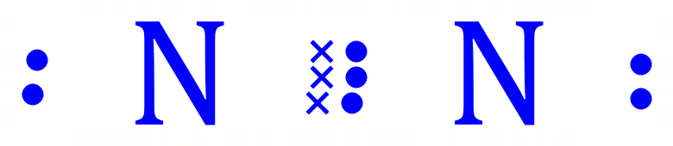

Electron Sharing - COVALENT BONDING
Covalent Bonding isn’t restricted to single electrons, and the electrons don’t have to come from all of the participating atoms:
NITROGEN, and the Hydrocarbon ETHYNE (Acetylene) have TRIPLE BONDS, and in BOTH cases ALL participating atoms believe that they have a FULL OUTER SHELL of electrons.

Slide 16
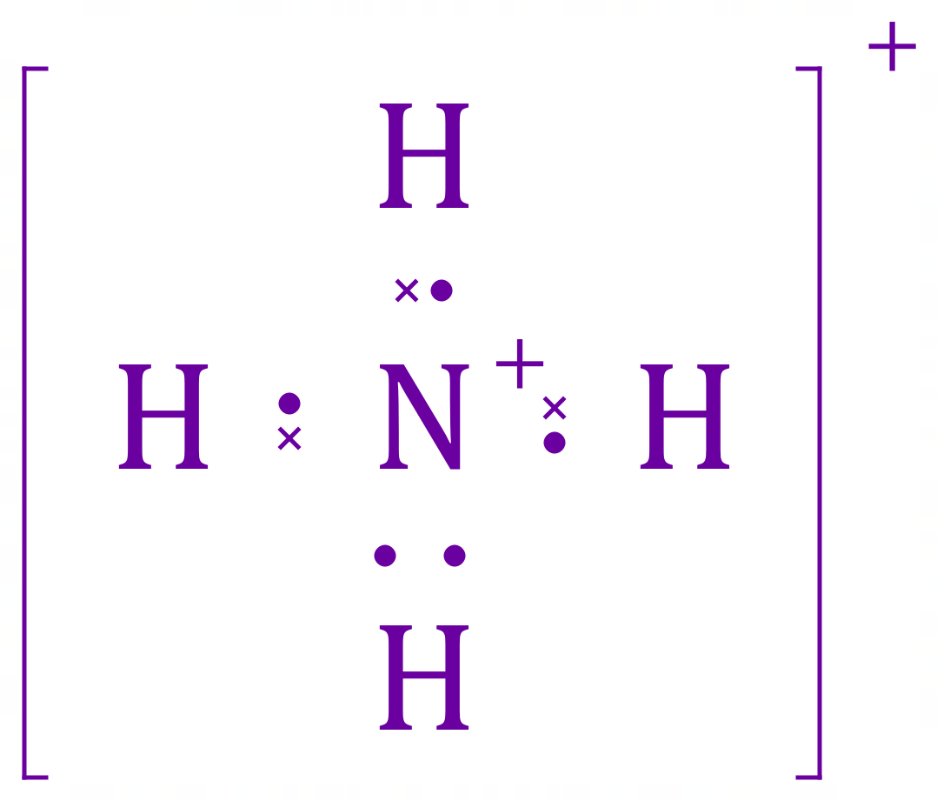
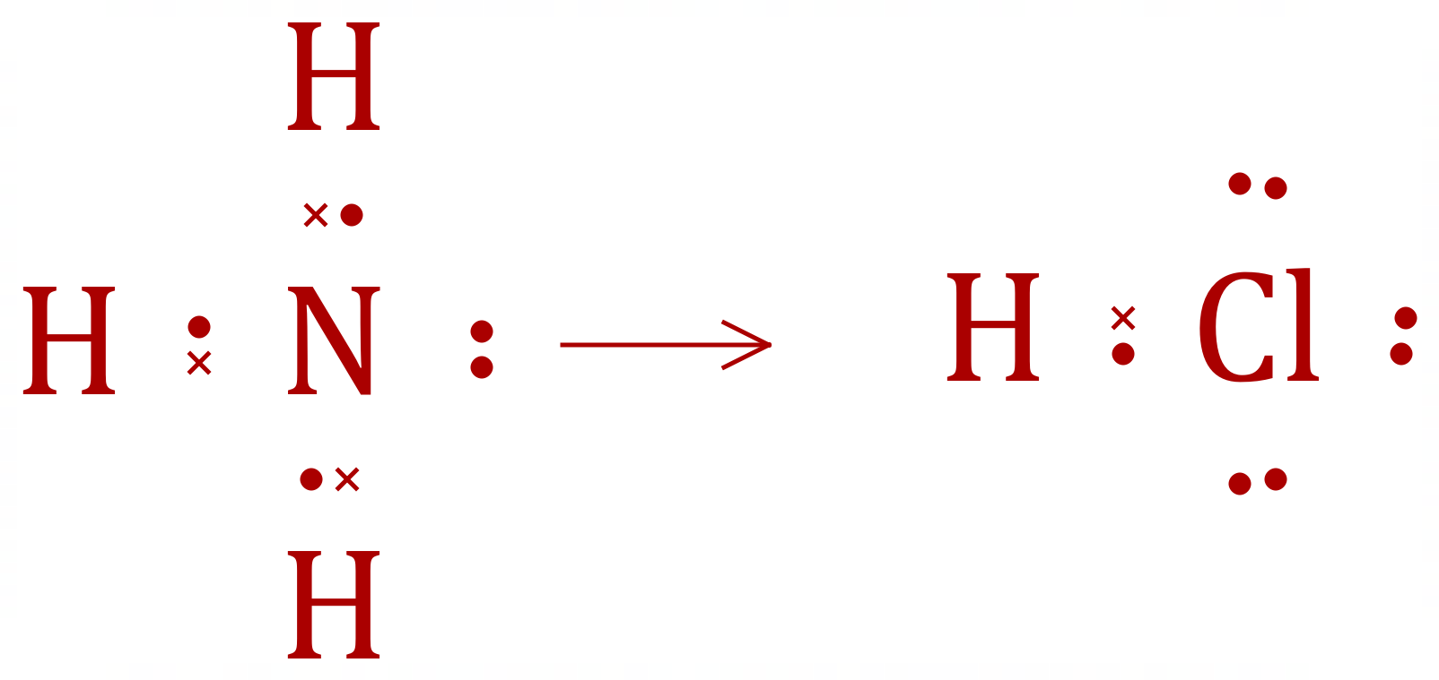
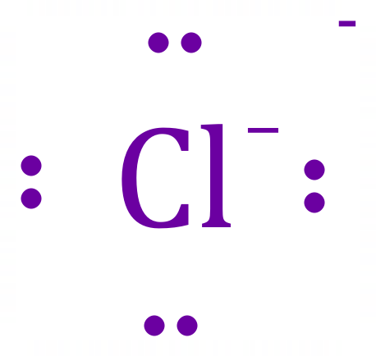
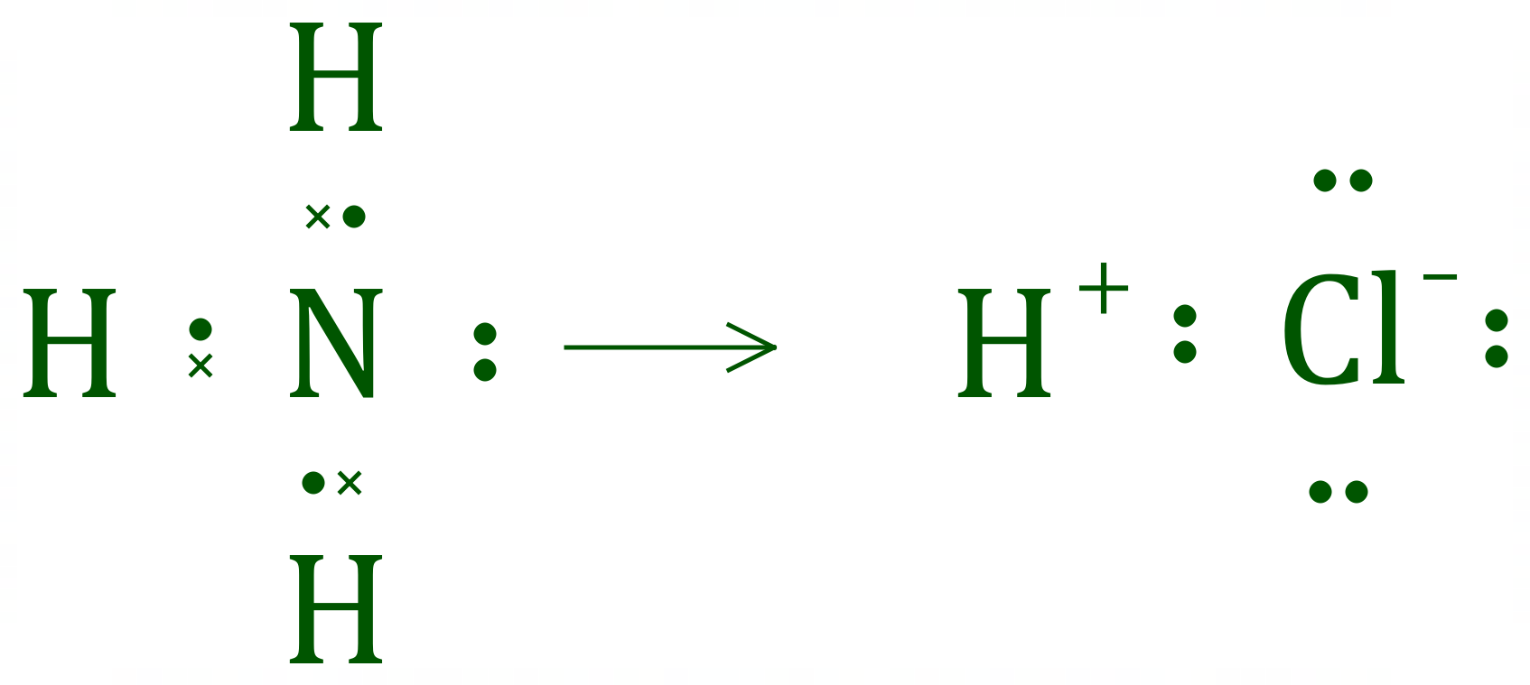
Electron Sharing - COORDINATE BONDING
NITROGEN has 5 valence electrons, in such compounds as AMMONIA only 3 of the 5 are used for bonding, the remaining 2 electrons form a LONE PAIR, essentially doing nothing.
Nitrogen donates BOTH electrons to the new fourth
N-H bond (shown as an arrow) as the Chlorine atom’s electron affinity essentially strips the Hydrogen of its electron.

Slide 17
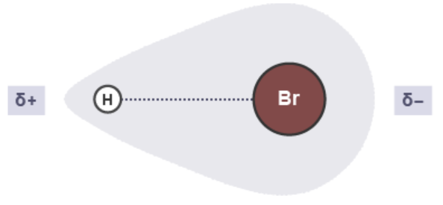
POLAR AND NONPOLAR COVALENT BONDING
Covalent Bonding is all about “sharing” but the sharing is not always equally done.
The shared pair of electrons between an atom of hydrogen and an atom of bromine are not shared equally. Since bromine has a greater electronegativity than hydrogen, it will pull the bonding electrons towards itself. This makes bromine slightly negative and hydrogen slightly positive). This is known as a dipole.

Slide 18
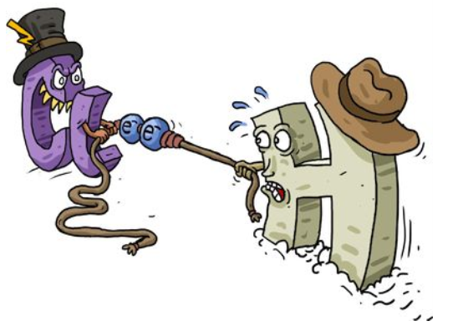

POLAR AND NONPOLAR COVALENT BONDING
POLAR
NON POLAR

