Slide 1
Sine and Cosine Rules
The Cosine Rule
Moving on from SOHCAHTOA

Slide 2
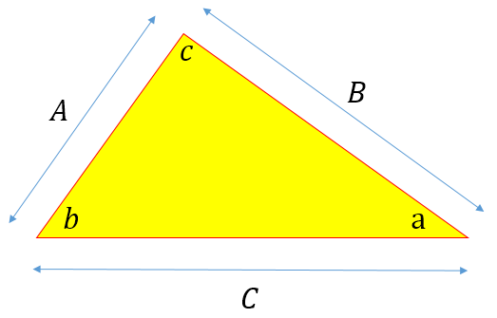
Sine and Cosine Rules
Previously we introduced Trigonometry and focused on right angles triangles, to bring in Pythagoras Theorem and some basic ‘Trig Identities’.
Pythagoras Theorem works only for triangles with one ‘right angle’, but of course there are other sorts of triangles such as equilateral, scalene and isosceles that don’t have any internal 90º angles so what about these?
It’s not a case of SOH CAH TOA here, there is a rule for finding side lengths and internal angles, in fact two rules known respectively as the SINE rule and the COSINE rule, effectively extensions of the Pythagoras Theorem.

Slide 3
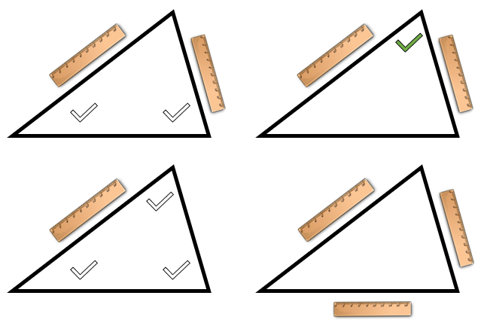
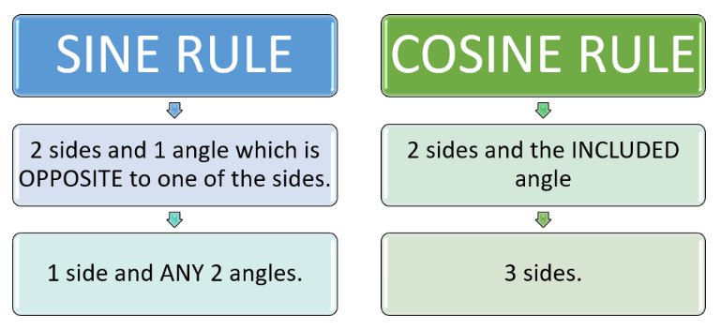
Sine and Cosine Rules
Previously we introduced Trigonometry and focused on right angles triangles, to bring in Pythagoras Theorem and some basic ‘Trig Identities’.

Slide 4
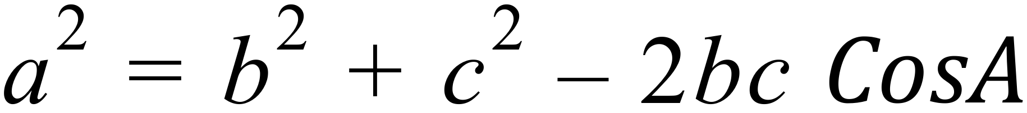
Cosine Rule
Previously we introduced Trigonometry and focused on right angles triangles, to bring in Pythagoras Theorem and some basic ‘Trig Identities’.
In the Cosine Rule, the requirements are seemingly simpler to remember, however some of the algebraic manipulations required can be testing.
A
b
c
C
B
a

Slide 5
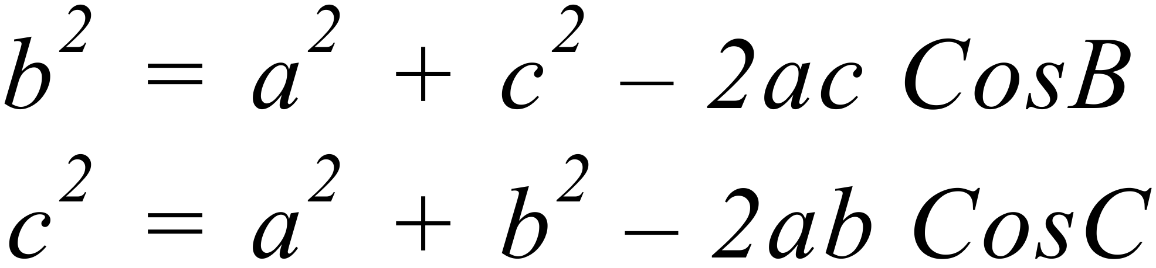
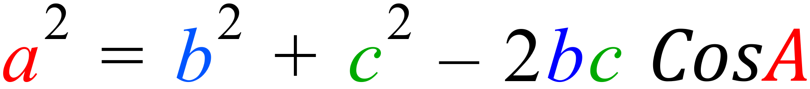
Cosine Rule
The colour coding helps with the relationships in the rule
A
It is the Cosine of the angle opposite the side being calculated which is used in the expression.
b
c
The following two alternatives may also apply:
C
B
a

Slide 6
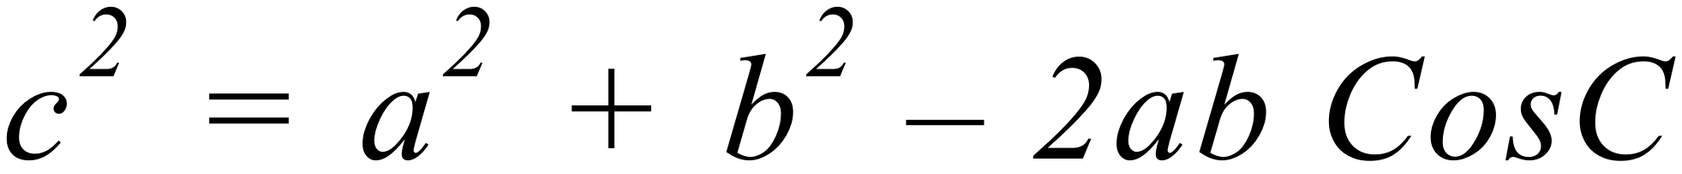
Cosine Rule
If the “2 sides and angle between” rule is satisfied, the Cosine Rule can be applied in this format.
A
15cm
c
Let’s look at the triangle shown, as an example:
Q. From the information given, calculate the value of side “c” in cm.
80º
B
19cm

Slide 7
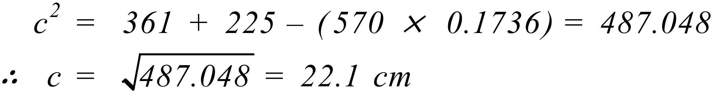
Cosine Rule
A
15cm
c
Q. From the information given, calculate the value of side “c” in cm.
80º
B
19cm

Slide 8
Cosine Rule
The algebraic complication that arises with the Cosine Rule is the need to “permute” the equation when all three sides are known, and the angles are being sought.
A
15cm
22.1 cm
Q. From the side lengths information given, calculate the values of all three angles in the triangle.
C
B
19cm

Slide 9
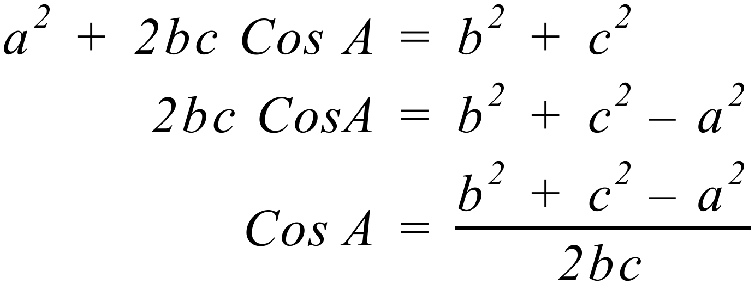
Cosine Rule
Q. From the side lengths information given, calculate the values of all three angles in the triangle.
A
15cm
22.1 cm
C
B
19cm

Slide 10
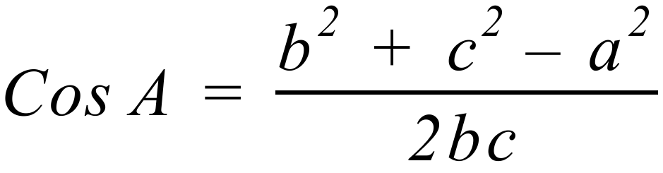
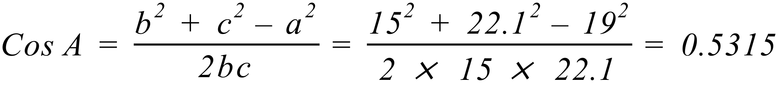
Cosine Rule
A
15cm
22.1 cm
C
B
19cm

Slide 11
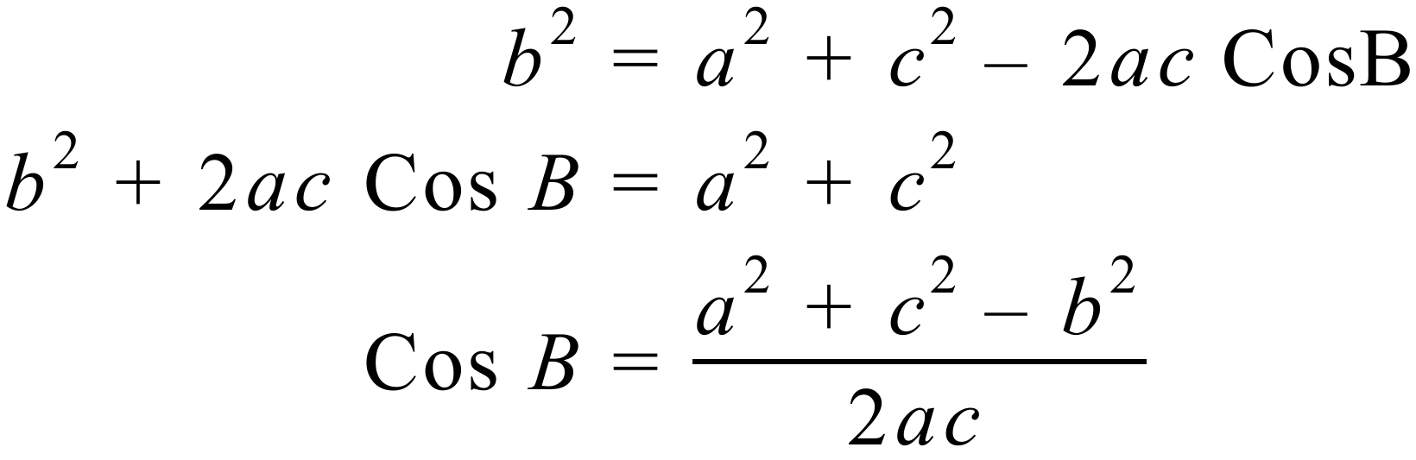
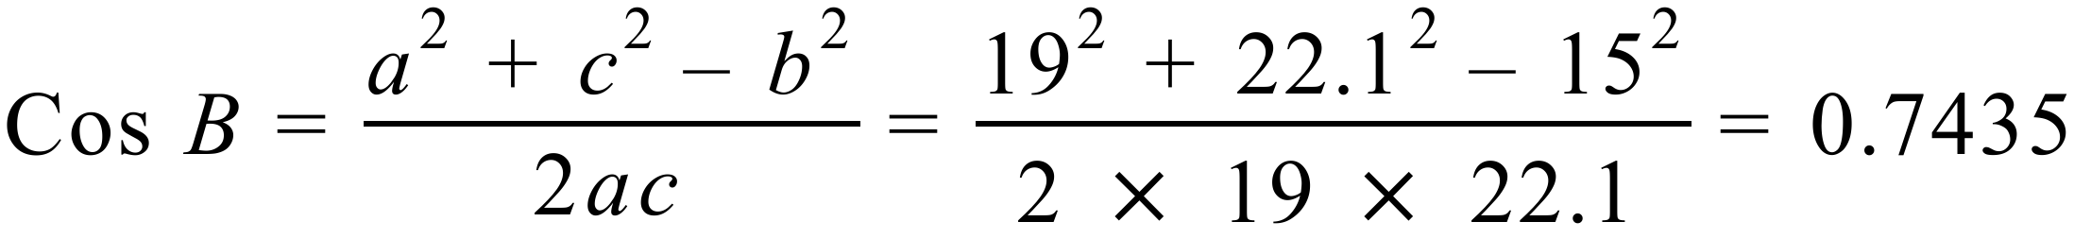
Cosine Rule
A
15cm
22.1 cm
C
B
19cm

Slide 12
Cosine Rule
So .....
A
15cm
22.1 cm
C
B
19cm
From the “180 degree” rule of triangles ....

