Slide 1
Diffusion
Write today’s date and the title of the lesson in your books, underline both.
(5 minutes)

Slide 2
W.I.L.F.
Describe the process of diffusion and see it in action using beakers of warm and cold water (F3)
Apply diffusion to a real life example (1)
Draw before and after particle diagrams to explain diffusion (2)

Slide 3
“Diffusion is the spreading out of particles from an area of
HIGH
concentration to an area of
LOW
concentration”

Slide 4
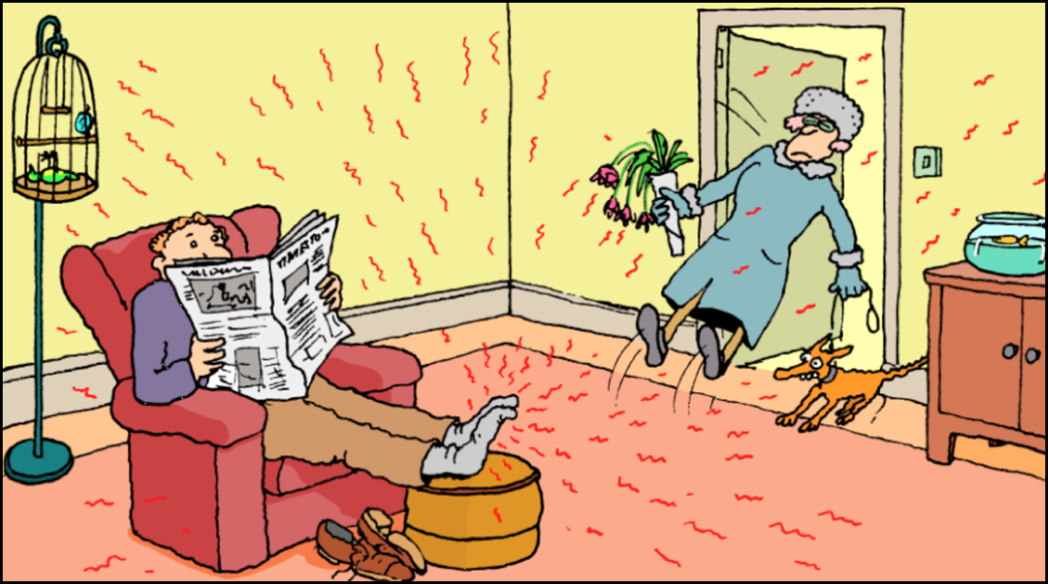
Diffusion – not always pleasant!

Slide 5
PRACTICAL SESSION
We will now see DIFFUSION in action.
1. Working in groups of 2 or 3 NO LARGER collect TWO glass beakers and pairs of safety glasses from the bench.
2. YOU WILL STAND UP DURING THIS PRACTICAL AND SAFETY GLASSES WILL BE KEPT ON AT ALL TIMES UNLESS YOU ARE GIVEN TEACHERS PERMISSION TO TAKE THEM OFF FOR A GOOD REASON.
3. Put COLD water from the tap into ONE of the beakers, until it is about three quarters full.
4. The teacher will put some hot water in the other beaker.
5. WHEN everyone is at this point AND NOT BEFORE, the teacher will come round and drop a crystal or two of POTASSIUM PERMANGANATE into EACH beaker, at the SAME time.
NOW WATCH BOTH BEAKERS
OF WATER – WHAT IS HAPPENING?
We will watch our beakers for 10 to 15 minutes, THEN WE WILL TIDY UP.

Slide 6
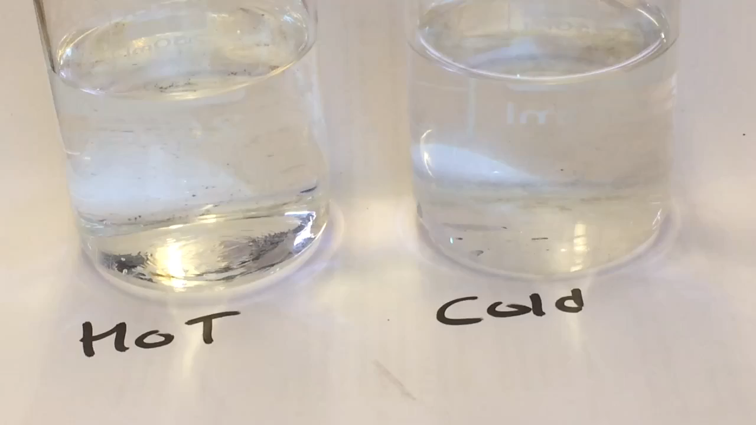
PRACTICAL SESSION

Slide 7


THIS IS CALLED DIFFUSION
The spray from an aerosol (like air freshener) starts off highly concentrated as it comes out of the can, but as it travels through the air it spreads out.

Slide 8
Describe the process of diffusion (F3)
“Diffusion is the spreading out of particles from an area of HIGH concentration to an area of LOW concentration”
“Down a concentration gradient”
(in other words, there has to be a LOW concentration for the particles in the HIGH concentration to move towards. If the concentrations aren’t that different, the diffusion will be slower)

Slide 9

“Down a (concentration) gradient”

Slide 10
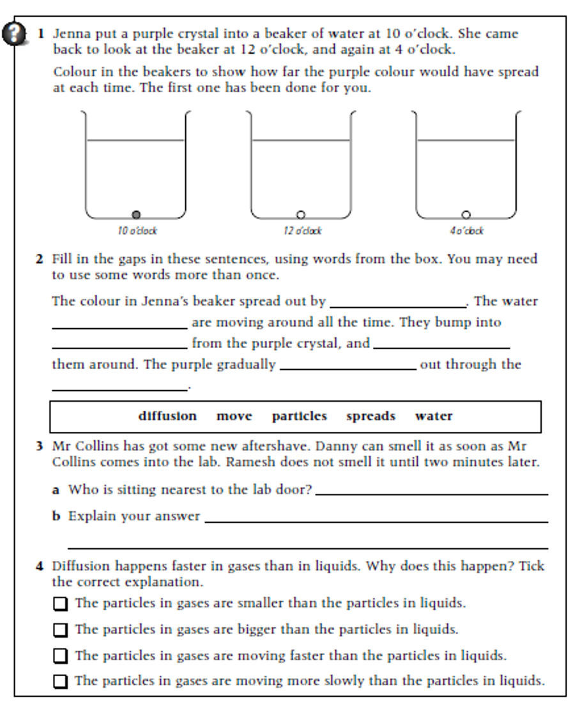
Activity 02
During this lesson you will be doing this experiment. Unfortunately you haven’t got 6 hours like Jenna but you will get the idea in the hour that we have got!
YOU HAVE 5 MINUTES!
When you have done these questions, swap your paper with somebody else and we will go through the answers.
Mark their paper and then give it back

Slide 11

Activity 02
diffusion
particles
particles
move
spreads
water
Danny
Diffusion is taking the smell into
the lab, but it reaches Danny first (as he is closest)

Slide 12
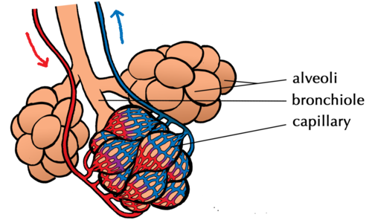
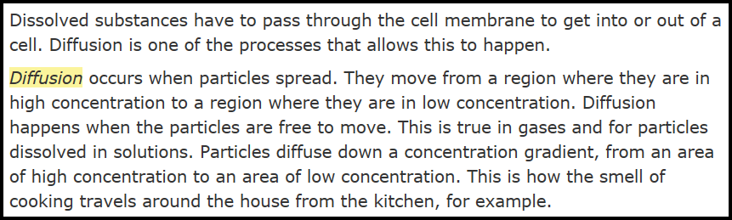
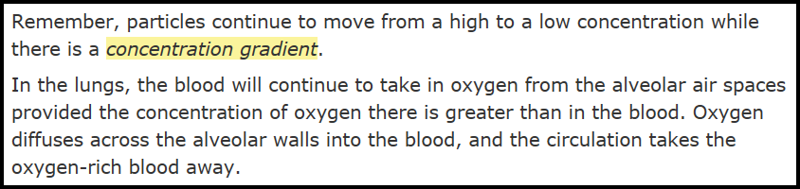
Diffusion in Real Life
Breathing
Can you give me an example of diffusion that you do every day, and you probably don’t even think about it !

