Slide 1
Highest Common Factor and Lowest Common Multiple
HCF and LCM

Slide 2
Prime Numbers and Prime Factors
To study the highest common factor and lowest common multiple of a pair of numbers we first have to understand some of the basics.
What is a FACTOR ?
A number which divides wholly into another, leaving NO remainder.
What is a PRIME ?
A number which can only be divided by ITSELF and ONE*
What is a PRIME FACTOR ?
A number which is PRIME and a FACTOR of the number.
To evaluate the HCF and LCM of a pair of numbers means that we have to have a GOOD understanding of prime numbers and prime factors. Before we look at HCF and LCM we will look at these more closely
*Although the number 1 fits the definition, it is NOT regarded as a prime number. The first prime number (and the ONLY even prime number) is 2

Slide 3
Factors
A number is a factor of another number if it divides wholly into the other number leaving NO remainder or fractional part.
12
1 2 3 4 5 6 7
8 9 10 11 12

Slide 4
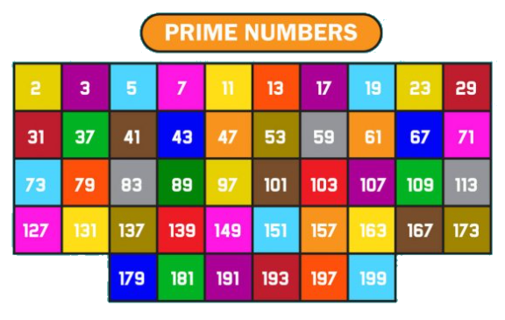
Prime Numbers
This table contains all of the prime numbers between 1 and 200.
You will find it useful to try to memorise at least the primes up to 100.

Slide 5
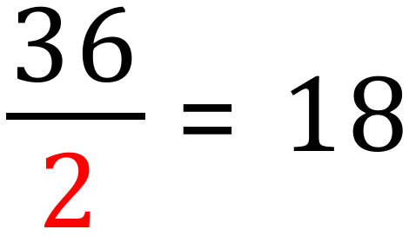
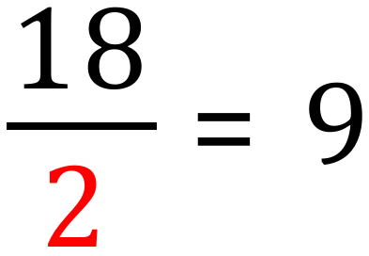
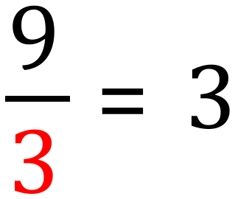
Prime Factors
To factorise a number using prime factors is done by dividing the number (and the result of that division) by the lowest prime, moving to the next suitable prime when the division stops.
Sounds weird?
Lets take a look at an example, this will clear up the confusion.
36
9 doesn’t divide by 2 so we move to the next prime which is 3.
We are left with 3, we stop here and list our prime factors.

Slide 6
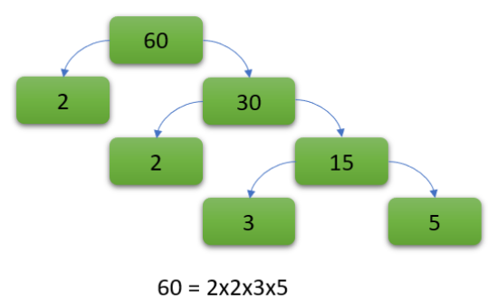
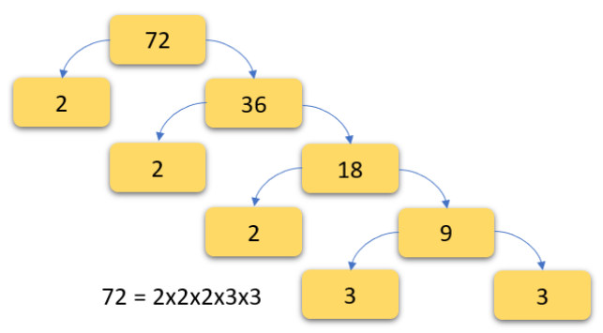
Prime Factors
We usually lay out the numbers as a sort of “tree” so you will hear the expression “prime factor tree” in your maths work.
Here are a couple of “prime factor trees”

Slide 7
Hot Spot 1a
Q1. Produce a prime factor tree for the number 56
56
56
2
28
2
14
2
7

Slide 8
Hot Spot 1b
Q2. Produce a prime factor tree for the number 180
180
2
90
2
45
3
15
3
5

Slide 9


Lowest Common Multiple
The LCM is the LOWEST number that is a multiple of two numbers.
Example - Find the LCM of the numbers 6 and 8
Common factors are counted only once so the LCM of 6 and 8 is 24

Slide 10

Lowest Common Multiple
The LCM is the LOWEST number that is a multiple of two numbers.
Example - Find the LCM of the numbers 8 and 12
Common factors are counted only once so the LCM of 8 and 12 is 24

Slide 11
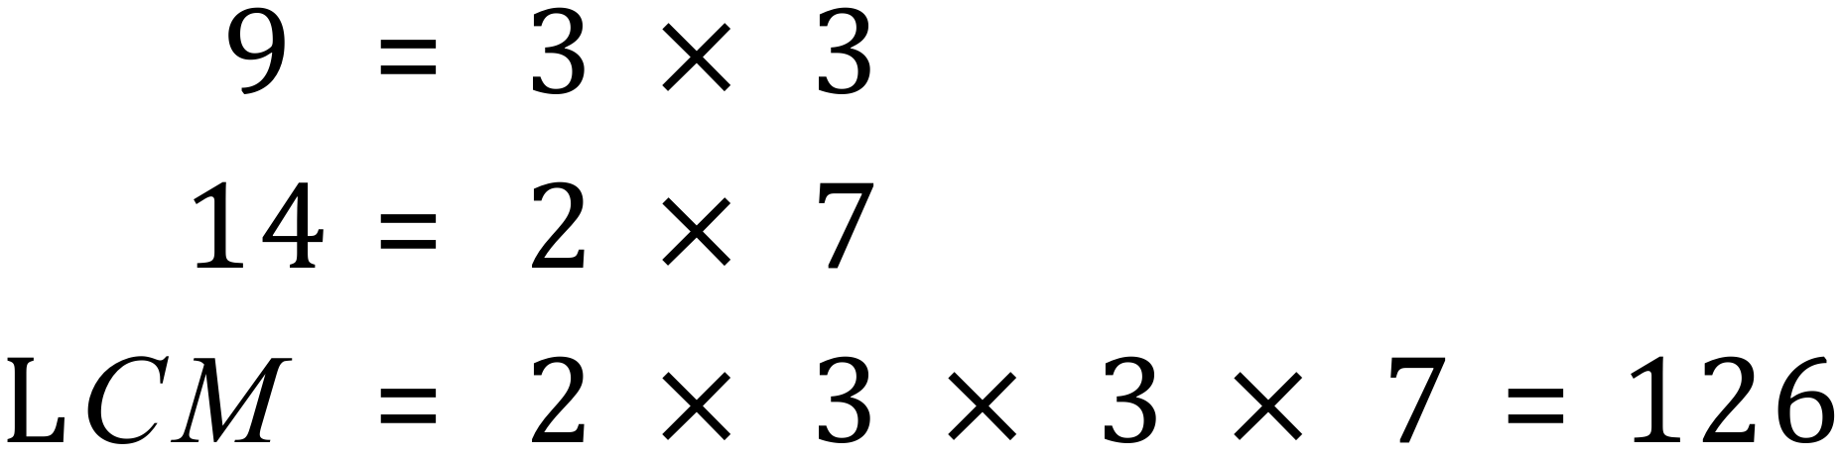
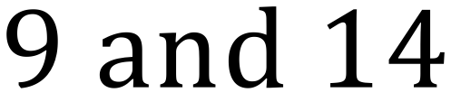
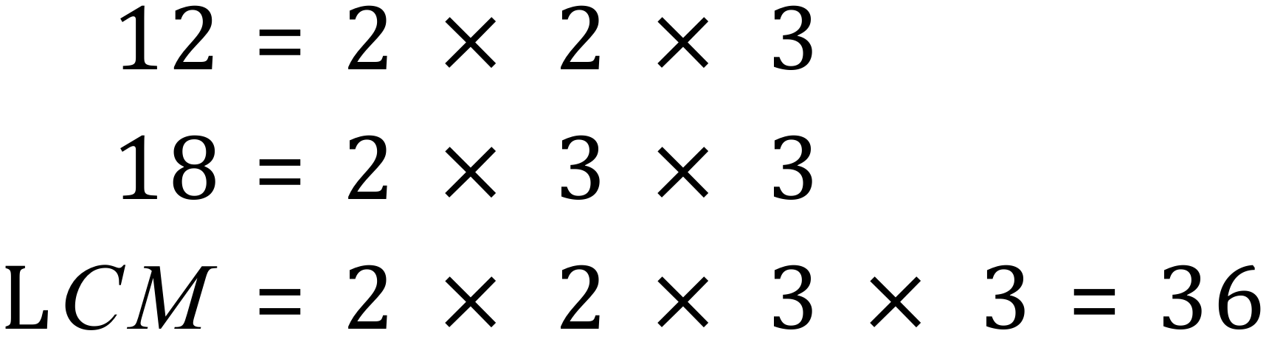
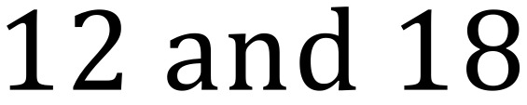
Hot Spot 2
Find the lowest common multiple of each of the following number pairs:

Slide 12
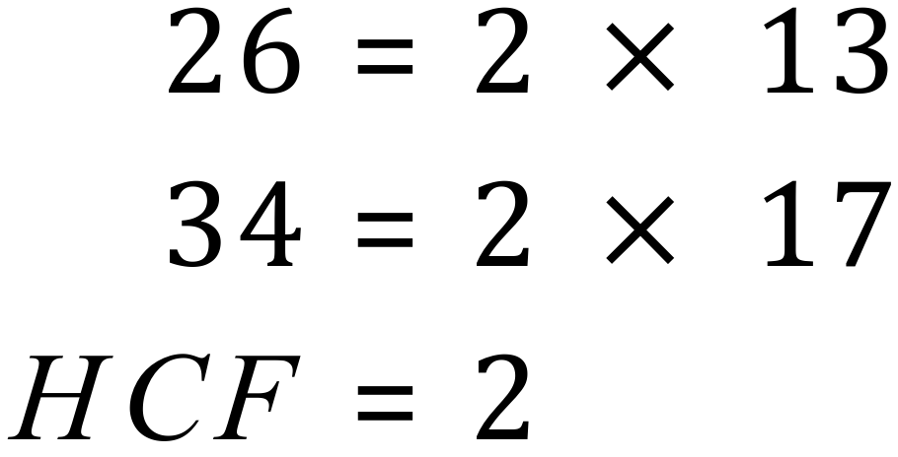
Highest Common Factor
The HCF is a little easier to work out. We simply write out the factors of each of the pair and calculate the largest common factor in each list by expanding the common factors:
Example: Find the HCF of 26 and 34

Slide 13
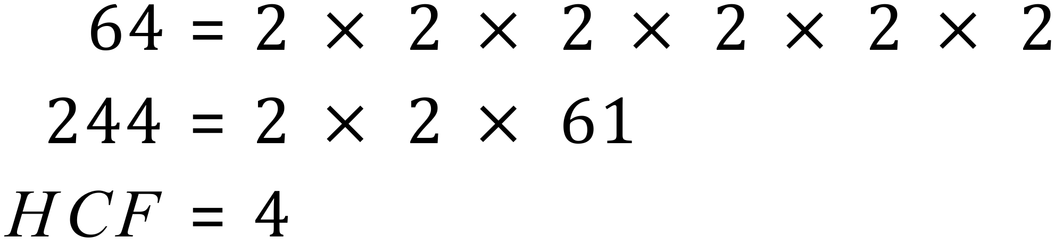
Highest Common Factor
The HCF is a little easier to work out. We simply write out the factors of each of the pair and calculate the largest common factor in each list by expanding the common factors:
Example: Find the HCF of 64 and 244

Slide 14
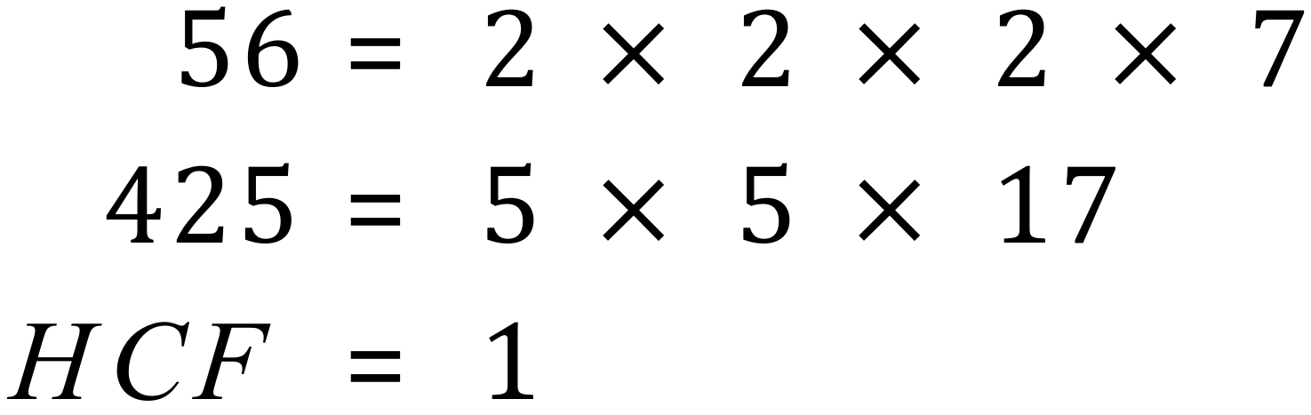
Highest Common Factor
The HCF is a little easier to work out. We simply write out the factors of each of the pair and calculate the largest common factor in each list by expanding the common factors:
Example: Find the HCF of 56 and 425
There are NO COMMON FACTORS between 56 and 425.
In these cases the HCF is 1 as 1 is a factor of ANY number.

Slide 15
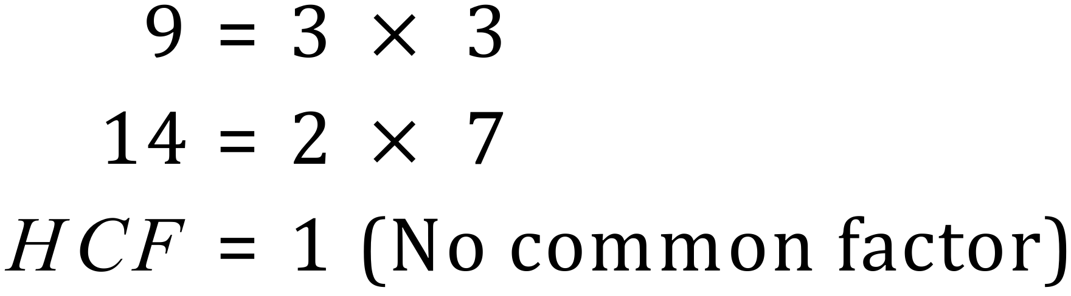
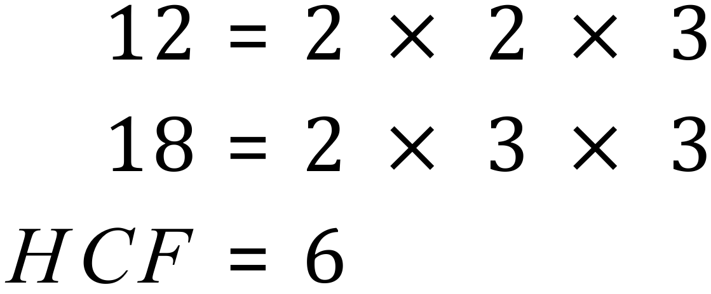
Hot Spot 3
Find the highest common factor of each of the following number pairs:

