Slide 1
Introducing Atoms and Molecules
The Building Blocks of the Universe

Slide 2
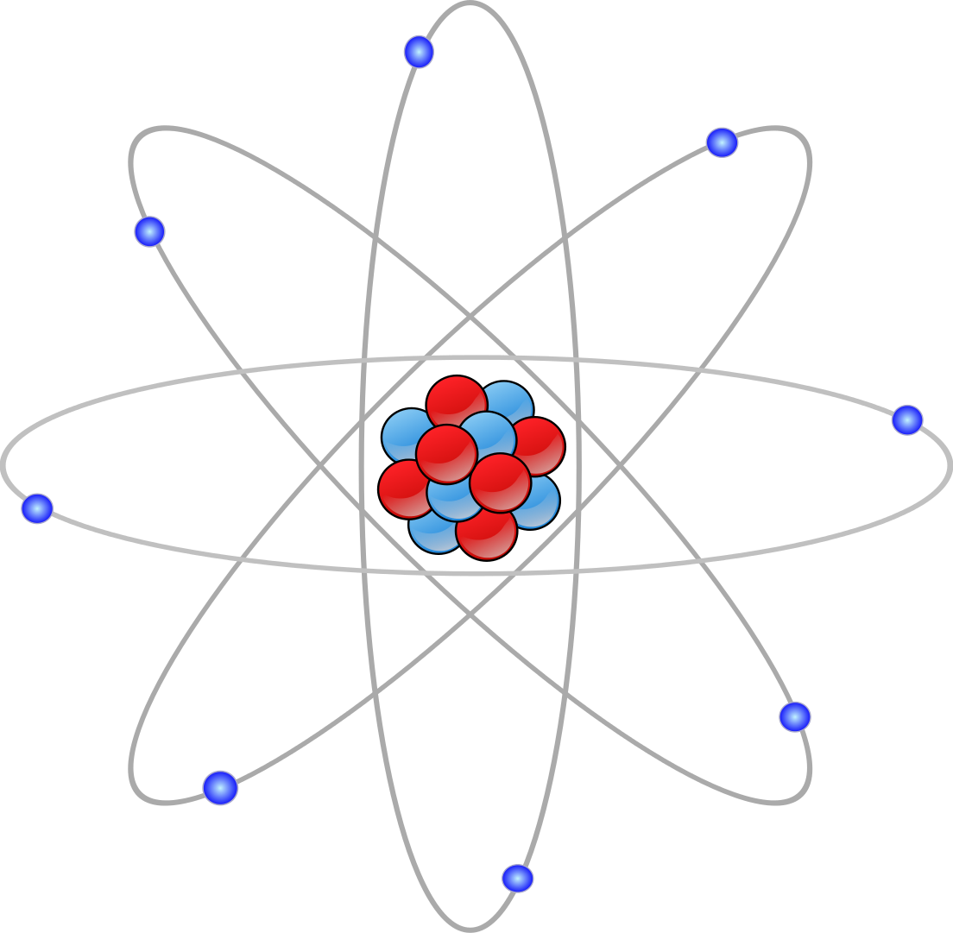
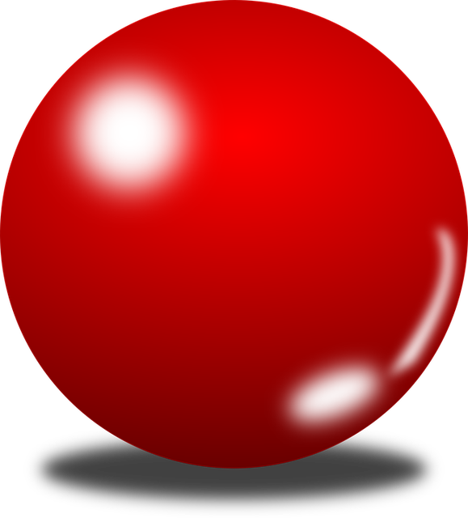
The image you might see when the word “Atom” is mentioned is likely to be the “Science Fiction” favourite type…
The real “atom” is much more complicated, but this “idea” of electrons flying round the nucleus like the planets going round the sun works quite well.
We call this a “model” and there are several, each one is used when the circumstances call for it.
Sometimes we just use a small ball, or “sphere”

Slide 3
So how did it get to be called an “Atom” ? Why not call it “Fred” or “Jim” ?
Around 400 BC a Greek philosopher named DEMOCRITUS stated that everything was made up of these little, indivisible entities, they are always moving around and between each one there is nothing but empty space.
DEMOCRITUS said that if you cut an object in half, then cut one of the halves in half, and keep cutting …
The Greek word for “indivisible” is…..
ATOMOS
… you would eventually get to a point where you could not cut any more, what you were left with was “indivisible”

Slide 4
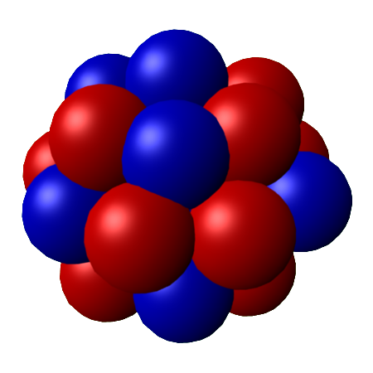
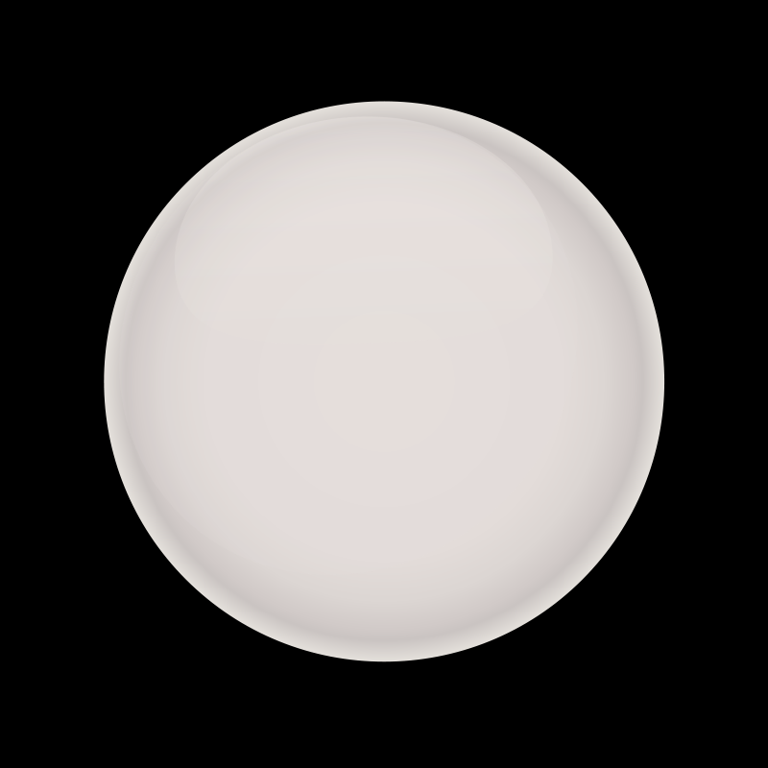
ATOMS – What are they made of?
With the exception of the simplest atom (Hydrogen), atoms are made of:
Protons
These carry a positive charge (+1) and weigh 1.6726 x 10⁻²⁷ Kg
Neutrons
These carry NO charge (0) and weigh 1.6749 x 10⁻²⁷ Kg
Electrons
These carry a negative charge (-1) and weigh 9.1 x 10⁻³¹ Kg

Slide 5
Because PROTONS have a +1 charge, the more of them we have in an atom, the more “charged” the atom will become.
But ….
Scientists KNOW that Atoms are NOT charged (normally) they are “Electrically Neutral” so where have all the +1’s gone?
Well …. The ELECTRONS as we know have -1 charges, so if the atom is NEUTRAL, what is this telling us? (discuss)
+3
+4
+6
+1
0
+2
+5

Slide 6
We now know that there are smaller parts to the Atom, such as Protons and Neutrons, and even smaller parts inside Protons, but we don’t need to worry about those just yet.
There is an expression in Science:
“It’s the protons that give an atom (element) its identity, but it’s the electrons that give it character!”
Atoms join together to make compounds, and everything you see around you (including yourself) is made up of atoms and compounds.
There are 92 naturally occurring atoms, but scientists have artificially forced some atoms together to make new ones, although some of them don’t last much more than a few billionths of a second, they exist and have got names.
Many years ago, a scientist called Dmitri Mendeleev studied the known atoms, and put them into a table, grouping them by the way they behaved (their ‘properties’). This table was called “The Periodic Table”.

Slide 7
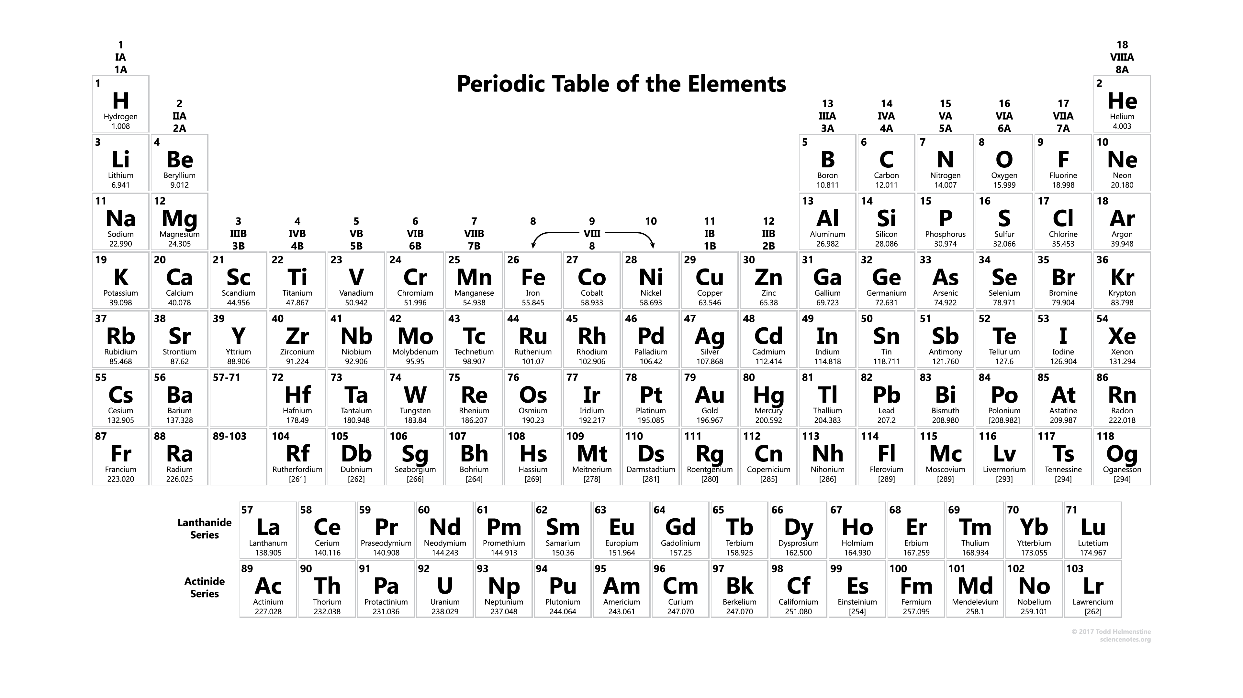
Here is the modern Periodic Table of the Elements (you might see this as PTE):

Slide 8
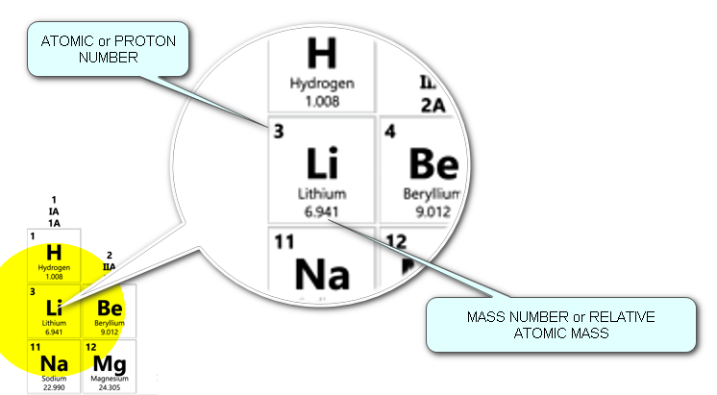
We need to look at a few definitions now, so that everything makes sense:
1. ALL matter is made up of ATOMS
2. An ELEMENT is a substance which is made up of only ONE type of ATOM
3. The number of PROTONS in the NUCLEUS is what identifies the ATOM/ELEMENT
4. The number of ELECTRONS is the SAME as the number of PROTONS in an ATOM
5. The number of PROTONS is known as the PROTON NUMBER, or ATOMIC NUMBER
6. The number of NEUTRONS in an ATOM determines the ISOTOPE of the ELEMENT
7. The number of PROTONS and NEUTRONS in an ATOM added gives the MASS NUMBER
The MASS NUMBER is RARELY a whole number because of ISOTOPES. If it is shown as a whole number it is usually in [ ] because we don’t have enough data to work it out more precisely.

Slide 9
Exercise:
12
C
What is this element’s name?
CARBON
What is this element’s atomic number?
6
What is this element’s mass number?
12
6
How many protons does carbon have?
6
How many electrons does carbon have?
6
How many neutrons does carbon have?
6 (in this example anyway, but can vary)
How did I work out the last answer?
MASS NUMBER – ATOMIC NUMBER

Slide 10
ATOMS join together to make COMPOUNDS
A COMPOUND is a substance that contains two or more different elements, joined together chemically (they are said to be “bonded”)
Compounds can often be broken down into the elements that they are made of, but this takes chemical reactions to do it, and can be quite complicated.
ATOMS can also make MIXTURES
A MIXTURE is a substance that contains two or more different elements, mixed together, they are NOT bonded and can usually be separated quite easily by one of a number of methods (we’ll see these later).

Slide 11
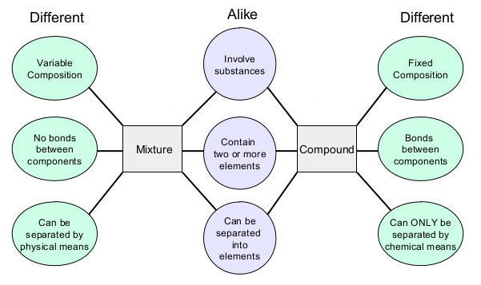

Slide 12
Exercise:
I have some sand and some water, I put them in the same beaker and stir it up. Have I got a compound of sand and water or a mixture?
This is a mixture, not a compound because sand won’t react with water. We can separate these by filtering out the sand through a filter paper.
I have a tablespoon of salt, and I dissolve it in water. Is this a compound now, or a mixture?
It’s still a mixture, although it dissolved, it didn’t chemically react so we could use evaporation to get the salt back if we wanted to.
I have a strip of magnesium metal and burn it in a Bunsen burner flame, it turns into a white powder called Magnesium Oxide. Is this a compound or a mixture?
When Magnesium burns in air, it chemically reacts with Oxygen to make Magnesium Oxide. This is a COMPOUND and can’t easily be separated back into the elements

Slide 13
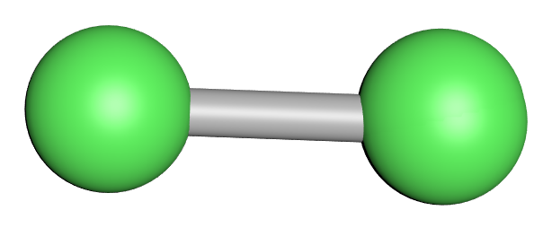
So …. What is a MOLECULE ?
A molecule is made of two or more atoms of the same OR different elements, chemically bonded by sharing electrons ……
This is a model of a molecule of CHLORINE, a poisonous gas and its atoms always go around in pairs. They are joined together by sharing TWO electrons. This is called a single bond and it is VERY strong.

Slide 14
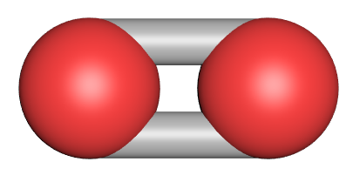
So …. What is a MOLECULE ?
A molecule is made of two or more atoms of the same OR different elements, chemically bonded by sharing electrons ……
This is a model of a molecule of OXYGEN, a gas which we need to breathe and its atoms always go around in pairs. They are joined together by sharing FOUR electrons. This is called a double bond and it is VERY strong.

Slide 15
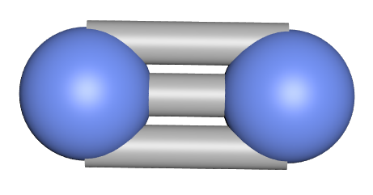
So …. What is a MOLECULE ?
A molecule is made of two or more atoms of the same OR different elements, chemically bonded by sharing electrons ……
This is a model of a molecule of NITROGEN, a gas which makes up 78% of our atmosphere and its atoms always go around in pairs. They are joined together by sharing SIX electrons. This is called a triple bond and it is VERY strong.

Slide 16
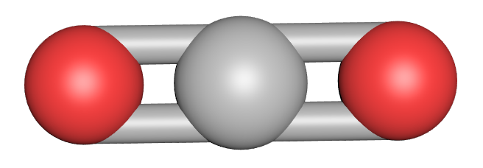
So …. What is a MOLECULE ?
A molecule is made of two or more atoms of the same OR different elements, chemically bonded by sharing electrons ……
Finally …. this is a model of a molecule of CARBON DIOXIDE, a gas which we breathe out and is one of the gases responsible for global warming. The carbon atom “borrows” electrons from each oxygen, and they “borrow” electrons from the carbon. Two double bonds form and this makes a very stable molecule.

Slide 17
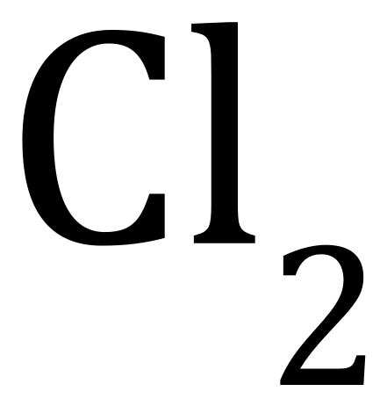
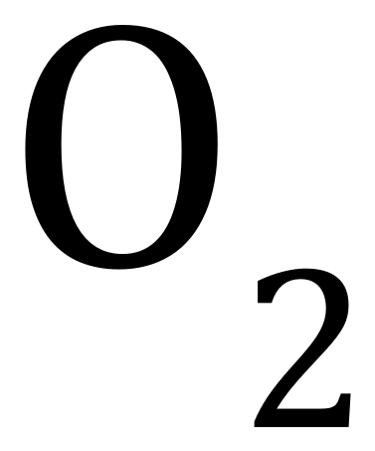
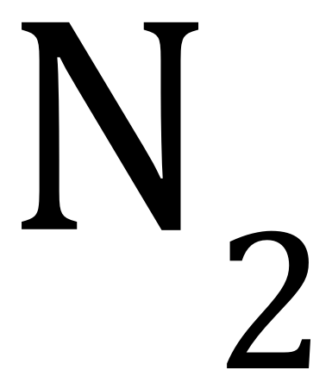
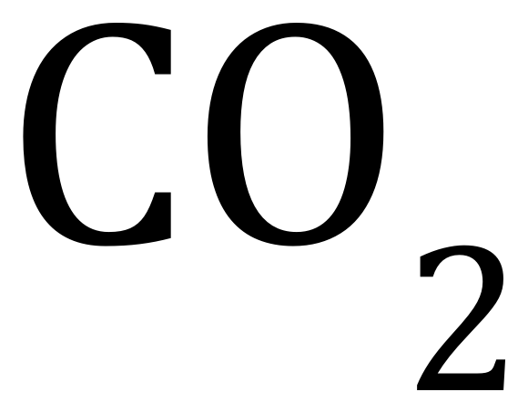
Exercise:
Chlorine
Oxygen
Nitrogen
Carbon Dioxide

