Slide 1
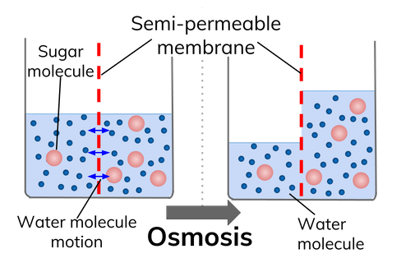
OSMOSIS
Following on from "diffusion", we look at another type of intracellular transport known as "osmosis".
Osmosis is an important process for life and is defined as:
"Osmosis is the movement of water molecules across a partially permeable membrane from a region of higher water concentration to a region of lower water concentration"

Slide 2
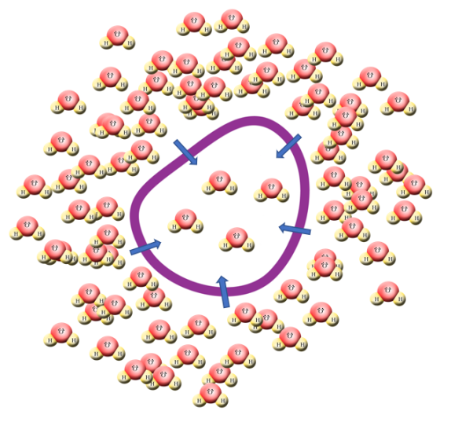
OSMOSIS
If a cell starts to become depleted of water, the concentration of water inside the cell will start to drop below the concentration of water outside the cell and as a result of this water will diffuse across the partially permeable membrane by osmosis into the cell to address the balance.

Slide 3
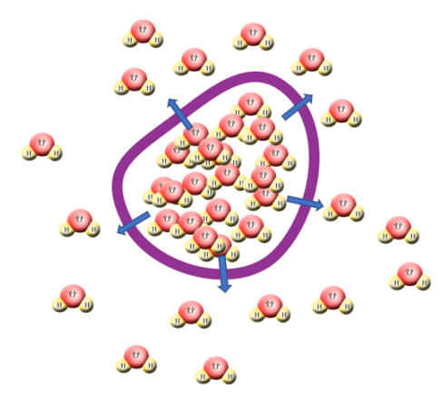
OSMOSIS
Similarly if a cell starts to contain too much water, its concentration will start to exceed that of the surroundings at which point osmosis will cause water to diffuse out of the cell

Slide 4
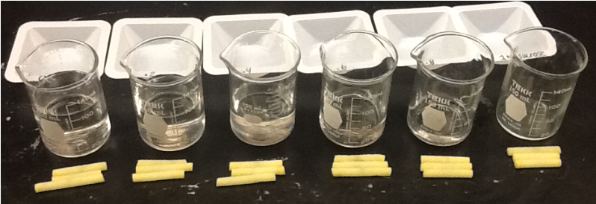
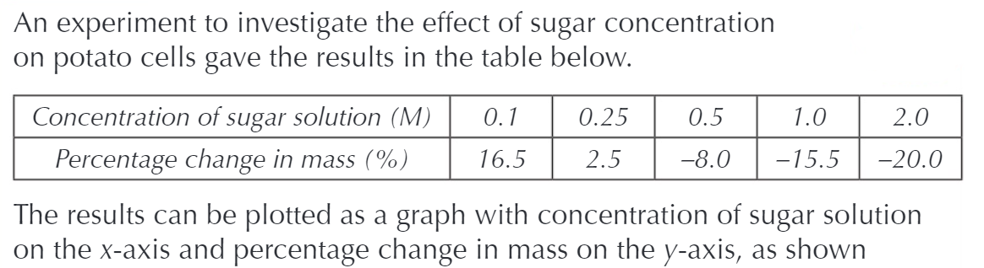
OSMOSIS

Slide 5
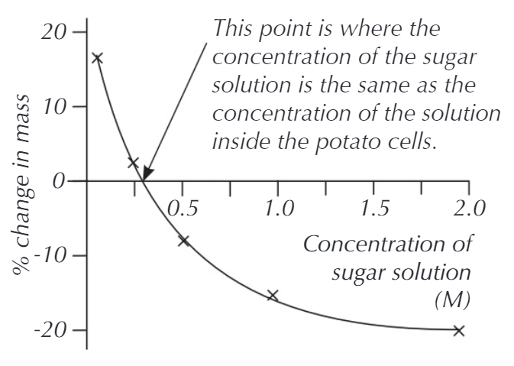
OSMOSIS

Slide 6
OSMOSIS
An investigation into the effects of varying solute / water concentration on the water content of samples of potato at varying solute concentration.
In this investigation we will be using a solution of:
__________________________________________________
 | Solution + Strength | Mass At Start (g) | Mass After 20 Minutes (g) | Difference In Mass(g) | Percentage Change (%)
Potato Sample 1
Potato Sample 2
Potato Sample 3
Potato Sample 4
Potato Sample 5

