Slide 1
Parallel Circuits

Slide 2
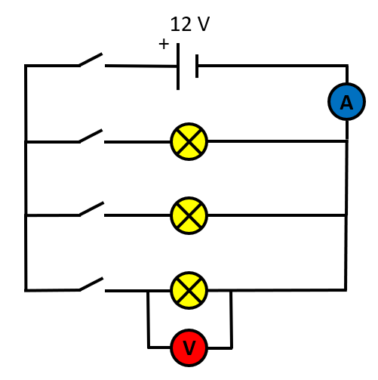
In parallel circuits, components or groups of components reside on their own particular branch.
Parallel circuits have far more uses than series circuits and are therefore more widely encountered.
In the example shown we have a 12 V cell with an ammeter connected in series (an ammeter is always connected in series in circuits) and three identical filament lamps on their own individual branches, individually switched.

Slide 3
There is a "master" switch to the left of the cell which will control the whole circuit and finally a voltmeter across the third lamp (note, voltmeters are always connected in parallel that is "across" the component being tested).
If the master switch is closed, nothing will happen because all of the lamps are individually switched, but when one of the individual lamps has its switch closed it will illuminate.

Slide 4
Closing the individual switches of the other two lamps will mean that all of the lamps will stay on because in parallel circuits the potential difference is identical to that of the cell across every branch in the circuit.
The potential difference across lamp number one will be the same as that across lamp number two, and the same as that across lamp number three ie: 12 V, because each branch of the circuit forms its own complete closed-loop from one end power supply to the other

Slide 5
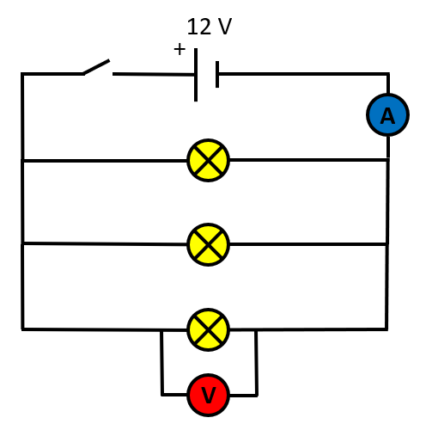
In this similar circuit, there is a "master" switch to the left of the cell which will control the whole circuit
Individual switches have gone, all 3 lights are controlled now by “the master” switch.
Each of the 3 lights glow with the same brightness, because in PARALLEL circuits the Potential Difference (PD) is the SAME across ALL branches of the circuit.

Slide 6
POTENTIAL DIFFERENCE - COMPARE SERIES AND PARALLEL
In a SERIES CIRCUIT the PD is SHARED across ALL components in the circuit.
In a PARALLEL CIRCUIT the PD is EQUAL across ALL components in the circuit.

Slide 7
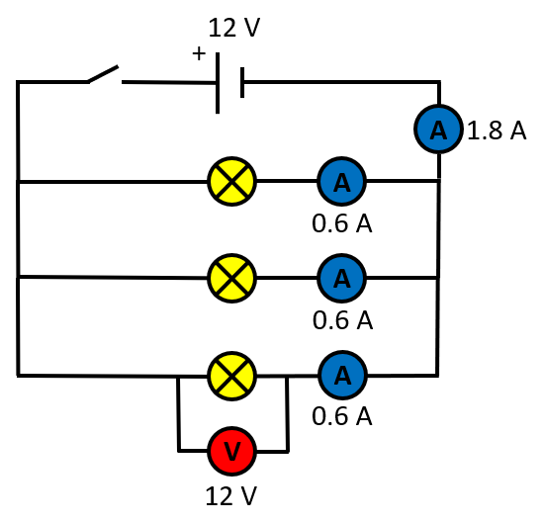
In parallel circuits the current flowing around the circuit "splits" as it meets the junction with another branch of the circuit.
Some of the current will travel off along THAT branch with the remainder of the current travelling along the continuation of the parallel circuit until it meets ANOTHER junction where it will split off a little bit more.
In the circuit shown (assuming of course that the switch is closed, I have just left it shown open as a convenience in this case) a potential difference of 12 V passes around the circuit producing an overall current of 1.8 A as shown.

Slide 8


Slide 9

CURRENT - COMPARE SERIES AND PARALLEL
In a SERIES CIRCUIT the CURRENT is EQUAL across ALL components in the circuit.
In a PARALLEL CIRCUIT the CURRENT is SHARED across ALL branches in the circuit.

Slide 10
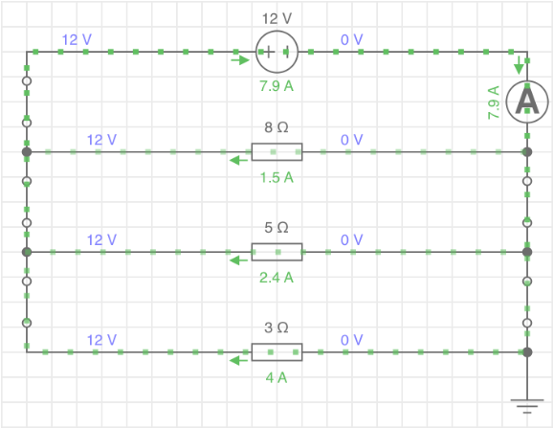
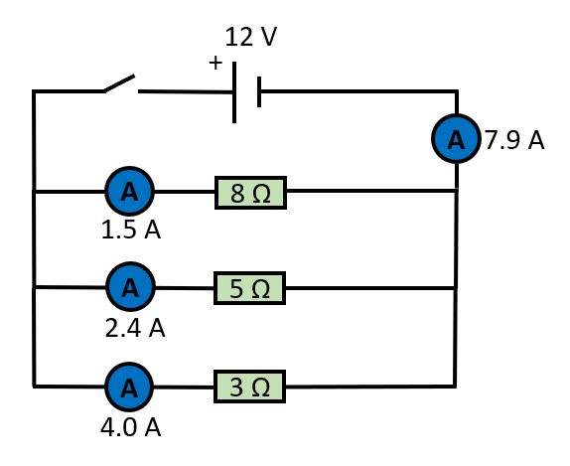
The circuit on the LEFT is a diagrammatical representation of a SIMULATION created in a CIRCUIT SIMULATOR program

Slide 11
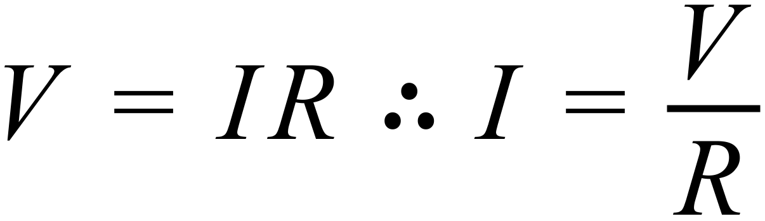
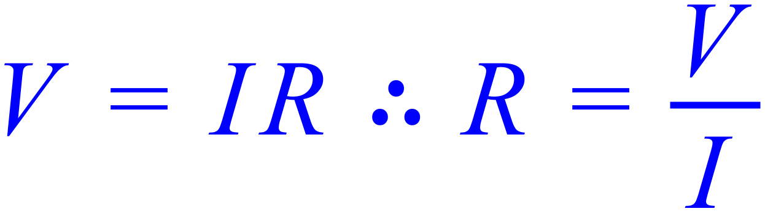
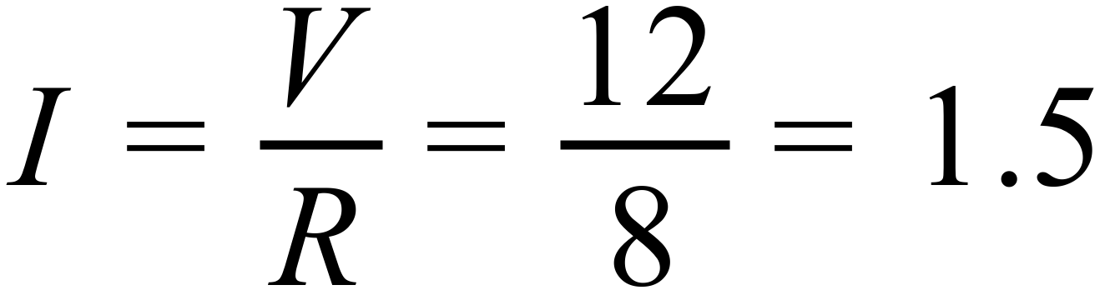
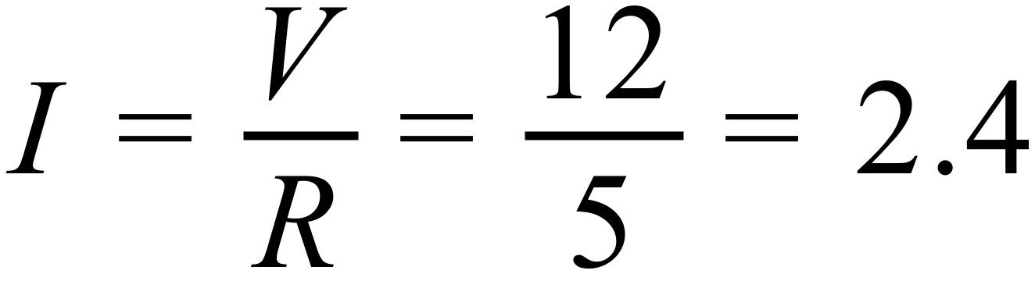
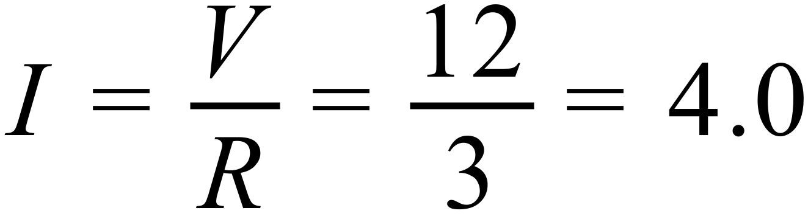
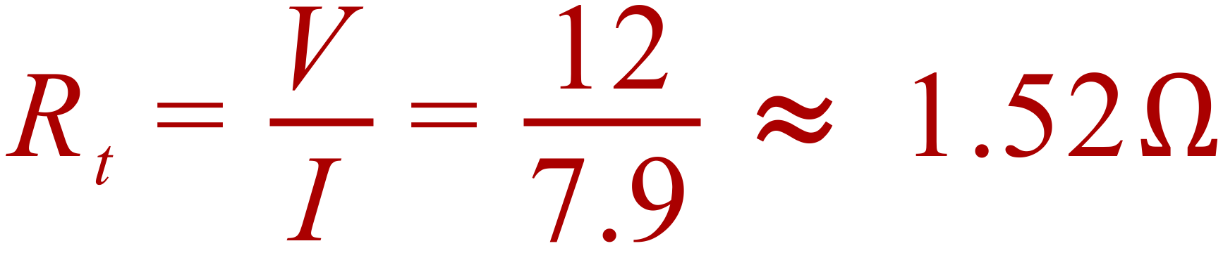

Slide 12
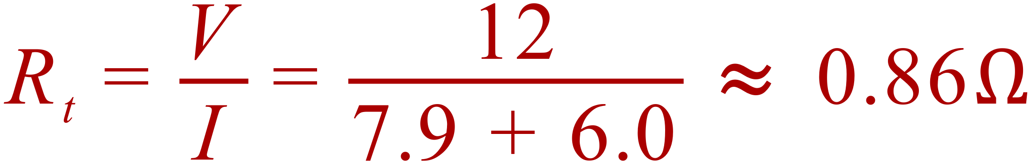
THE TOTAL RESISTANCE IN A PARALLEL CIRCUIT IS LOWER THAN THE SMALLEST INDIVIDUAL RESISTANCE.
A FOURTH resistance of, say, 2 OHM added parallel to the existing resistors will reduce the overall circuit resistance to below 2
An extra 2 OHMS will draw an extra 6 AMPS on the circuit (from I = V/R = 12/2 = 6) which will raise the overall circuit current to 7.9+6=13.9A

Slide 13
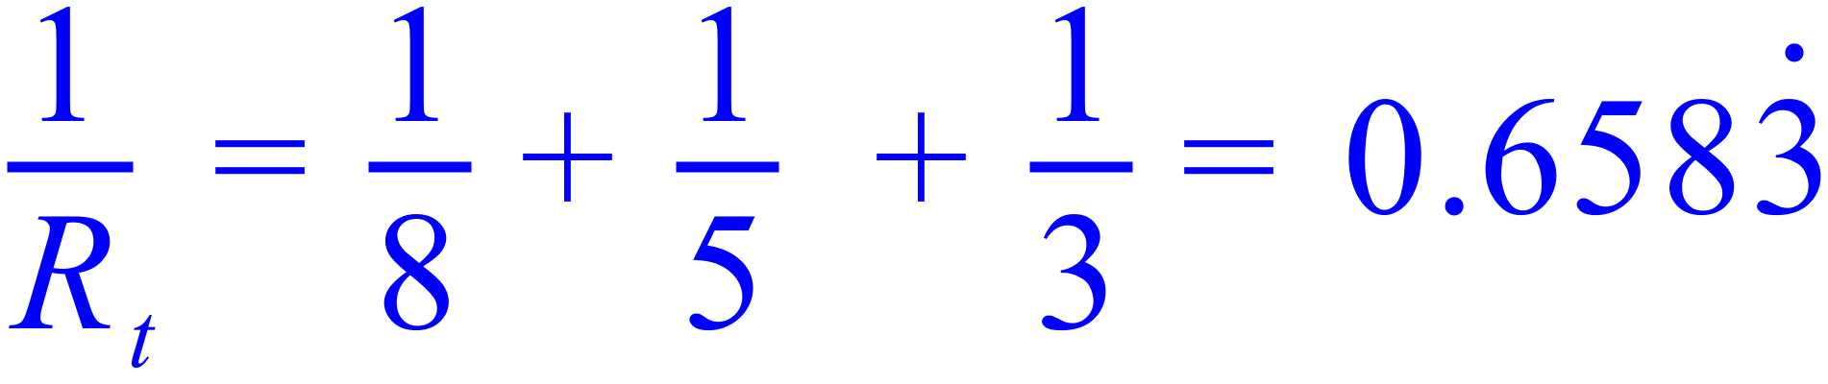
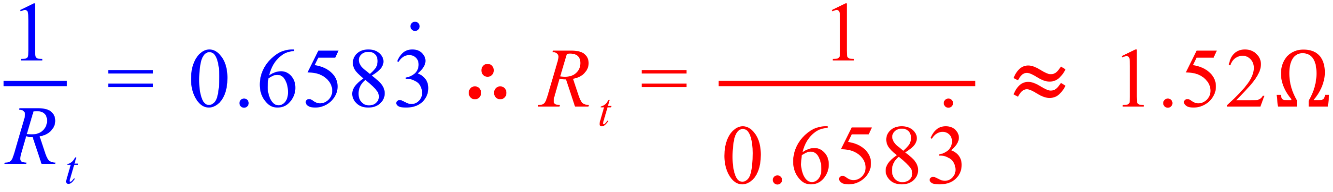
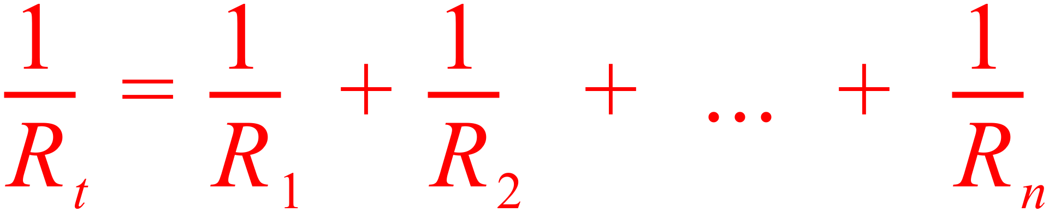
The TOTAL RESISTANCE in a PARALLEL CIRCUIT is lower than the lowest resistance of a component in the circuit.

Slide 14
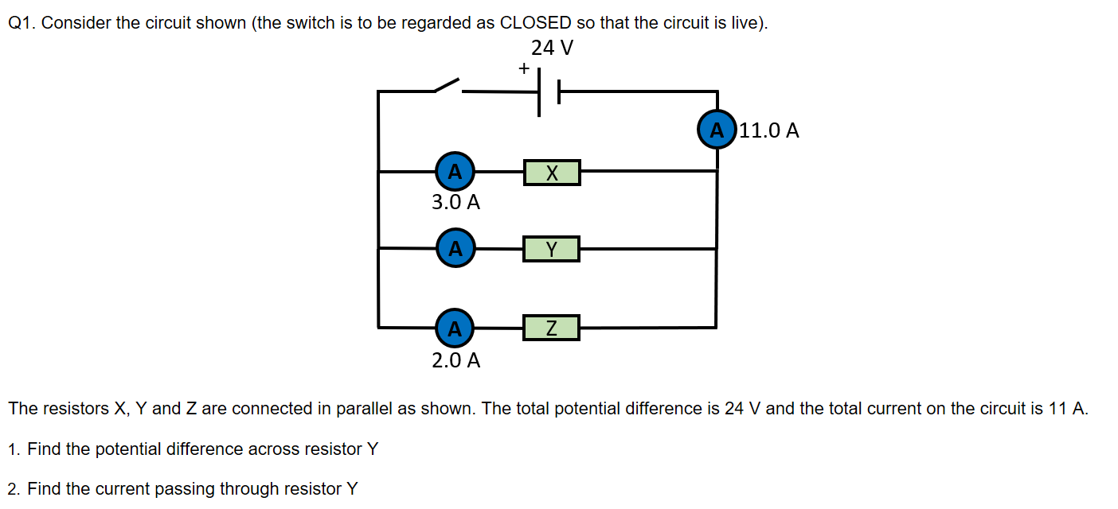
Exercise 1

Slide 15
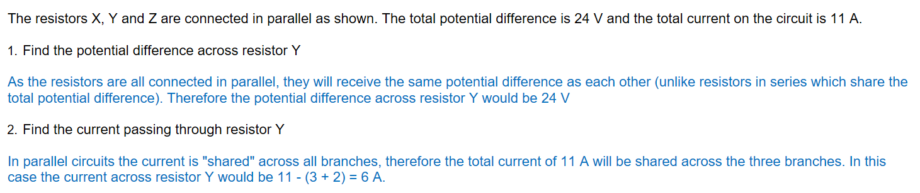
Exercise 1

Slide 16
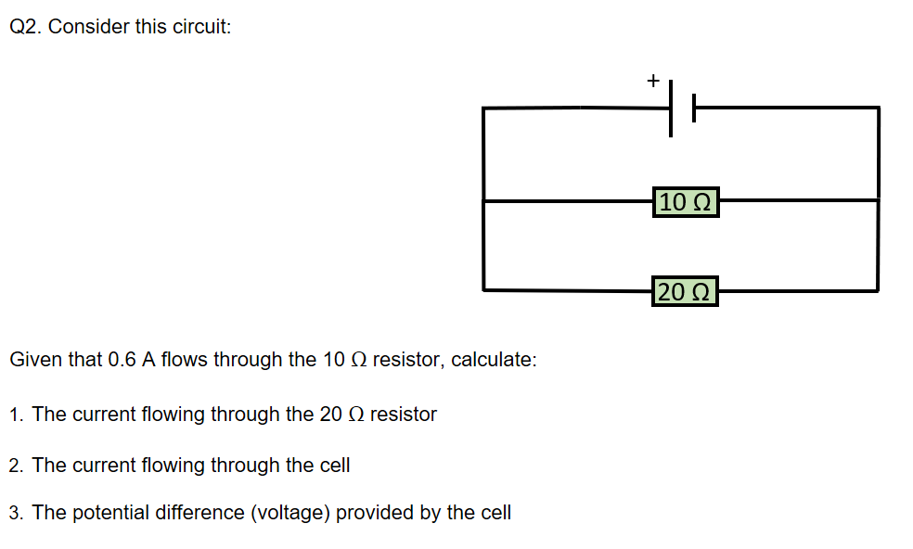
Exercise 2

Slide 17
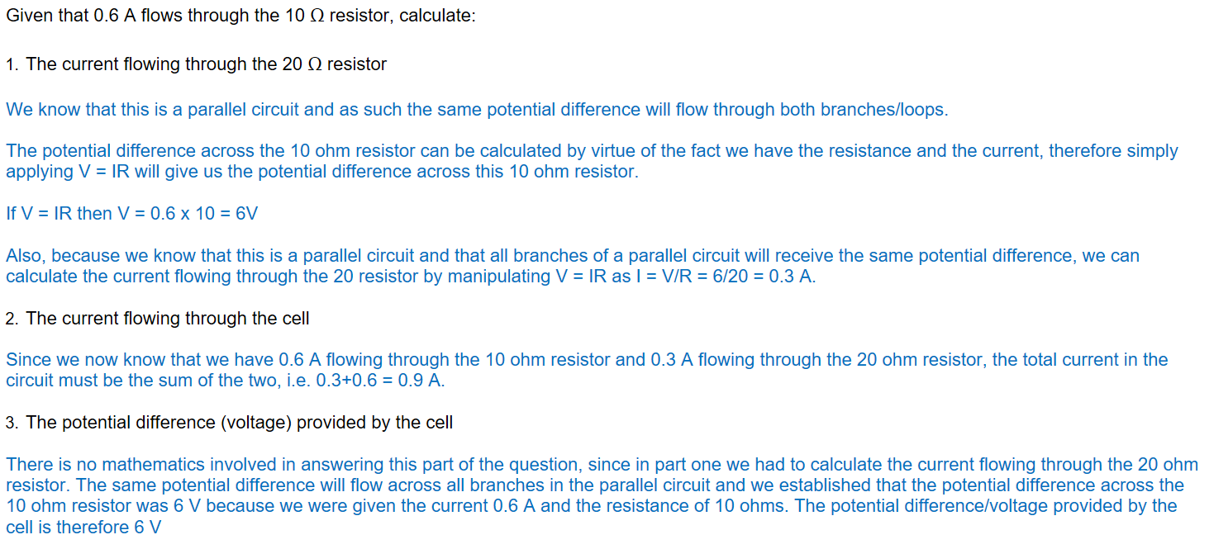
Exercise 2

Slide 18
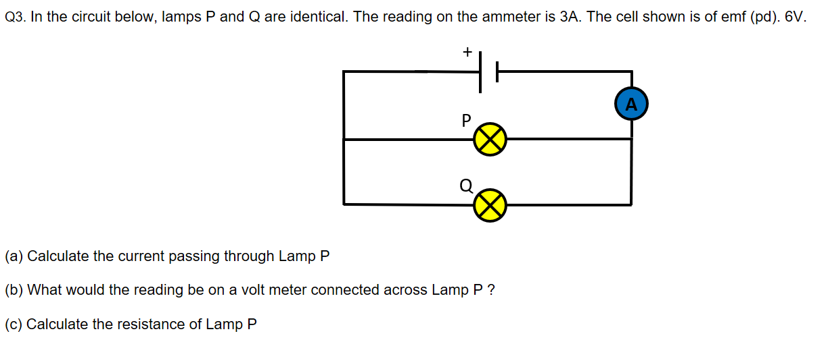
Exercise 3

Slide 19
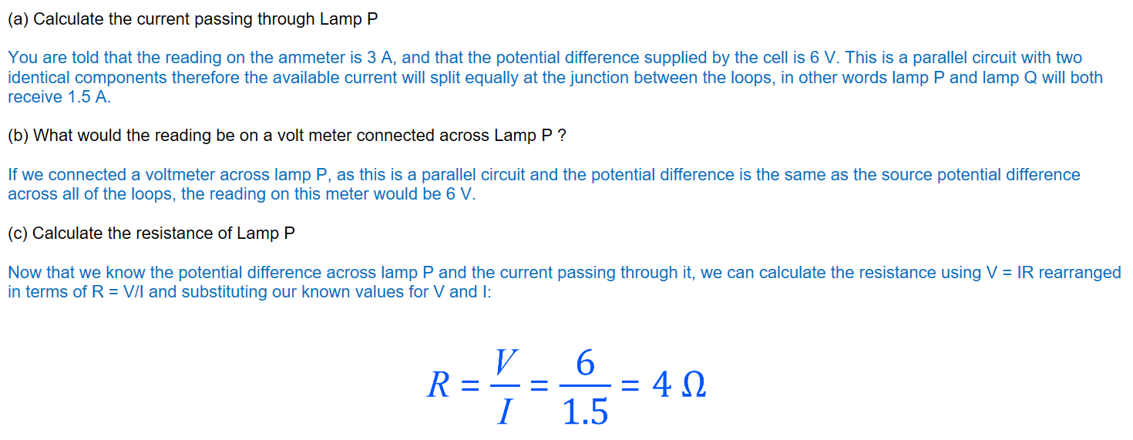
Exercise 3

