Slide 1
Planets Satellites and Orbits
Introducing Red Shift

Slide 2
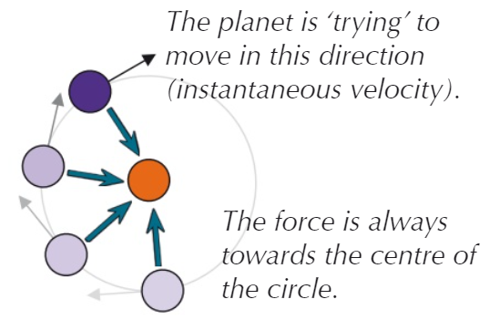

Planets Satellites and Orbits
Our planet Earth, just like all of the other planets orbiting the Sun, is an a fairly circular orbit.
Our planet Earth, just like all of the other planets orbiting the Sun, is an a fairly circular orbit.
There are TWO forces acting on the planet Earth:
1. The force attracting Earth to the Sun, ie: the Sun’s gravitational pull
2. The “instantaneous” velocity of the Earth which is making it try to break free from the Sun’s pull, and continue in a straight line.
These forces are in balance, so the Earth remains in a steady orbit, at a set speed.
SPEED is a SCALAR quantity,it has MAGNITUDE only.
VELOCITY is a VECTOR quantity,it has MAGNITUDE and DIRECTION.
The Orbit of the Earth has a FIXED speed but a CHANGING VELOCITY

Slide 3

Planets Satellites and Orbits
How far away from the Earth is the sun?
Approximately 92.94 million miles!
This can be described as the orbital radius of the planet, and if we wanted to, from this we could calculate the approximate circumference of the orbit which would be the distance travelled by the planet in one year.
Q. Approximately how far does the planet Earth travel in one year?
Remember that this should be only taken as a guideline because the figures I've used are not particularly accurate, but we can say that the Earth travels roughly half a billion miles every year.

Slide 4
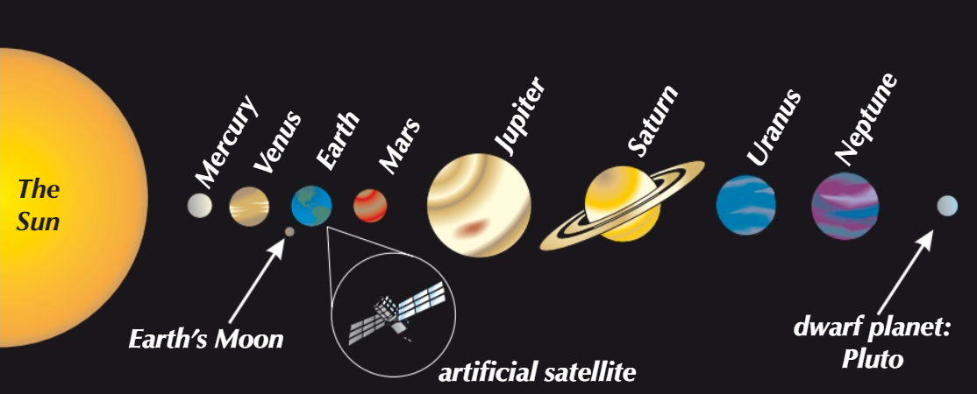
Planets Satellites and Orbits
The closer you get to a star or planet the stronger will be the effect of the force of gravity on you.
The closer you are, the faster you will need to travel to stay in orbit and not be pulled towards the star or planet. So we can say that the larger planets such as Jupiter and Saturn etc travel more slowly around the Sun because they are further away and the pull of the Sun's gravitational field is quite a lot less

Slide 5
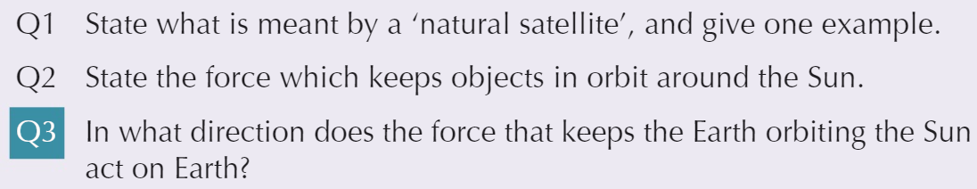

Hot Spot 1
A1. A natural satellite is a naturally occurring object which orbits the planet, with smaller mass than the planet, for example our moon.
A2. Gravity
A3. The force acts towards the centre of the sun/the centre of the orbit
If the planet Earth moved further away from the sun, what would happen to its speed (of the orbit) provided that it was going to remain in a stable orbit, and why would this be?
The speed of the orbit would decrease because the force of attraction between the Earth and the Sun would have been reduced and there would not be the need for such a great orbital velocity to keep the Earth in a stable orbit.

Slide 6
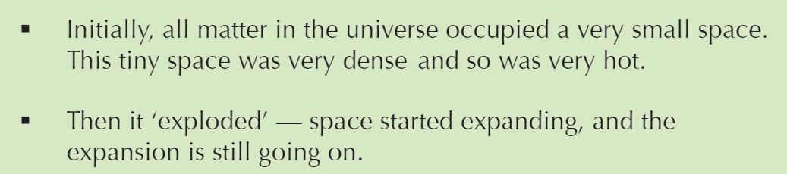
The Big Bang and Steady State Theories
Scientists know from observations that all of the galaxies in the universe are moving away from each other. If this is the case something must have started them off. The "Big Bang theory" suggested that everything started from a central point:
Before this, there was another theory called the "Steady-State Theory" . This suggested that the density (amount of stuff) in the universe was constant, being kept this way by the formation of new stars, as old ones died.
Scientists observed the light emitted from the galaxies and saw what they described as a “Red Shift” suggesting that the galaxies are moving away, and with nothing filling the space they leave behind, the SST was quickly dropped!

Slide 7



Red Shift
As we know a light wave travels as a transverse wave, going "up and down" and having a frequency and wavelength.
In this picture we can see that the wavelength is the distance between peaks, troughs or centre points, in other words one complete cycle of the wave.
If the light source is moving towards us, the waves are "compressed" as if they are being pushed back as shown. In this case the wavelength decreases, and the colour of light shifts towards the blue end of the spectrum. This is called a "blue shift".
If the light source is travelling away from us, the waves are stretched (lengthened) which causes them to move towards the red end of the spectrum. This is known as a "red shift".

Slide 8
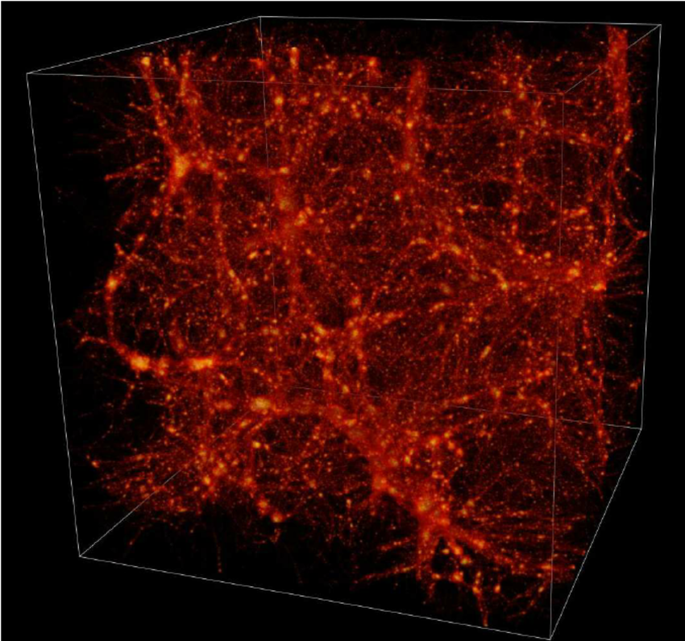
Red Shift
Scientists have observed that the light from most distant galaxies is red shifted, which suggests that they are moving away from us. This suggests to us that the universe is constantly expanding and supports the "Big Bang Theory" more so than the "Steady-State Theory".
There are some unexplained theories, scientists are of the opinion that the universe is made up of "dark matter" and "dark energy"
In astronomy and cosmology, dark matter is hypothetical matter that is undetectable by its emitted radiation, but whose presence can be inferred from gravitational effects on visible matter.

Slide 9
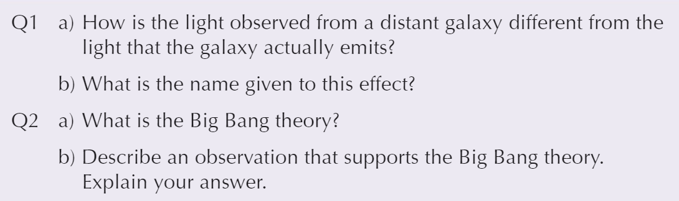
Hot Spot 2
A1a. The observed wavelength is greater than the wavelength of the light when it is actually emitted by the galaxy.
A1b. This is known as the "red shift".
A2a. The universe began as a small region of space that was very hot and very dense. It exploded, and has been expanding ever since and this theory is supported by the red shift observations.
A2b. The light observed from distant galaxies is red shifted and it is more red shifted further the galaxy is away from us. This suggests that the universe is expanding not that it has remained at the same size forever (as the steady-state theory would suggest).

