Slide 1
Electricity – Series Circuits

Slide 2
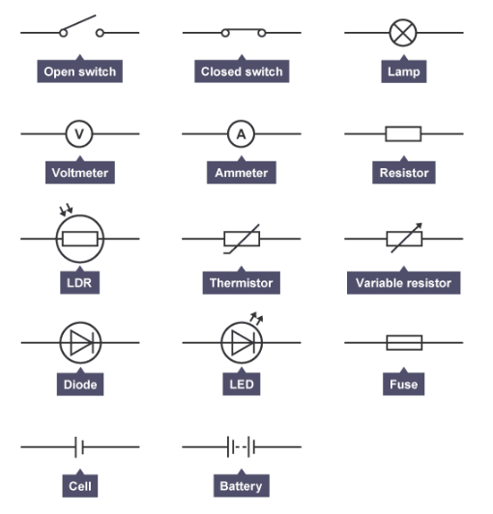

This list shows some of the components that you will come across in your study of circuits at GCSE.
You should try to memorise these, some are quite obvious (such as Ammeter, Voltmeter) but others are less obvious (such as Diode or LDR).
Note the distinction between “Cell” and “Battery”, the longer line of the two is the positive terminal and the shorter is the negative terminal.

Slide 3
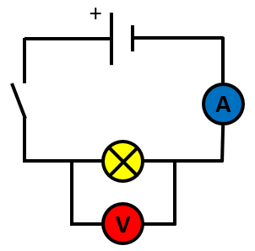
This is called a series circuit because the different components are connected in a line “end to end” between the positive and negative terminals of the cell or battery.
Any break in the circuit at any point will cause the whole thing to stop working.
When the switch is closed, electrons will flow from the cell, through the ammeter, through the filament bulb and back to the cell. Convention states that current flows from positive to negative but electrons do in fact flow from negative to positive.
The “flow rate” of electrons in the circuit is measured in “Amperes” or “Amps”. It is usually abbreviated to “A”
The “flow volume” of electrons in the circuit indicates the movement of “Electrical Charge” which is measured in “Coulomb”, usually abbreviated to “C”

Slide 4


Think of the Water in the river as the CHARGE
Think of the Water Flow in the river as the CURRENT
The FASTER the FLOW (Higher Current) the greater the amount of Water passing between the arrows
Let “Q” be the amount of Water (Charge)
Let “I” be the Water Flow Rate (Current)
Let “t” be the length of the flow, in Seconds

Slide 5
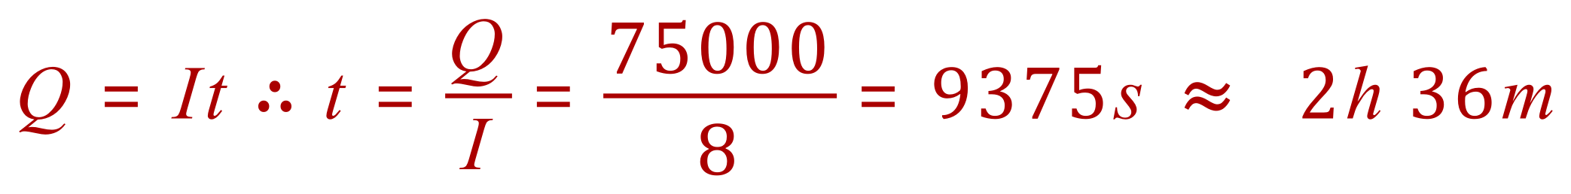
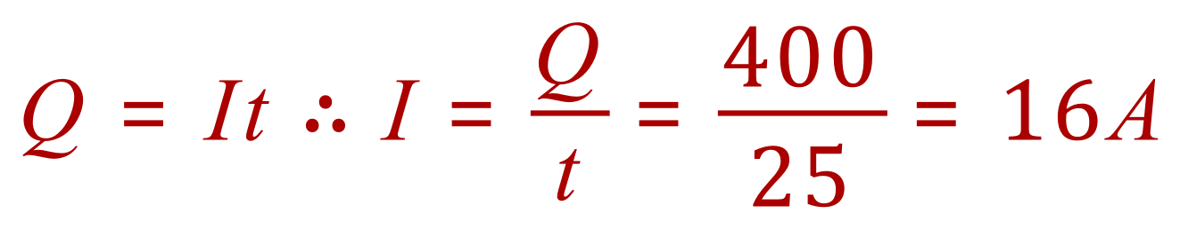
Q. In a particular electrical circuit, 25 A flowed in 10 seconds, what was the charge in Coulombs passing through the circuit?
Q. A battery charger is connected to a battery/cell and passes a current of 8 A. If the overall charge transferred to the battery/cell is 75,000 C, how long was the charger switched on for?
Q. A circuit passes 400C of charge in 25 seconds, what is the current in the circuit?

Slide 6
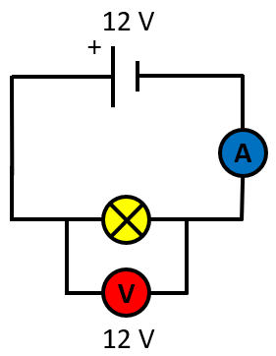
This SERIES CIRCUIT has a 12V power supply, in scientific terms we would say that:
The POTENTIAL DIFFERENCE in the circuit is 12 VOLTS
It is the POTENTIAL DIFFERENCE that provides the “Driving Force” (Electromotive Force, E.M.F.) to ‘push’ the current around the circuit.
GREATER POTENTIAL DIFFERENCE
GREATER DRIVING FORCE
The Potential Difference is SHARED across EACH component in the circuit, so the more components you add in series, the lower the PD will be for each of them.
In the example shown, there is only one component (the filament bulb) so it will feel the FULL PD of 12V (we disregard the ammeter, and the voltmeter is connected in parallel).

Slide 7
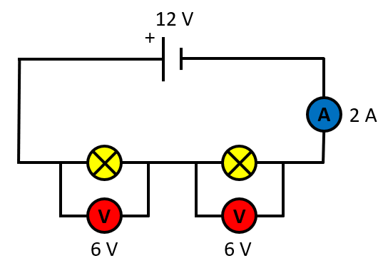

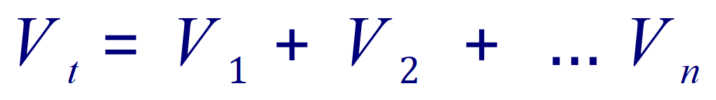
Q. What would be the PD across each of the filament bulbs if they were identical?
A. PD is shared equally if they were identical, so the answer is 6V.
If the components are not identical, the share of PD for each will vary.
However, all of the PD is shared so that the sum total across each component equals the value of the source PD:

Slide 8
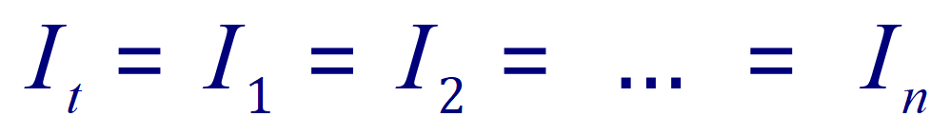
CURRENT IN SERIES CIRCUITS
In series circuits, the value of the current flowing through ALL components is the SAME, and EQUAL to the current flow in ALL parts of the circuit.
The ammeter here shows 2A flowing around the circuit, so the current passing through EACH filament lamp is 2A

Slide 9
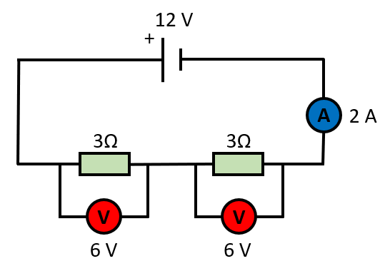

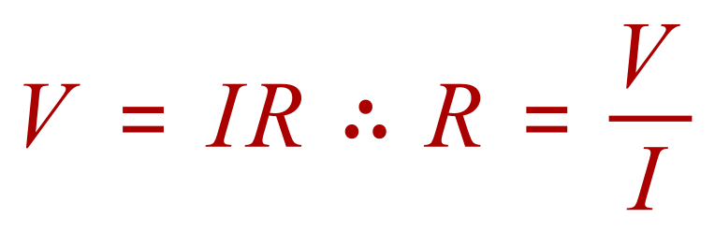
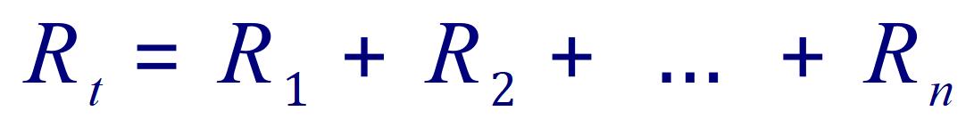
RESISTANCE IN SERIES CIRCUITS
In a series circuit the total resistance is the sum of all of the resistances of the individual components making up the circuit.
This is fairly straightforward, and we measure the resistance of a circuit from OHMS LAW:

Slide 10
RESISTANCE IN SERIES CIRCUITS
Take a look at this circuit. Each resistor shown is identical to the other.
The CIRCUIT resistance is 6 OHM (6Ω) and we can see this in 2 ways:
The CIRCUIT resistance is 6 OHM (6Ω) and we can see this in 2 ways:
The sum of the resistances comes to 6 ohms)
Using Ohms Law we have 12V / 2A = 6Ω)

Slide 11
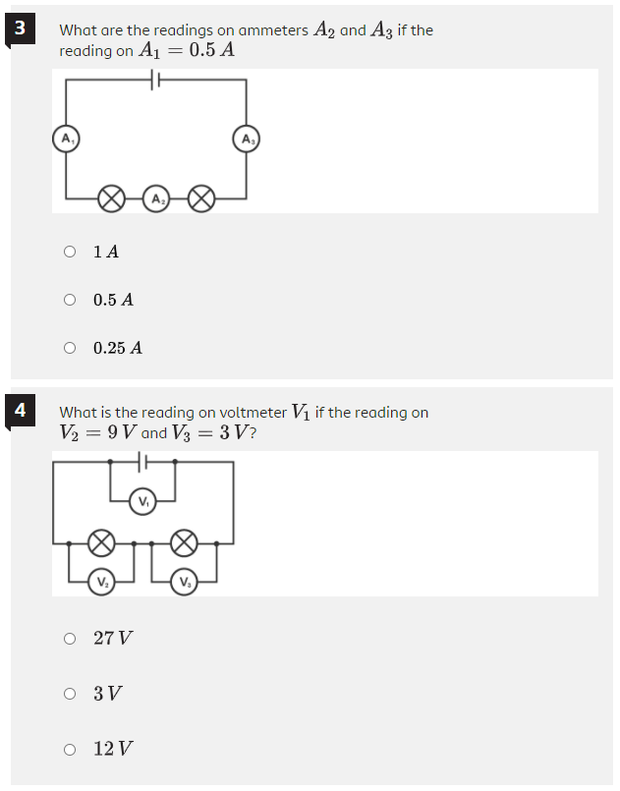
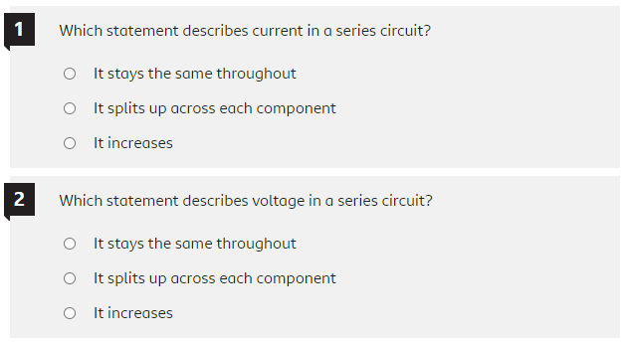

Exercises:

Slide 12
Exercises:

Slide 13
Exercises:

Slide 14
Exercises:

Slide 15
Exercises:

Slide 16
Exercises:

