Slide 1
Sine and Cosine Rules
The Sine Rule
Moving on from SOHCAHTOA

Slide 2
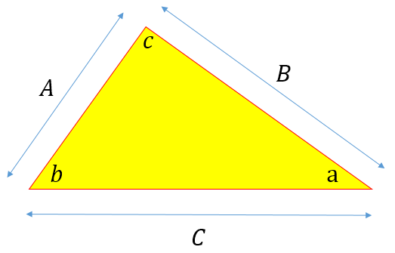
Sine and Cosine Rules
Previously we introduced Trigonometry and focused on right angles triangles, to bring in Pythagoras Theorem and some basic ‘Trig Identities’.
Pythagoras Theorem works only for triangles with one ‘right angle’, but of course there are other sorts of triangles such as equilateral, scalene and isosceles that don’t have any internal 90º angles so what about these?
It’s not a case of SOH CAH TOA here, there is a rule for finding side lengths and internal angles, in fact two rules known respectively as the SINE rule and the COSINE rule, effectively extensions of the Pythagoras Theorem.

Slide 3
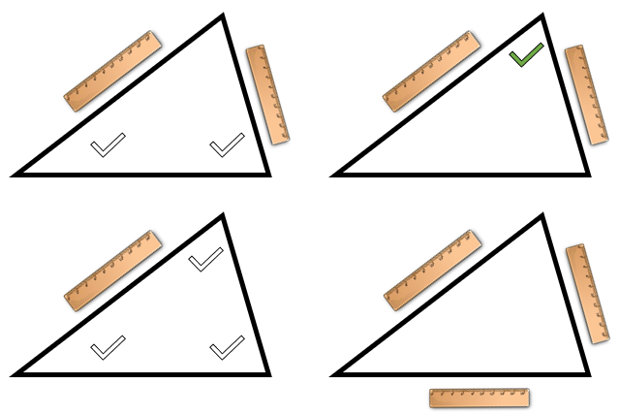
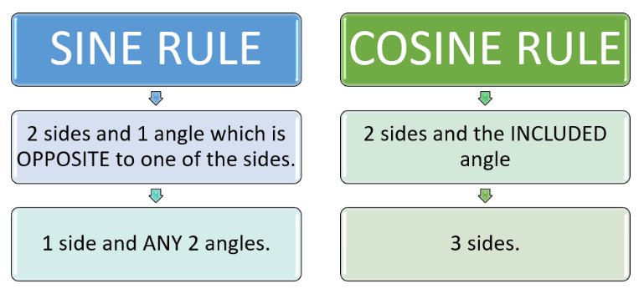
Sine and Cosine Rules
Previously we introduced Trigonometry and focused on right angles triangles, to bring in Pythagoras Theorem and some basic ‘Trig Identities’.

Slide 4
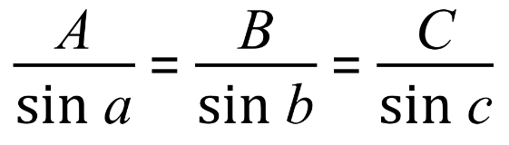
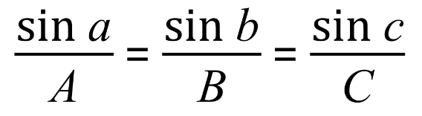
Sine Rule
Either of the two expressions below will work for the “Sine Rule” if (as the rule states) we have 2 sides and an opposing angle, OR any 1 side and all 3 angles.

Slide 5
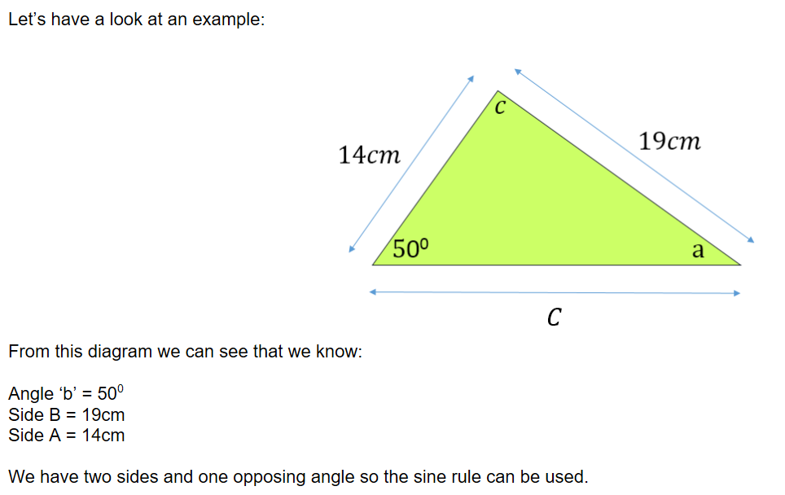
Sine Rule - Example 1

Slide 6
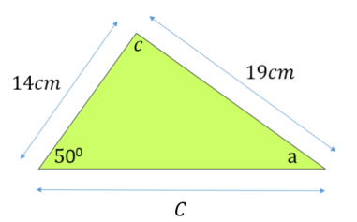
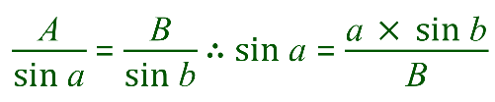


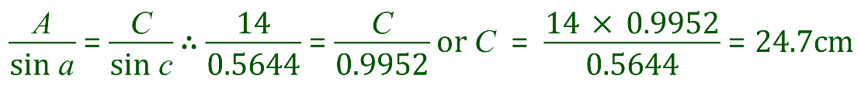
Sine Rule - Example 1
Using the sine rule again, we can establish that the length of the remaining side C is thus:

Slide 7
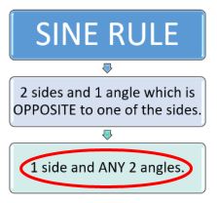
Sine Rule - Example 2
In the triangle shown, side AB = 12cm, angle B = 70º and angle C = 60º
Using this information, calculate the value of angle A and the lengths of the remaining sides AC and BC
C
First of all, let us name the variables according to the Sine Rule convention:
12cm
B
Side “C” = 12cm
Angle a = ?
Side “B” = ? cm
Angle b = 70º
Side “A” = ? cm
Angle c = 60º
70º
60º
A
From this data we can see that the problem is an ideal candidate for the Sine Rule

Slide 8
Sine Rule - Example 2
“C” = 12cm
a = ?
The “given” data has been summarised, now we can start
“B” = ? cm
b = 70º
“A” = ? cm
c = 60º
C
12cm
B
70º
60º
A

Slide 9
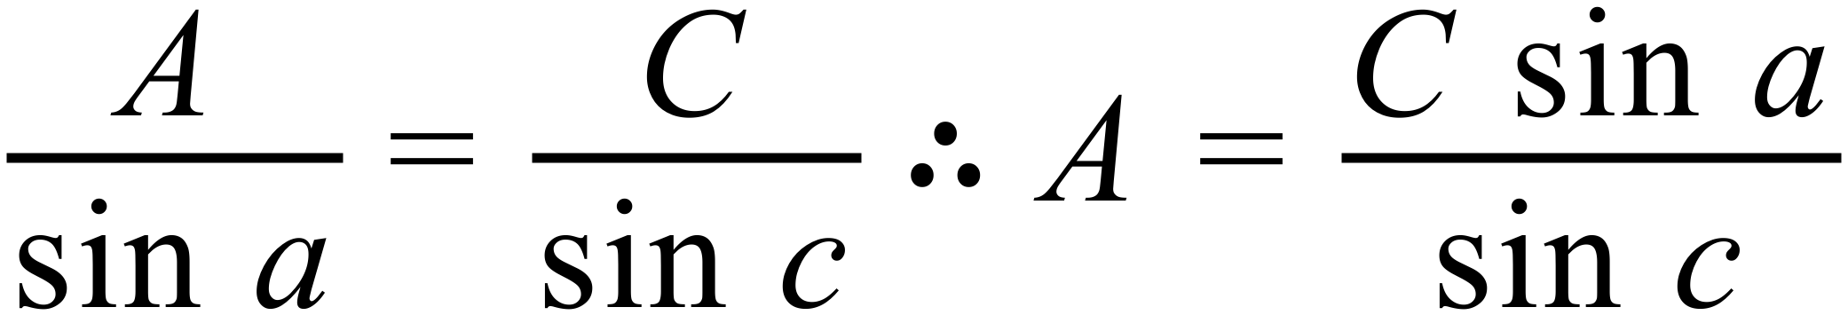
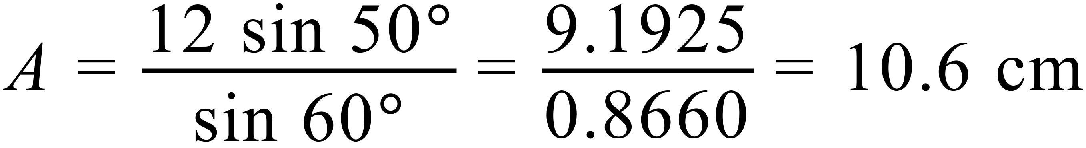
Sine Rule - Example 2
Angle “a” is easily established from the fact that the internal angles of a triangle add up to 180º. Angle “a” is therefore 180 - (70 + 60) = 50º.
Now ... two “runs” of the Sine Rule to calculate the lengths of sides A and B
C
12cm
B
70º
60º
A

Slide 10
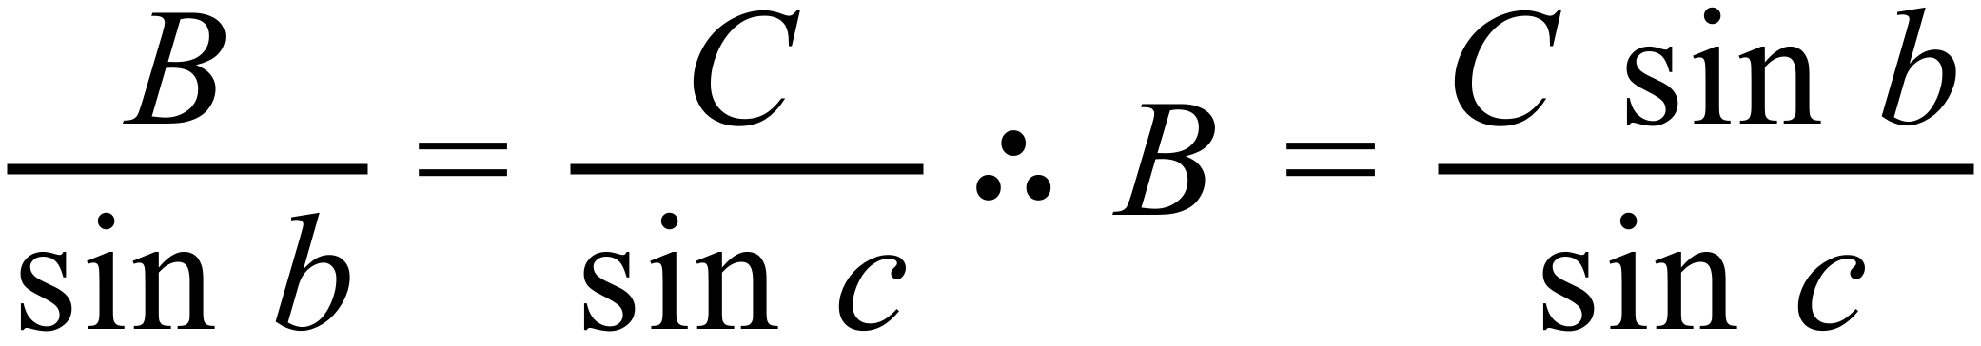
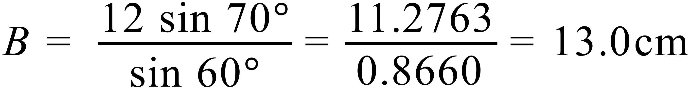
Sine Rule - Example 2
Angle “a” is easily established from the fact that the internal angles of a triangle add up to 180º. Angle “a” is therefore 180 - (70 + 60) = 50º.
Now ... two “runs” of the Sine Rule to calculate the lengths of sides A and B
C
12cm
B
70º
60º
A

