Slide 1

What is DNA?
Monday, September 6, 2021
An introduction to the "Building Blocks"
Of Life
The STEM Cell

Slide 2
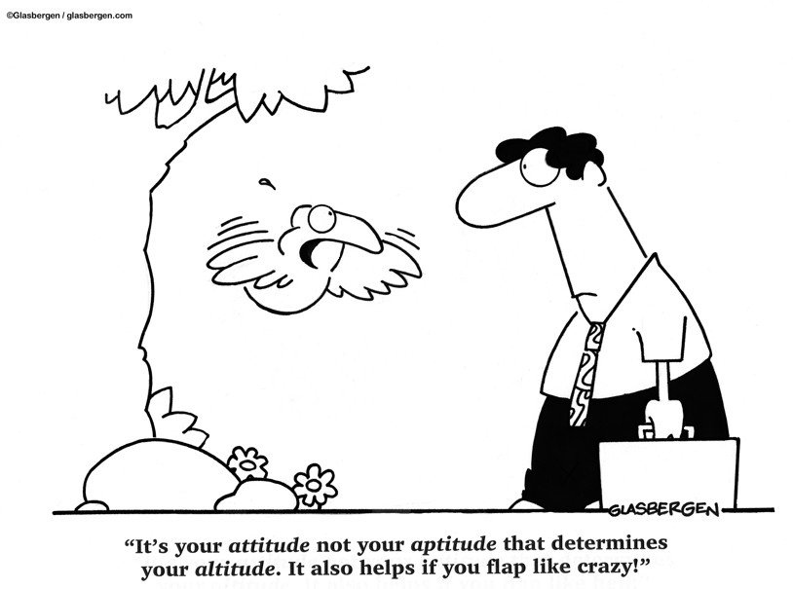
Before we start
This slide carries a very important message
(c) Glasbergen.com
(Reproduced with permission)
The STEM Cell

Slide 3
What is DNA?
Monday, September 6, 2021
An introduction to the "Building Blocks"
Of Life
The STEM Cell

Slide 4
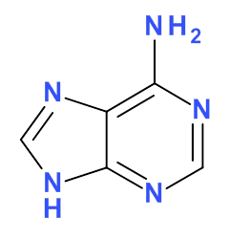
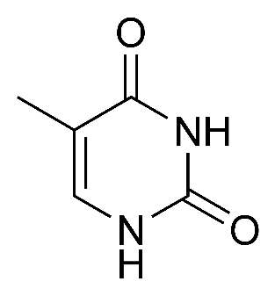
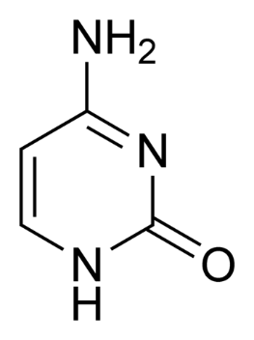
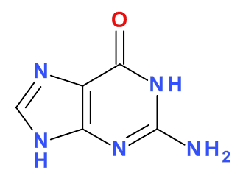
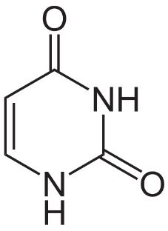
Monday, September 6, 2021
DNA stands for “Deoxyribonucleic Acid” and is the chemical substance that makes up all cells.
ALL animal and plant cells contain DNA in the nucleus, it is a very long molecule, a POLYMER and contains the coded information required to make organisms.
Try to imagine having an alphabet with ONLY FOUR letters (with the occasional use of a 5th), but being able to make ALL of the words you will EVER need with that alphabet….. these are the four words:
Adenine
Thymine
Cytosine
Guanine
Uracil (replaces Thymine in mRNA)
The STEM Cell

Slide 5
Monday, September 6, 2021
Adenine
Thymine
Cytosine
Guanine
Uracil (replaces Thymine in mRNA)
A
T
C
G
U
Each of the five molecules shown is called a “base”. A “base” joins with a PHOSPHATE [PO₄]³⁻ group and a SUGAR molecule (Deoxyribose) to make a NUCLEOTIDE.
To make things a bit simpler, we only use the LETTER of the base when we talk about DNA and what it can make.
The STEM Cell

Slide 6
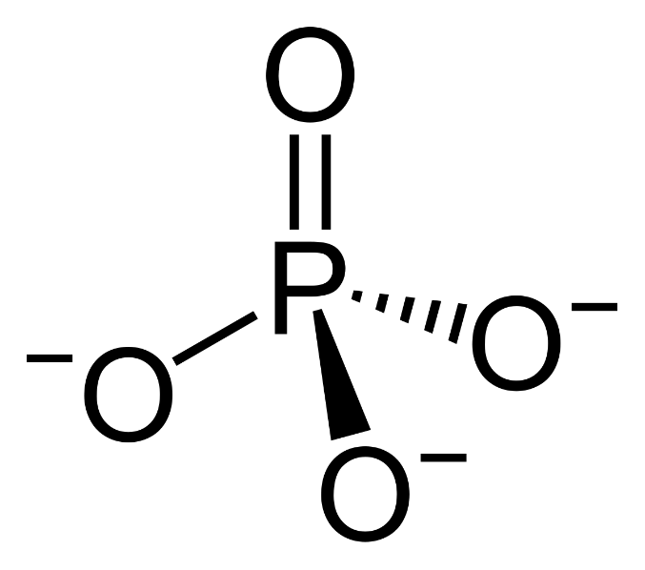
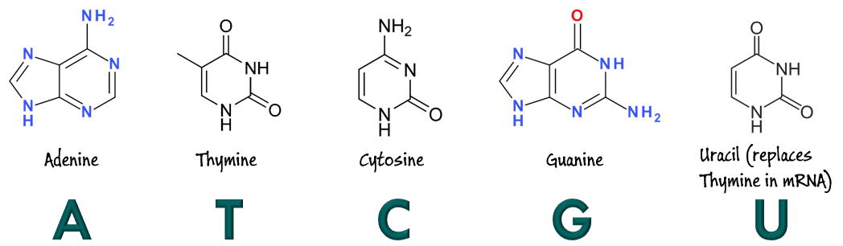
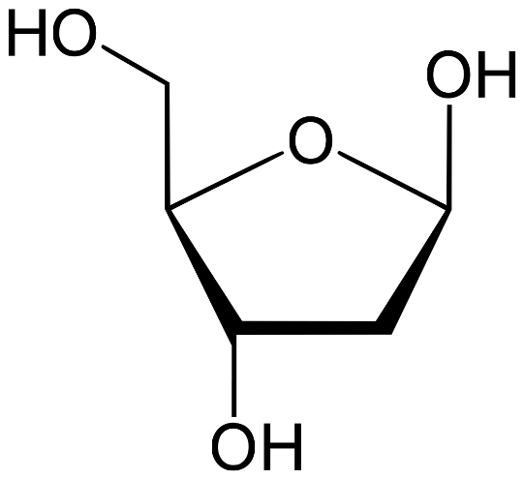
Monday, September 6, 2021
A phosphate group, a deoxyribose molecule and one of four ‘bases’ (A T C G)will make up a NUCLEOTIDE unit.
The STEM Cell

Slide 7
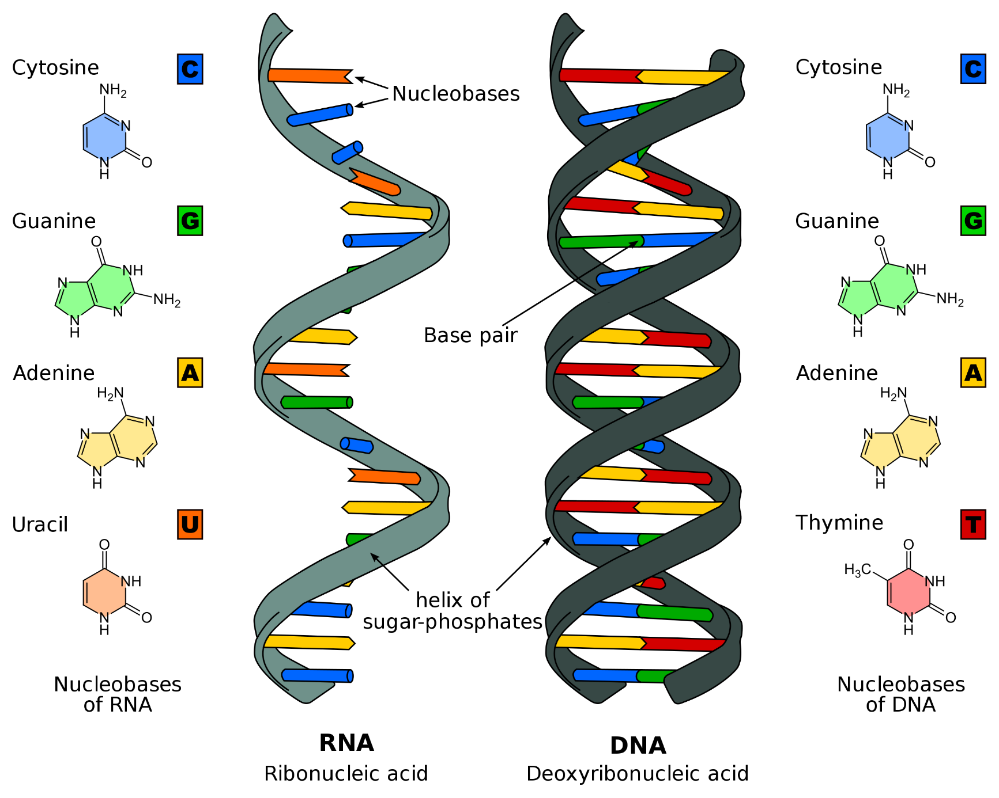
Monday, September 6, 2021
Note that in the DNA model we use the bases:
C G A T
In the mRNA model we use the bases:
C G A U
BUT – now we have introduced a new player – mRNA which is “messenger RNA” and this is the holder of the template for a protein to be created.
The STEM Cell

Slide 8
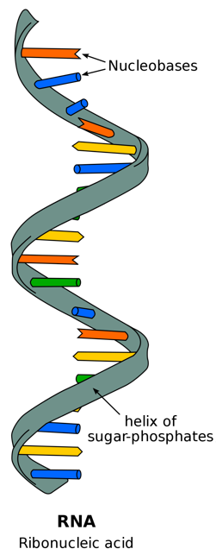
Monday, September 6, 2021
DNA is too large to leave the nucleus. The nuclear membrane is porous but the pores are too small to allow DNA out.
Chemical processes (RNA Polymerase) “splits” or “unwinds” the double helix of the DNA into a single strand, much like sawing a wooden ladder in half by cutting each rung in the middle,
This “messenger RNA” or mRNA holds the sequence of required bases to recreate the double helix in the creation of the protein. mRNA is small enough to slip out of the nucleus through the pores.
This is the sequence that the image to the left shows, drawn simply like a comb lying on its back:
U C C U
A C G G
A U G C
U A G A
C A C
Remember that each set of 3 bases codes for a specific Amino Acid, so for example the three bases UCC would code for TCC (Uracil replaces Thymine in mRNA) and this would require the amino acid with the complementary base codes of AGG)
The STEM Cell

Slide 9
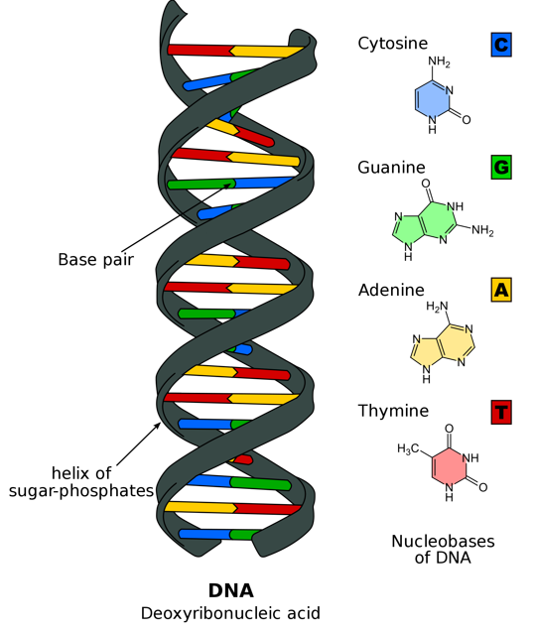
Monday, September 6, 2021
The bases pair up in the following way:
A
T
C
G
A simple way to remember this is to remember the number 82 …….. A-T-2 which indicates that the DOUBLE bond occurs between Adenine and Thymine (so the triple bond must occur between Cytosine and Guanine)
A G G A T G C C T A C G A T C T G T G
U C C U
A C G G
A U G C
U A G A
C A C
The STEM Cell

Slide 10
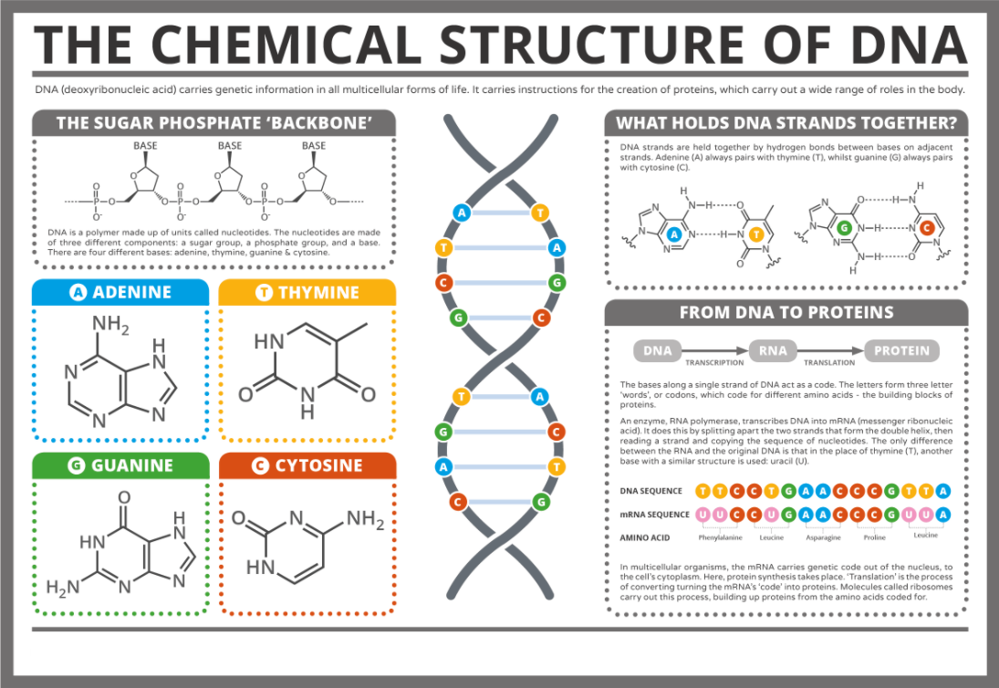
Monday, September 6, 2021
The STEM Cell

Slide 11
Monday, September 6, 2021
denine
ytosine
hymine
uanine
1. Name the 4 bases: A ________ C________ T________ and G________
Uracil
2. Name the base that replaces T in mRNA : _________________
False
3. The nucleotides with bases G and C are double bonded to form the DNA helix: True or False? ____________
Messenger
4. What does the “m” stand for in mRNA? ___________________
False
5. The sugar “Deoxyribose” which is a key component of a Nucleotide is a Hexose sugar, true or false ? ____________
The STEM Cell

