Slide 1

Communicable Diseases
The STEM Cell

Slide 2

Before we start
This slide carries a very important message
(c) Glasbergen.com
(Reproduced with permission)
The STEM Cell

Slide 3
Communicable Diseases
Sunday, September 26, 2021
The STEM Cell

Slide 4
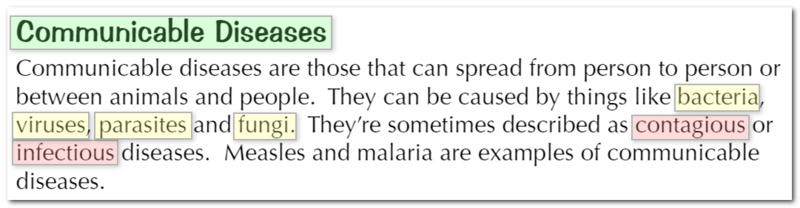
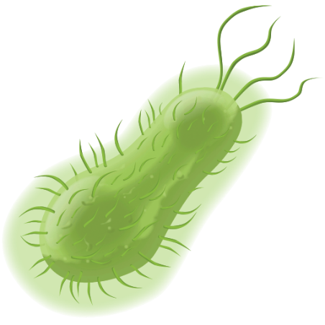
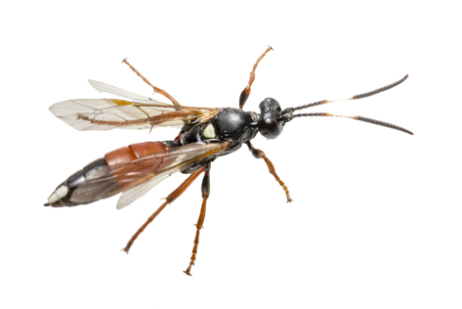
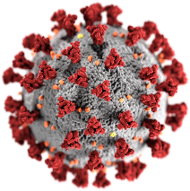
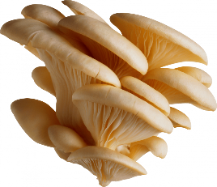
Communicable Diseases
Sunday, September 26, 2021
Communicable Diseases are caused by Pathogens which enter the body. These are usually categorised as:
Bacteria
Protists
(Parasites)
Viruses
Fungi
The STEM Cell

Slide 5
Communicable Diseases
Sunday, September 26, 2021
Bacteria are very small, being about 100th of the size of your body cells.
They reproduce rapidly and produce poisons when they do it. It is the poisons that they produce which make you feel ill.
An example of such a bacteria is Salmonella, the common bacteria which gives you food poisoning..
The STEM Cell

Slide 6
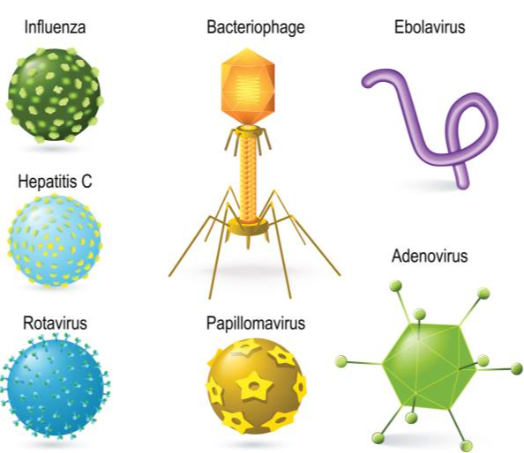
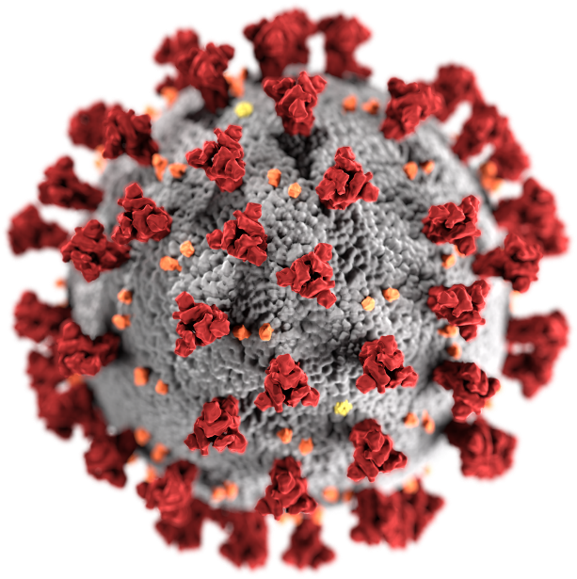
Communicable Diseases
Sunday, September 26, 2021
Viruses are even smaller than bacteria, about 100th of the size of the bacteria (or about a 10,000th of the size of the body cells).
Perhaps the most famous virus at the moment, is the coronavirus, which is responsible for the disease, COVID-19
The STEM Cell

Slide 7
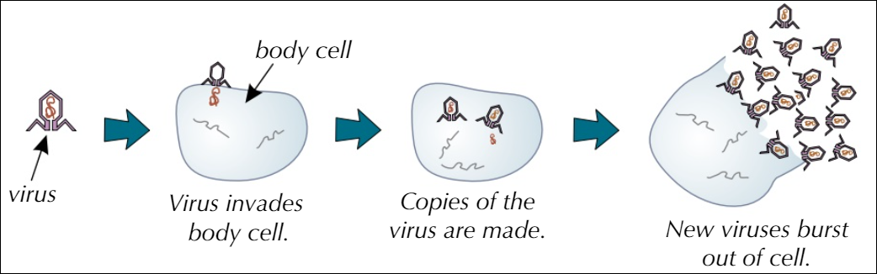
Communicable Diseases
Sunday, September 26, 2021
Viruses live inside the body cells where they reproduce rapidly. Eventually they burst out of the cell, destroying it. It is this cellular damage which makes you feel ill.
The STEM Cell

Slide 8
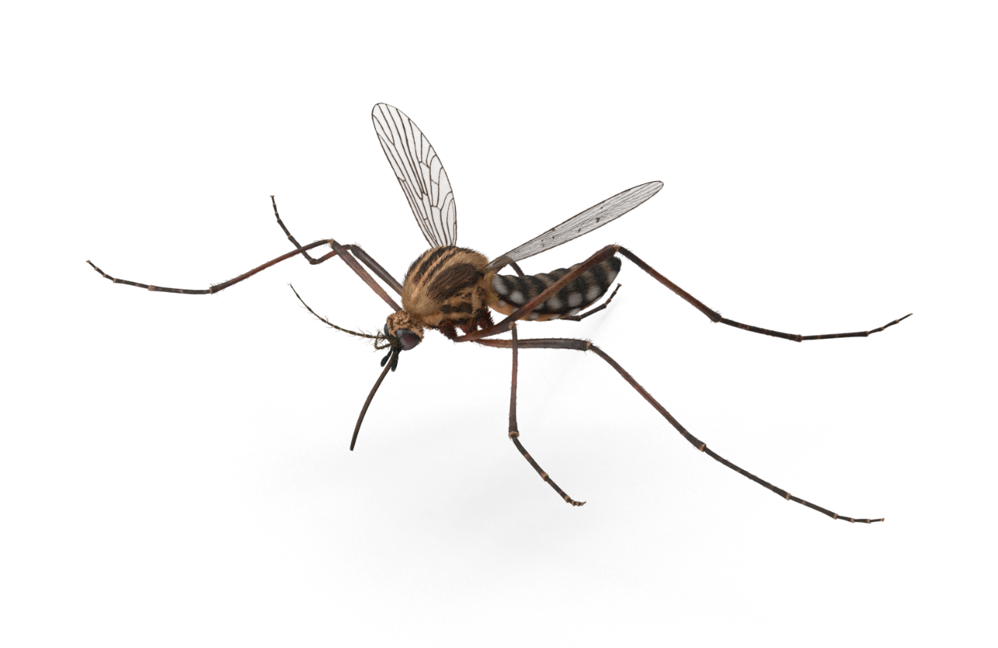
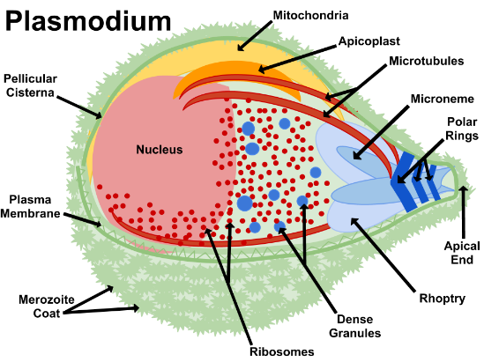
Communicable Diseases
Sunday, September 26, 2021
There are many kinds of Protist, they are generally eukaryotes that live inside the host.
The protist is usually carried to the host by a "carrier" such as insect which does not itself get the disease that the protist causes. This carrier is sometimes referred to as a "vector".
The symptoms of malaria include fever, sweats, chills, headaches and vomiting as well as diarrhoea. Approximately 200,000,000 people a year contract malaria, of which almost half of them will die from it.
The Plasmodium protist is carried to the host by the mosquito, and passed to the host when the mosquito feeds on blood. This Plasmodium protist causes the disease Malaria.
The STEM Cell

Slide 9
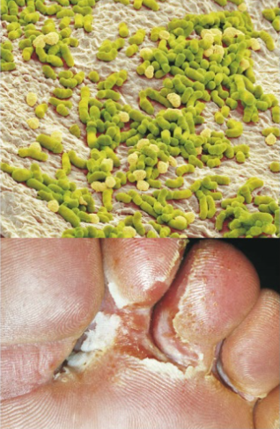
Communicable Diseases
Sunday, September 26, 2021
Fungal infection - Some fungi are single celled organisms while others are made up of hyphae which are threadlike structures. These threadlike structures can grow and penetrate the skin and can also produce spores which can be spread to other plants and animals.
A common example of a fungal infection is "athlete's foot" which causes the skin to become itchy, brittle and break away into flakes. Athlete's foot is spread by contact with such things as changing room floors, showers and an infected person's towels.
The STEM Cell

Slide 10
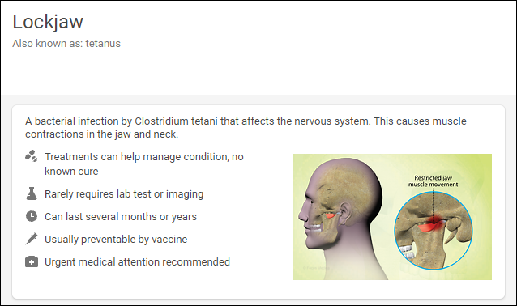
Communicable Diseases
Sunday, September 26, 2021
Q1. Clostridium Tetani is a bacteria. It causes the infection known as Tetanus and usually enters the body through deep cuts.
Discuss how you think this bacteria might make you feel ill?
The STEM Cell

Slide 11
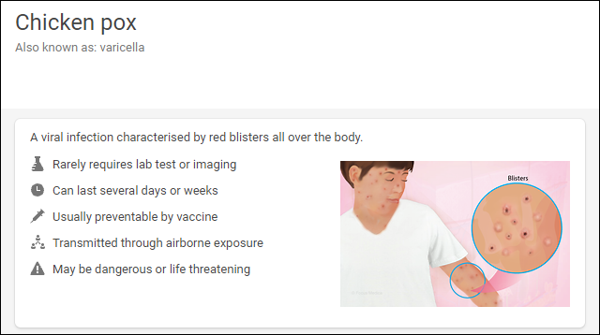
Communicable Diseases
Sunday, September 26, 2021
Q2. The pathogen that causes Chickenpox is a virus. It can be carried in the air (airborne) in droplets of water.
Suggest how a person such as a student in the classroom could infect another student sitting in another part of the same classroom.
The STEM Cell

Slide 12
Communicable Diseases
Sunday, September 26, 2021
Viruses
These organisms reproduce inside the body and produce toxins (poisons) when they do. The presence of these poisons are what make you feel ill.
Bacteria
These organisms are often single celled, eukaryotes. They are transported by "vectors" which do not contract the illness themselves.
Fungi
These reproduce rapidly inside the cell, eventually they burst out of the cell (killing it). It is this cell destruction which causes the feeling of illness
Protists
These organisms can be spread by contact and can cause such infections as Athlete's Foot.
The STEM Cell

