Slide 1

Concentrations
Amount of Solute in Solutions
The STEM Cell

Slide 2

Before we start
This slide carries a very important message
(c) Glasbergen.com
(Reproduced with permission)
The STEM Cell

Slide 3
Concentrations
Amount of Solute in Solutions
The STEM Cell

Slide 4
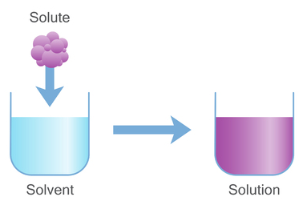
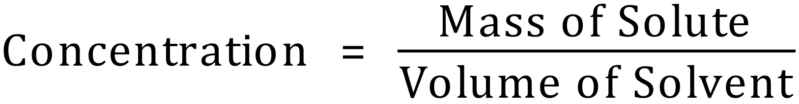
Sunday, October 31, 2021
Solutions are mixtures containing a "solute" dissolved in a "solvent". Sometimes this is referred to as the strength of the solution, but more properly should be regarded as its concentration.
We calculate the concentration of a solution by dividing the mass of the solute by the volume of the solvent:
To calculate the concentration will you need to know the mass of the solute, or the number of moles if you wish to refer to the concentration in moles per litre.
We will now look at a quick reminder of moles before we carry on.
The STEM Cell

Slide 5
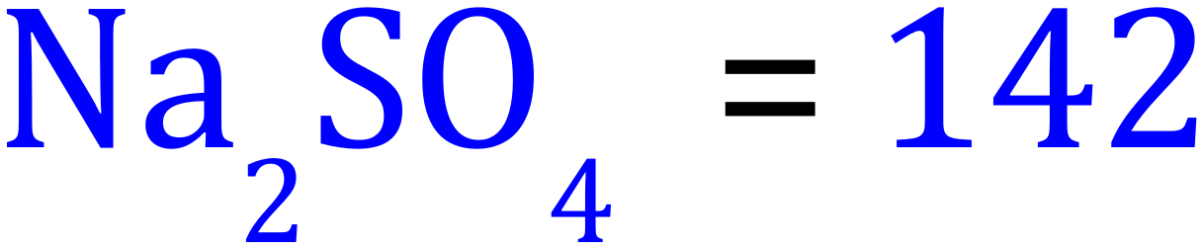
Sunday, October 31, 2021
Moles of a substance is the RMM expressed in Grams
A “molar” solution of Sodium Sulphate would have a concentration of 142g per dm³ or 142g per litre.
Volume is usually expressed in Litres, Decimetre Cubed (dm³) or cm³ / ml
Concentration can be Moles per Litre / dm³ or grams per litre / dm³
The STEM Cell

Slide 6
Sunday, October 31, 2021
Calculate the concentrations of the following solutions in “grams per litre”:
1. 25g Sodium Chloride dissolved in 1000 cm³ water.
Na = 23 | Cl = 35.5 | H = 1
S = 32 | O = 16
2. 98g Sulphuric Acid dissolved in 500 cm³ water.
3. 20g Sodium Hydroxide dissolved in 125 cm³ water.
Now … calculate the concentrations of the above solutions in “moles per litre” using the relative atomic mass data in the table.
The STEM Cell

Slide 7
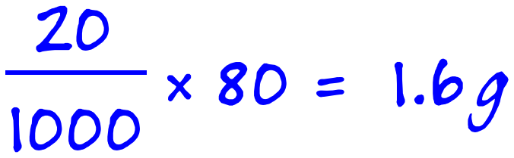
Sunday, October 31, 2021
We can reverse the operation, and given a volume and the concentration of the solution we can calculate the mass the solute in it. Let's take a look at an example:
Q. What is the mass of copper chloride in 20 cm³ of an 80 g/dm³ solution?
Step 1 - we know that a 1 dm³ is 1000 cm³ so effectively we have been told that we have 80 g of copper chloride in 1000 cm³
Q. What is the Molarity of copper chloride in an 80 g/dm³ solution?
Step 1 - In this case we need the relative atomic masses of copper and chlorine as we need to calculate the mass of one mole of the compound. Copper (63.5) and chlorine (35.5). The chemical formula is CuCl₂.
The STEM Cell

Slide 8
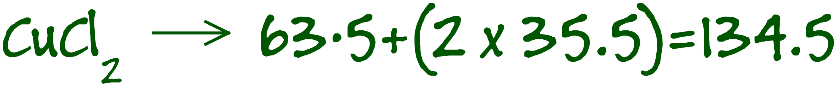
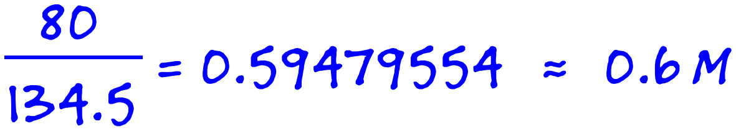
Sunday, October 31, 2021
Q. What is the Molarity of copper chloride in an 80 g/dm³ solution?
Step 1 - In this case we need the relative atomic masses of copper and chlorine as we need to calculate the mass of one mole of the compound. Copper (63.5) and chlorine (35.5). The chemical formula is CuCl₂.
This tells us that 134.5g of copper chloride would be present in a molar solution. The molarity of an 80 g/dm3 solution would be:
The STEM Cell

Slide 9
Sunday, October 31, 2021
Q. What mass of NaCl would be required to make 250 cm³ of a 3M solution?
43.875g
Q. What mass of Mg(NO₃)₂ would be required to make 50 cm³ of a 0.5M solution?
3.7g
Q. A student states that 5cm³ of 2M Ca(OH)₂ solution contains 0.85g Ca(OH)₂ , is this correct?
No = 0.74g
So, why do things dissolve in the first place. There are a number of factors to consider generally whether a substance dissolves or not depends on the polarity of the solute and solvent:
The STEM Cell

Slide 10
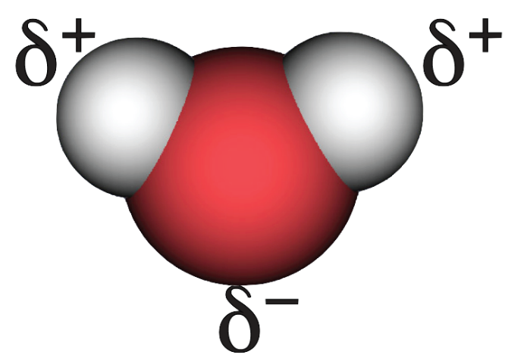



Sunday, October 31, 2021
When making solutions, can we continue to dissolve the solute indefinitely? The answer to this is of course no, let's take a look at why.
Water is a polar molecule with partial positive charge on each hydrogen atom and partial negative charge on the oxygen atom. This polarity is shown in the following figure:
Ionic solids like sodium chloride, by definition, contain cations and anions. As a result, when an ionic solid such as sodium chloride is placed into water, we see the following take place:
When sodium chloride is placed into water, the partial positive charges on the hydrogen atoms in water are attracted to the negatively charged chloride ions. Likewise, the partial negative charges on the oxygen atoms in water are attracted to the positively charged sodium ions.
Because the attractions of the water molecules for the sodium and chloride ions are greater than the forces holding the crystal together, the salt dissolves. When a solute dissolves in water, the process is referred to as hydration.
The STEM Cell

Slide 11
Sunday, October 31, 2021
When making solutions, can we continue to dissolve the solute indefinitely? The answer to this is of course no, let's take a look at why.
Water is a polar molecule with partial positive charge on each hydrogen atom and partial negative charge on the oxygen atom. This polarity is shown in the following figure:
Ionic solids like sodium chloride, by definition, contain cations and anions. As a result, when an ionic solid such as sodium chloride is placed into water, we see the following take place:
The solvent molecules manage to overcome the strength of the lattice, this causes the lattice to fall apart and so the solute (in this case NaCl) dissolves.
There will come a point when there is either no solvent left, or so few solvent molecules that the force of attraction between ions in the lattice can no longer be broken. When this point is reached the solute stops dissolving.
We have reached "saturation".
The STEM Cell

Slide 12
Sunday, October 31, 2021
The amount of solute present in a solution can be described without numbers by one of the following terms:
Unsaturated: "Unsaturated" refers to any solution that is still capable of dissolving more of a solute. For example, a glass of iced tea is not saturated with sugar if you've placed one tablespoon of sugar in it because it's still capable of dissolving more sugar. This term isn't very good for determining the exact quantity of solute present? For example, both a glass of water and a filled swimming pool would be said to be unsaturated salt solutions if there were one gram of salt dissolved in each.
Saturated: These solutions have dissolved the maximum possible amount of solute. For example, if you keep adding sugar to a glass of fizzy drink, it will eventually stop dissolving and settle to the bottom. This solution is said to be saturated.
Supersaturated: These solutions are those that have dissolved more than the normal maximum possible amount of solute. These solutions are unusual and aren't very stable. For example, the addition of a small mote of dust to such a solution causes enough of a disturbance that crystals spontaneously form until the solution reaches a saturated state.
It's easy to tell if a solution is unsaturated, saturated, or supersaturated by adding a very small amount of solute. If the solution is unsaturated, the solute will dissolve. If the solution is saturated, it won't. If the solution is supersaturated, crystals will very quickly form around the solute you've added.
The STEM Cell

