Slide 1

Bearings
The STEM Cell
www.thestemcell.net

Slide 2

Before we start
This slide carries a very important message
(c) Glasbergen.com
(Reproduced with permission)
The STEM Cell

Slide 3
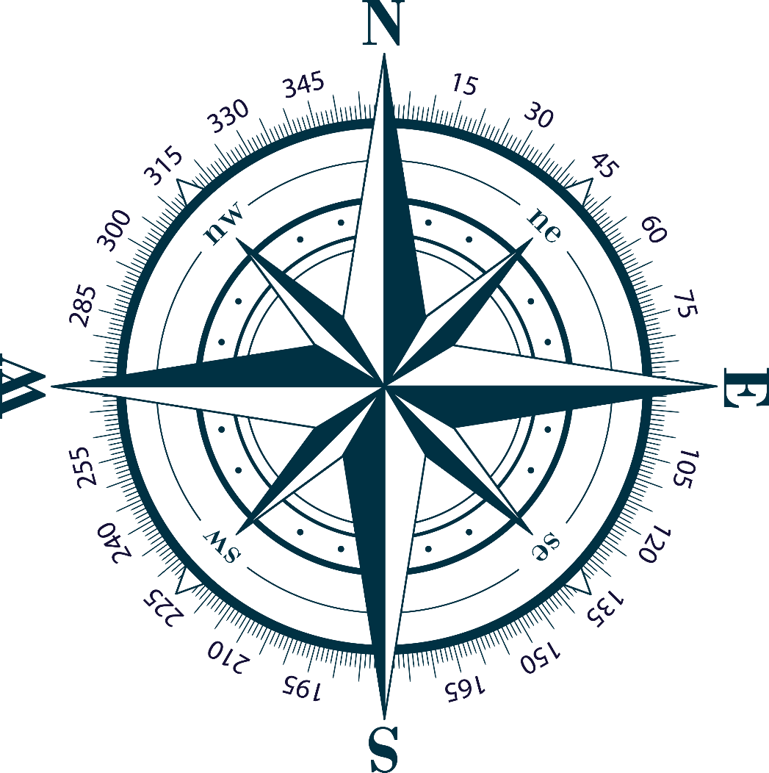
Monday, May 30, 2022
In mathematics, a bearing is the angle in degrees measured clockwise from north:
When we use bearings, we express the values in 3 digits, so for example if we travelled East from a point, we would say that we “ take a bearing of 090^{o “}
Ships and Aircraft navigators will use bearings to calculate direction of travel. You won’t hear a navigator telling the Captain to “turn left” !!
On the next slide we will look at some bearings by moving a hypothetical ship on a grid.
The STEM Cell
www.thestemcell.net

Slide 4
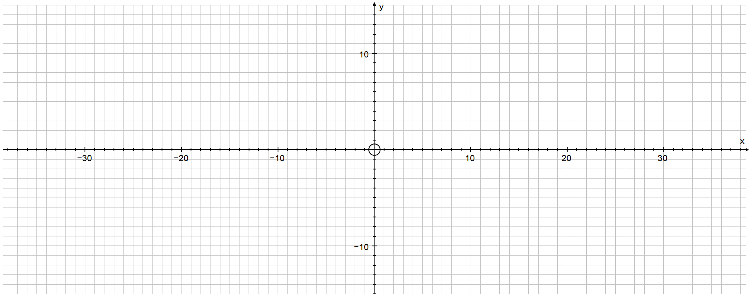

Monday, May 30, 2022
The rocket ship below is travelling North for 10 miles from the point it is presently at:
The rocket travels 34 miles East on a bearing 090º
What is the rocket’s required bearing to return to the starting point?
Work out its final position then continue to see if you are correct.
The STEM Cell
www.thestemcell.net

Slide 5
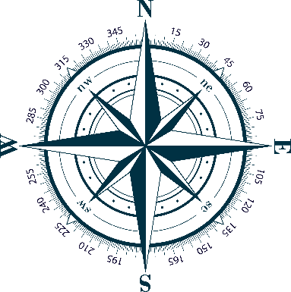
Monday, May 30, 2022
There are a couple of ways to work out the bearing, but we will simply use a compass.
Remembering that bearings are clockwise from 000º North, our rocket ship will take a course of 255º to return home.
The STEM Cell
www.thestemcell.net

Slide 6
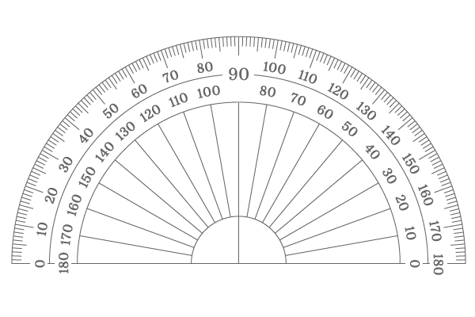

Monday, May 30, 2022
A car leaves town and travels 29.5 km on a bearing 300º, then 35 km on a bearing 090º. Calculate the bearing it now has to travel to get back to town.
The missing angle is 27.5º and if we add 180º to this, the resulting bearing (and the answer) is 207.5º
The easiest way is to drop a vertical line from the current location. Due South is 180º so all we need now is the number of degrees from this line….
There are mathematical ways to calculate these angles AND the distances but they involve the SINE and COSINE rules which we will encounter much later.
The STEM Cell
www.thestemcell.net

Slide 7
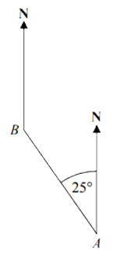
Monday, May 30, 2022
A student states that the bearing from Point A to Point B is 25º as shown.
Is this correct? – explain your answer.
No this is incorrect. Remember that bearings are measured from the North but CLOCKWISE so the angle (bearing) would be:
THE NEXT TWO EXAMPLES ARE ACTUAL GCSE QUESTIONS !
The STEM Cell
www.thestemcell.net

Slide 8
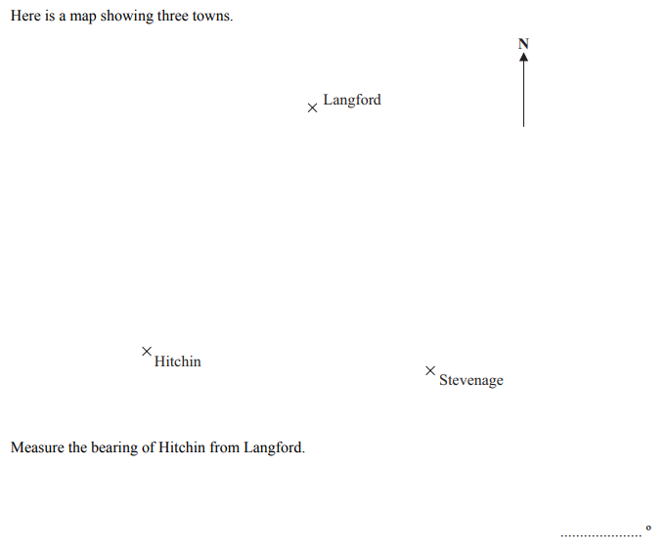
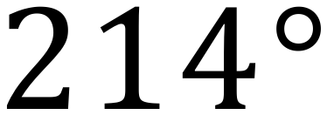
Monday, May 30, 2022
Step 1 – drop a vertical N-S line through Langford.
Step 2 – connect Langford to Hitchin
Step 3 – use a protractor to measure the angle at the intersection of the lines (at Langford), then ADD this value to 180. You now have the bearing as requested.
The STEM Cell
www.thestemcell.net

Slide 9
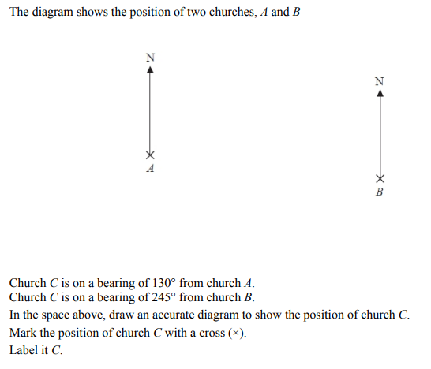
Monday, May 30, 2022
Step 1 – use a protractor to draw a line from church A at the bearing 130º
Step 2 – use a protractor to draw a line from church B at the bearing 245º
Note – do this by measuring the angle from NORTH, anticlockwise at a value of 360-245=115 degrees.
Step 3 – you have located Church C, label it.
x
C
The STEM Cell
www.thestemcell.net

Slide 10
Monday, May 30, 2022
The STEM Cell
www.thestemcell.net

