Slide 1

The Quadratic Formula
Finding The Roots Of A Quadratic Equation
The STEM Cell
www.thestemcell.net

Slide 2

Before we start
This slide carries a very important message
(c) Glasbergen.com
(Reproduced with permission)
The STEM Cell

Slide 3
The Quadratic Formula
Finding The Roots Of A Quadratic Equation
Finding The Roots Of A Quadratic Equation
The STEM Cell
www.thestemcell.net

Slide 4
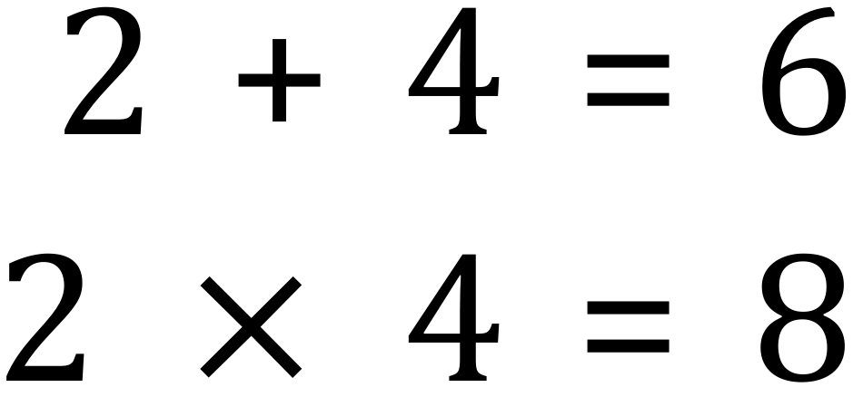
Solving quadratic equations can be performed in a number of ways. One way would be to find the factors of the coefficient term and use these to split the linear term:
The method used here is to find two factors of the constant value (c, or +8 in this case) which ADD to produce the linear coefficient (b, or +6 in this case). In this particular example we find that the factors of 8 being +2 and +4 work well, so we use these and split the linear coefficient as shown.
Now that we have 4 terms in our newly modified quadratic expression, we ‘pair’ them up and factorise.
The STEM Cell
www.thestemcell.net

Slide 5
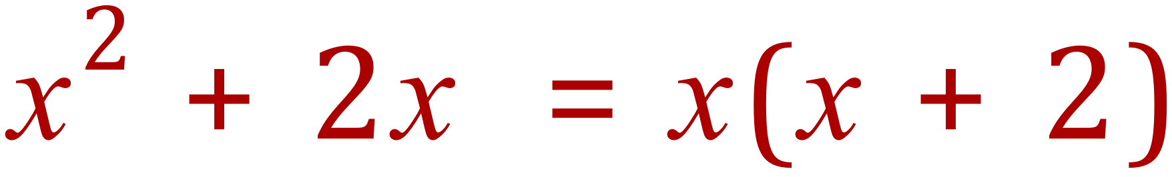
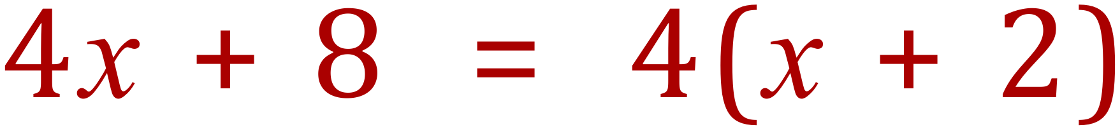
Split and factorise:
Collect terms:
Expand the bracketed pair to satisfy yourself that the original expression is factorised correctly
The STEM Cell
www.thestemcell.net

Slide 6
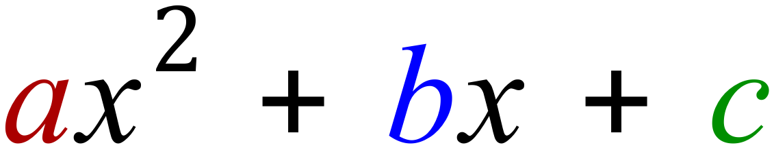
The Quadratic Formula
Let's look at the GENERAL formula for a Quadratic expression:
The Quadratic Coefficient
The Linear Coefficient
The Constant Value
It is important to remember that EACH of the coefficients and the constant will have its own sign (ie: positive or negative) aligned to it. The black “+” signs show the fixed operation BUT the independent sign of the coefficient/constant may change this.
The STEM Cell
www.thestemcell.net

Slide 7
The Quadratic Formula
It is important to remember that EACH of the coefficients and the constant will have its own sign (ie: positive or negative) aligned to it. The black “+” signs show the fixed operation BUT the independent sign of the coefficient/constant may change this.
This may seem very confusing but it will become clearer as you get more used to these expressions, It is IMPERATIVE that you understand the importance of signs.
The STEM Cell
www.thestemcell.net

Slide 8
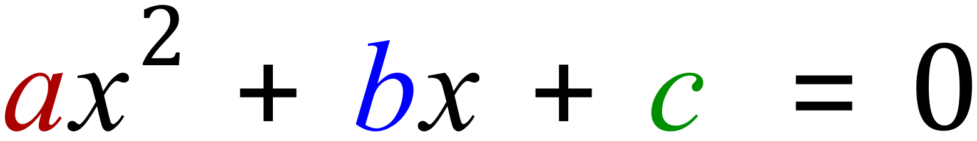
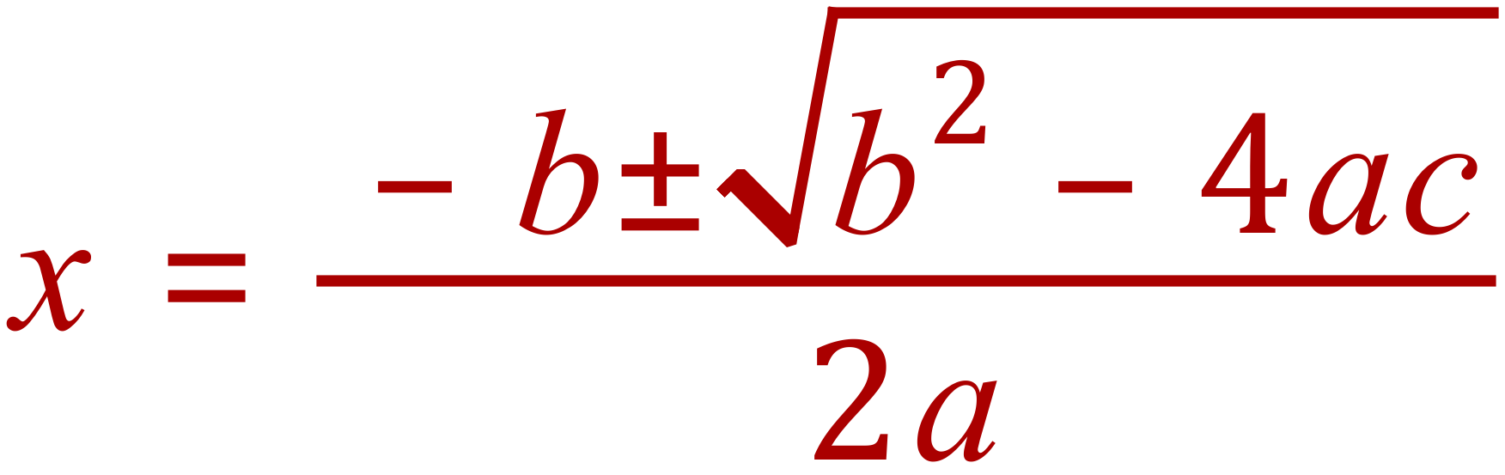
The Quadratic Formula
Now that the definitions and values of the coefficients and constants have been introduced we can now look at the QUADRATIC FORMULA which allows us to ‘plug in’ their respective values and obtain values for ‘x’ that would satisfy a QUADRATIC EQUATION:
Note that this is no longer an EXPRESSION, it is a QUADRATIC EQUATION as there is an EQUALITY that makes both sides equal. There can be up to 2 values of ‘x’ that might satisfy the equation, according to:
The STEM Cell
www.thestemcell.net

Slide 9
The Quadratic Formula
When you are working on a problem using this equation it is good practice to make a note (perhaps in a small table) of the values of a, b and c with their signs and then prepare your solution.
Let’s look at the next slide which will show a worked example using the formula.
The STEM Cell
www.thestemcell.net

Slide 10
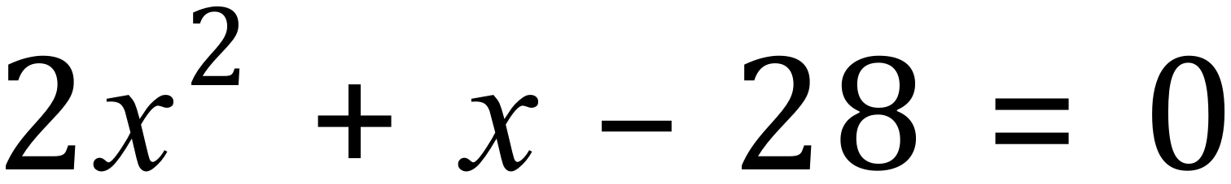
The Quadratic Formula
a | b | c
+2 | +1 | -28
First of all, satisfy yourself that the values of a, b and c are in fact correct. Only at this point should you start ‘plugging in’.
On the next slide I will expand the formula to show you why there could be 2 solutions (roots).
The STEM Cell
www.thestemcell.net

Slide 11
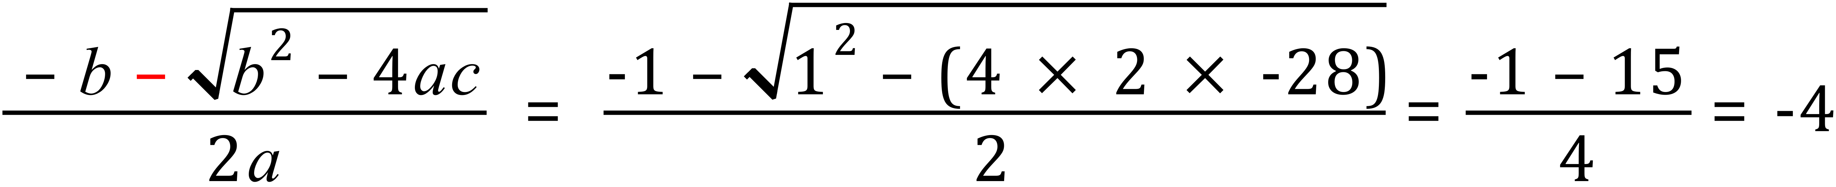
The Quadratic Formula
Substituting the values for a, b and c will provide 2 roots, or none at all. Sometimes the roots will be identical.
The STEM Cell
www.thestemcell.net

Slide 12
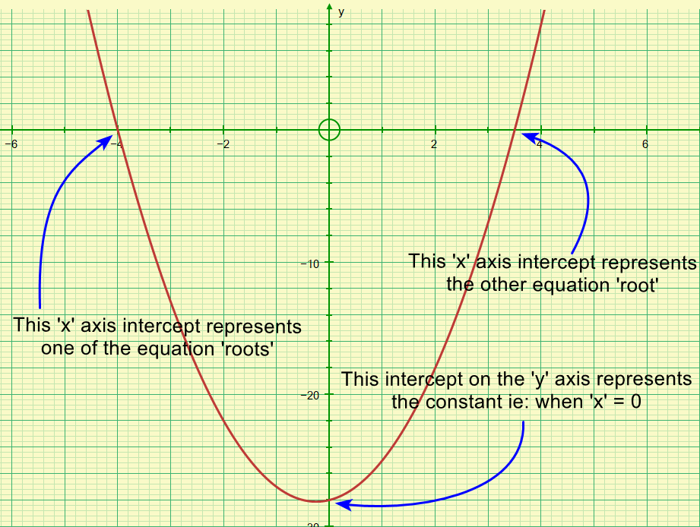
The Quadratic Formula
The STEM Cell
www.thestemcell.net

Slide 13
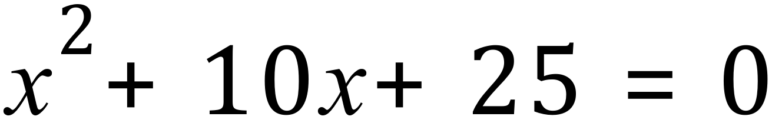
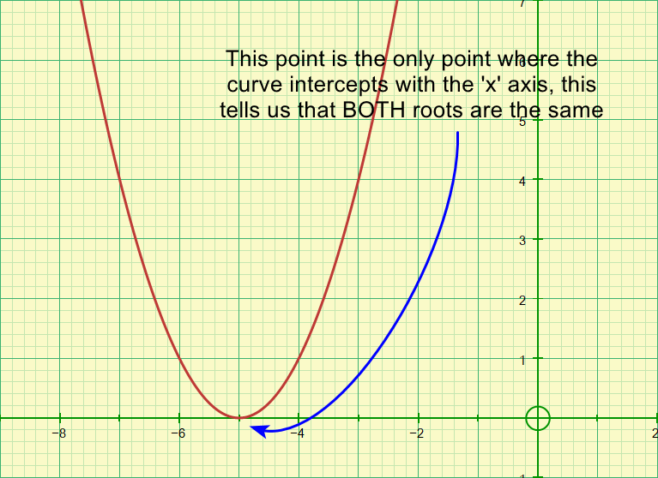
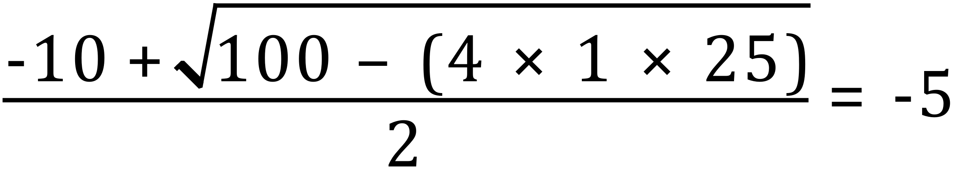
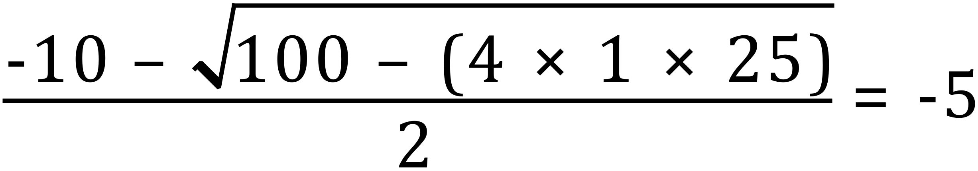
The Quadratic Formula
When there is a duplicated root, ie: still two solutions but they are identical:
a | +1
b | +10
c | +25
The STEM Cell
www.thestemcell.net

Slide 14
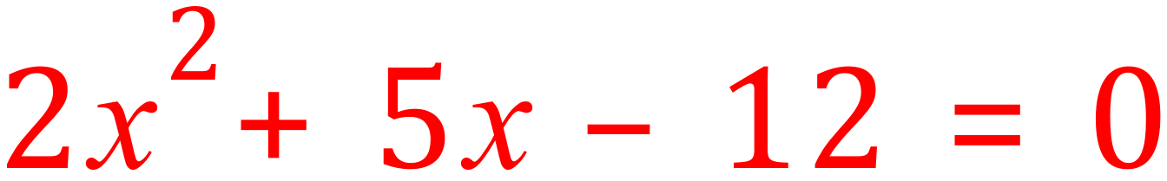
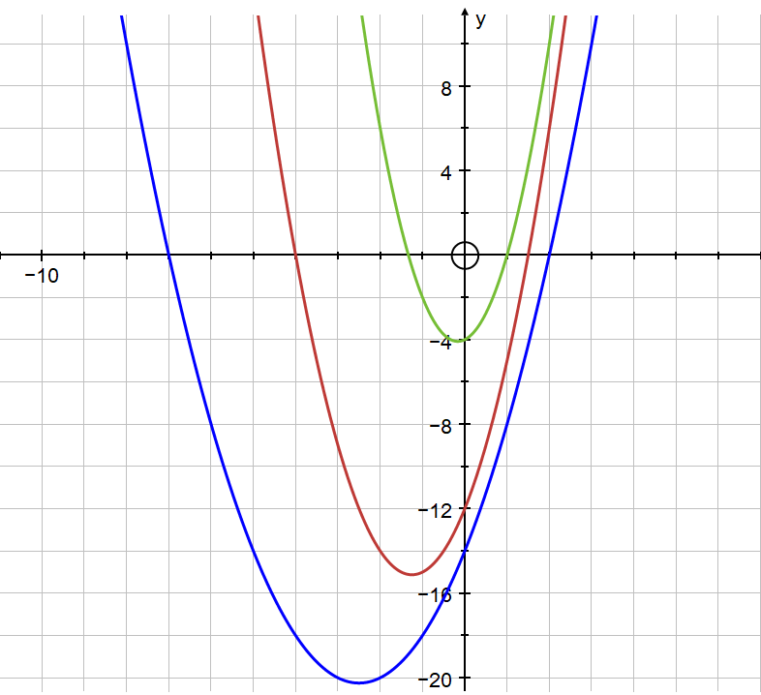
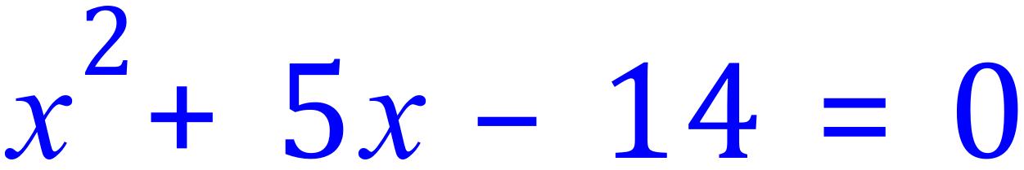
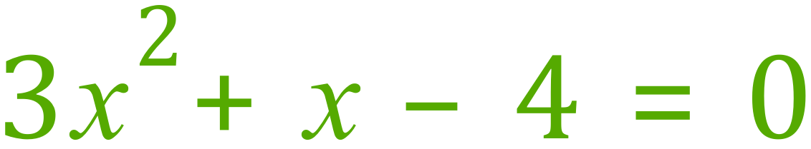
The Quadratic Formula – Over To You…
Check the solutions you get with the graph.
Pay attention to the intercepts on both ‘x’ and ‘y’ axes (remember the ‘y’ intercepts are the constants -12, -14 and -4)
The STEM Cell
www.thestemcell.net

