Slide 1

Vectors
Magnitude and Direction
The STEM Cell

Slide 2

Before we start
This slide carries a very important message
(c) Glasbergen.com
(Reproduced with permission)
The STEM Cell

Slide 3
Vectors
Magnitude and Direction
The STEM Cell

Slide 4
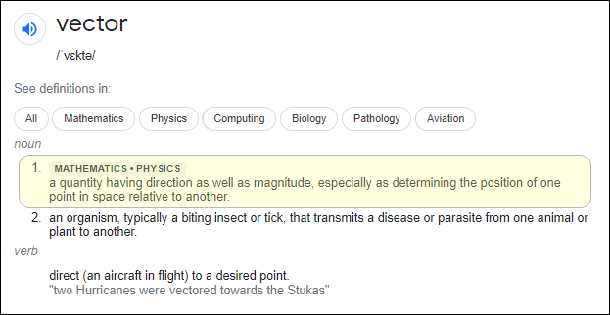
What do we mean when we say "Vector"?
"Vector“ – a scientific and mathematical expression indicating the properties of a quantity having a magnitude (size) and a direction.
The STEM Cell

Slide 5
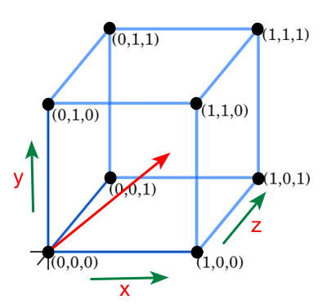
When an object moves from one point to another, it usually moves in a straight line.
This movement can be thought of as movement by a certain amount in the three dimensions of space, each of which is combined with the other to show both the overall direction, and size of the movement:
In this presentation we will be looking at movement in the “x” and “y” axes alone, in other words, only in 2 dimensions.
The STEM Cell

Slide 6

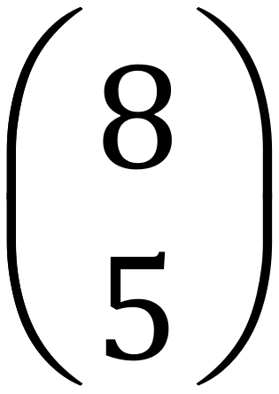
How do we show a vector?
A vector is shown as a straight line, from one point to another. The direction of the vector is obvious, and is broken into its movements along the 2 dimensions “x” and “y”. The size / magnitude of the vector is indicated by the length of the drawn line.
The green line is a vector from the origin point O to the point P
y
The vector is written as:
5
P
Or as a column with the “x” and “y” components (x at the top)
O
x
8
The STEM Cell

Slide 7
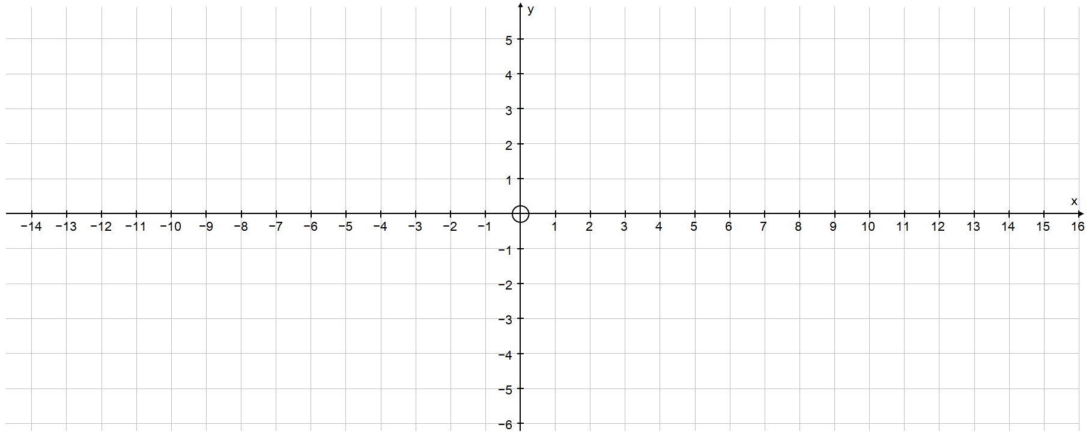
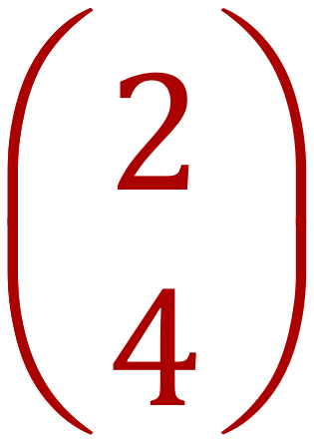
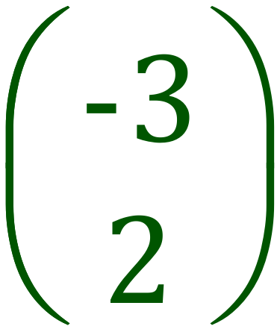
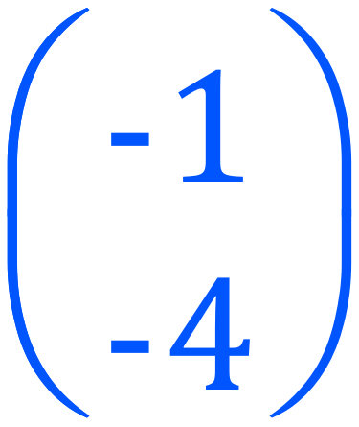
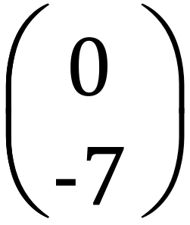
Draw Vectors – Choose an origin unless specified:
The STEM Cell

Slide 8
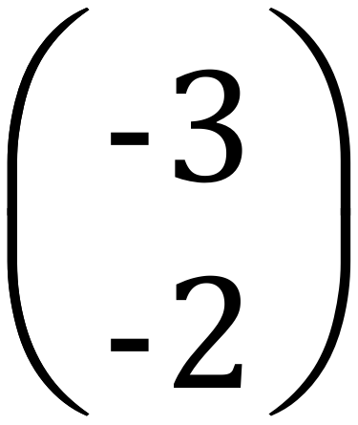
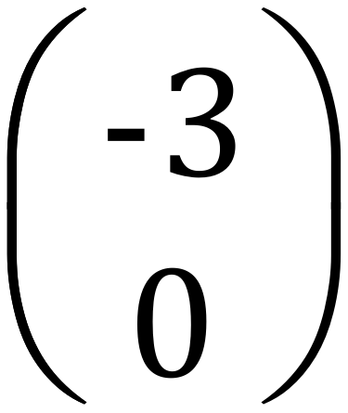
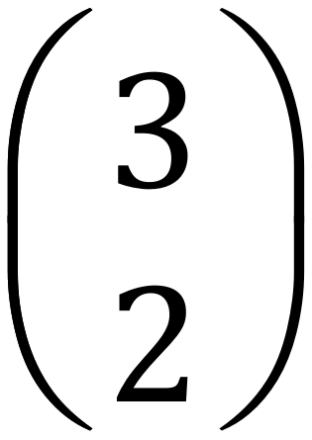
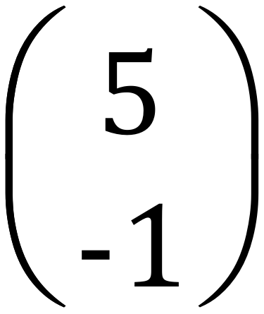
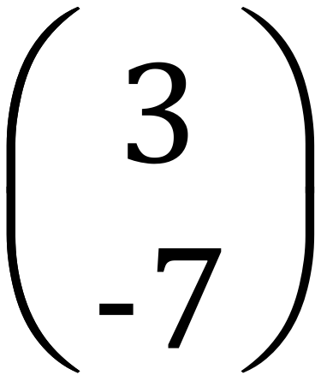
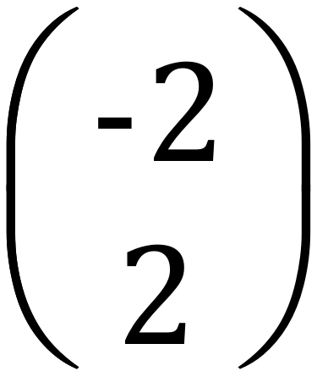
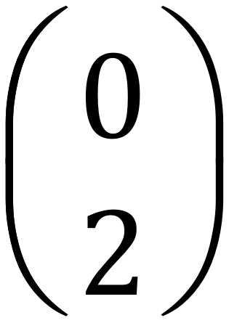
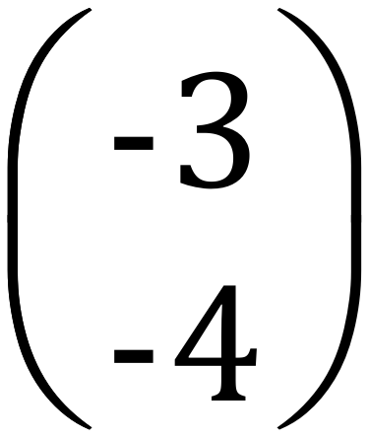
Column Vectors – Write the Column Vector for each arrow:
The STEM Cell

Slide 9
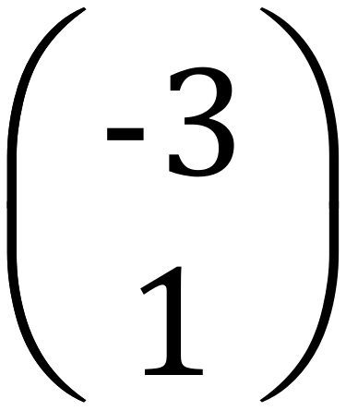
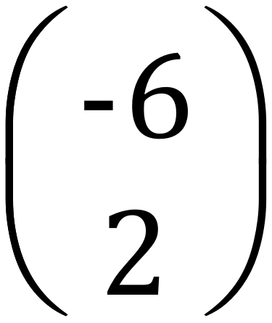
Scalars
A scalar is a number, it has magnitude but no direction. A vector can be multiplied by a scalar to give a new vector, which will be parallel to the original vector (and on top if the origin is the same):
Multiplying P by the scalar 2 gives the new vector:
P =
2P = 2 x
=
P
The STEM Cell

Slide 10
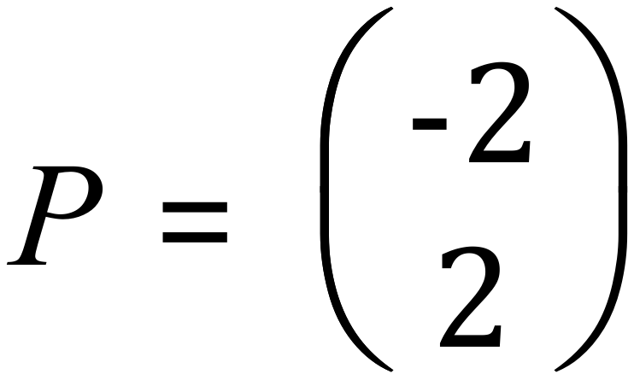
Draw Vectors P, 2P, 3/2P and -3P (Use any start point)
3/2P
P
-3P
2P
Note that if the scalar is negative, the direction of the new vector is reversed.
The STEM Cell

Slide 11
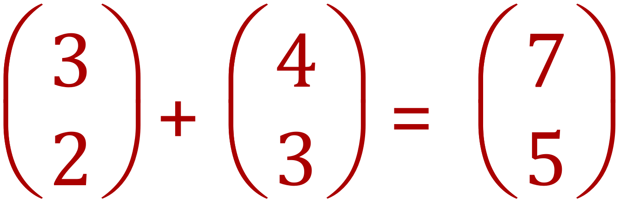
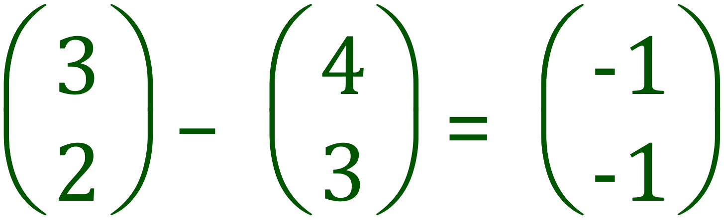
Vector Addition and Subtraction
Vectors can be added or subtracted by adding and subtracting the respective “x” and “y” components, this will produce a NEW vector which is called the RESULTANT.
Vector Addition
Vector Subtraction
Vectors can be added by drawing them as a “linked chain” nose-to-tail with the resultant vector running from the start point of the chain to the end point.
The STEM Cell

Slide 12
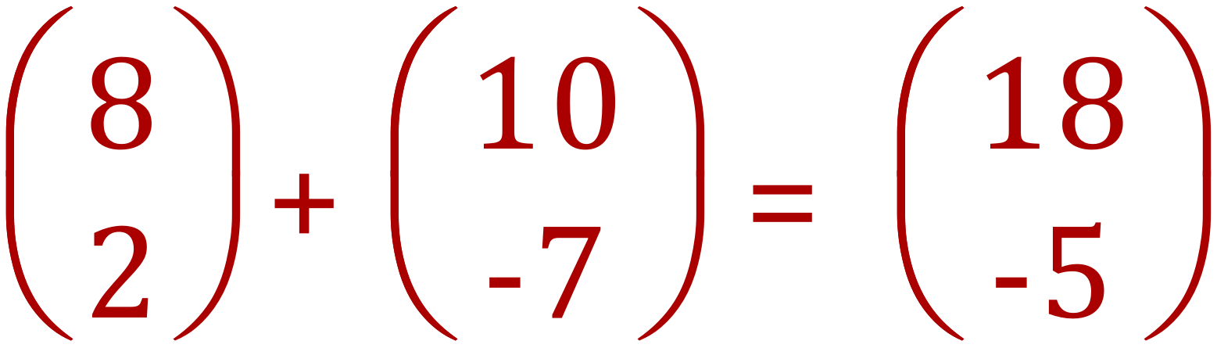
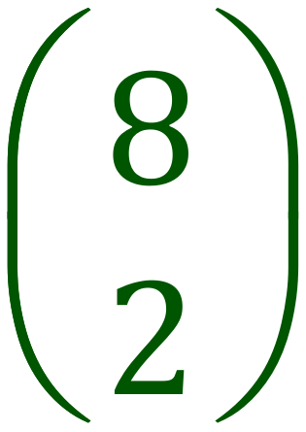
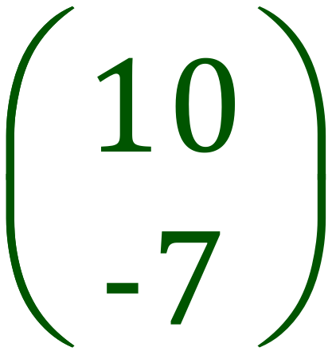
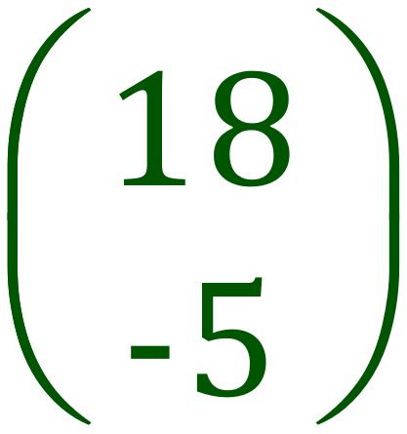
Adding Vectors by Drawing
The STEM Cell

Slide 13
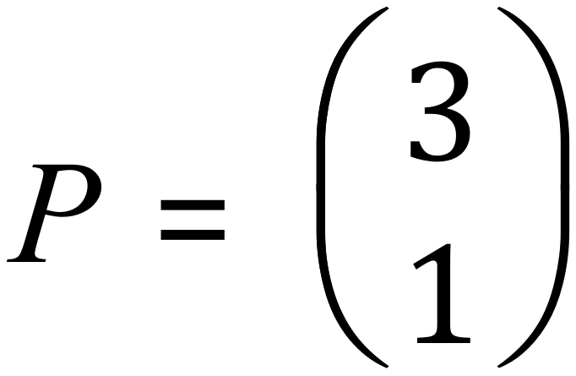
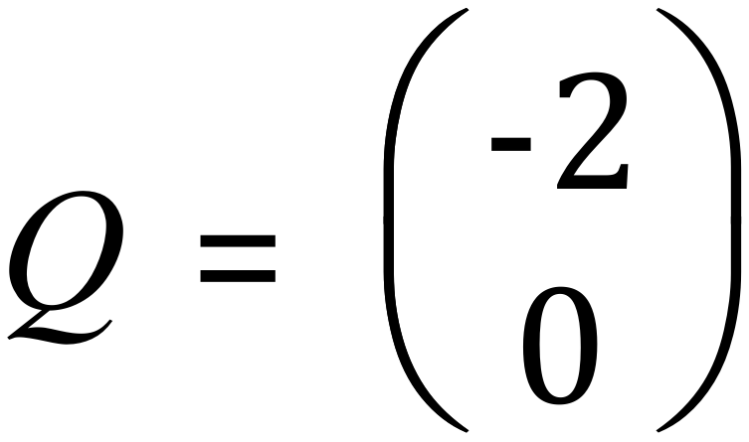
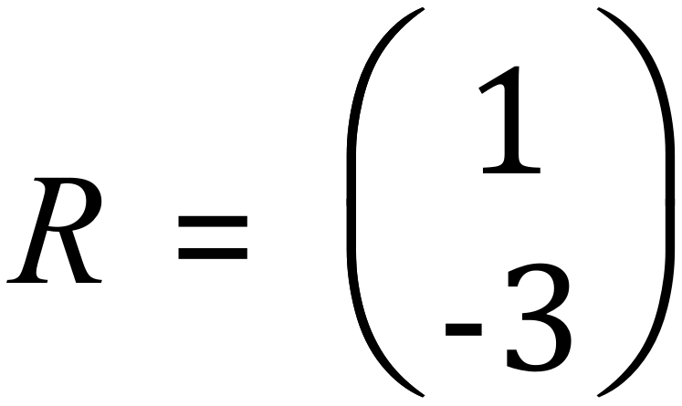
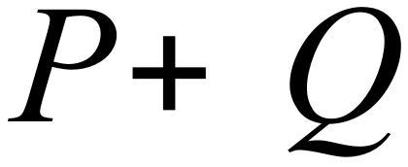
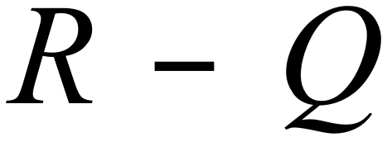
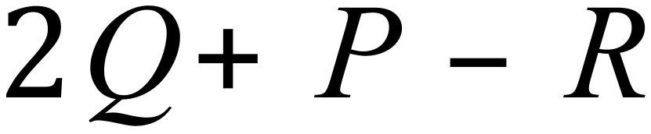
Adding Vectors by Drawing
Given the vectors P, Q and R work out the following resultants and draw them.
The STEM Cell

Slide 14
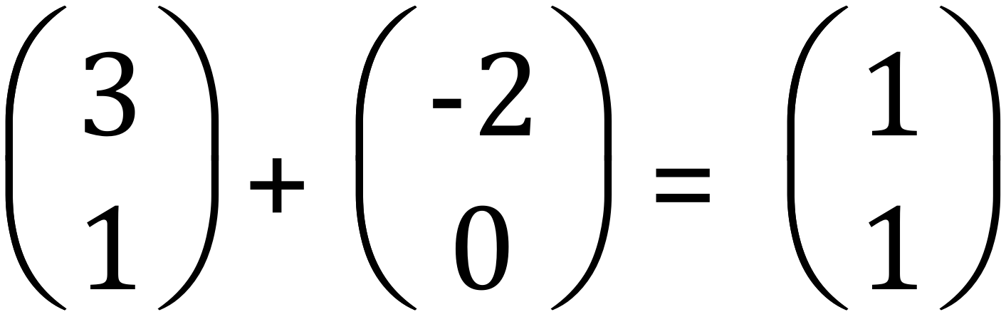
Adding Vectors by Drawing
The STEM Cell

Slide 15
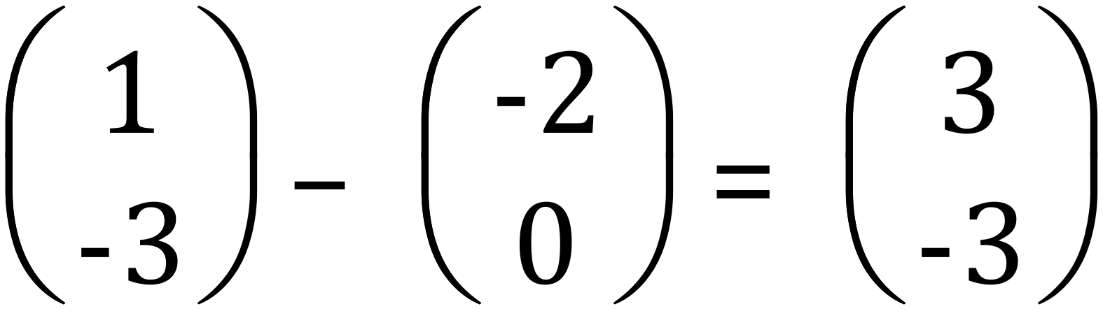
Adding Vectors by Drawing
The STEM Cell

Slide 16
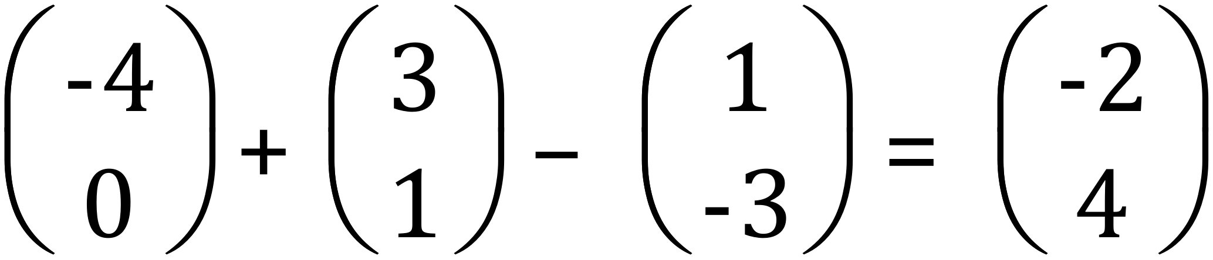
Adding Vectors by Drawing
The STEM Cell

Slide 17
Draw Vectors – Exercises
The STEM Cell

