Slide 1

Circles
Area and Circumference
The STEM Cell

Slide 2

Before we start
This slide carries a very important message
(c) Glasbergen.com
(Reproduced with permission)
The STEM Cell

Slide 3
Circles
Area and Circumference
The STEM Cell

Slide 4
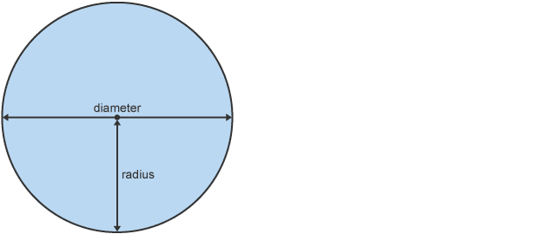
Wednesday, January 19, 2022
We have already looked at perimeter, and found that the perimeter of a two-dimensional object is simply the distance all the way around it.
The perimeter of the circle is given a special name, and is calculated in a slightly more complicated way to that of "straight sided" shapes.
The perimeter of the circle is known as the "circumference" and is found by multiplying the diameter (the distance across a circle passing through the centre) by a special multiplier which we will now identify.
The STEM Cell

Slide 5

Take any circular object, a baked bean tin will do. Measure the distance all the way around its circumference.
Now measure the distance across the diameter, making sure that you pass through the centre.
Divide the circumference by the diameter and note your answer.
Repeat this exercise with some other circular objects, what do you notice about the answers that you get every time?
Object | Circumference | Diameter | C / D
M+M Sweet Tin | 410mm | 132mm | 3.110
Pen Holder | 153mm | 49mm | 3.122
Whiteboard Cleaner Fluid | 180mm | 57mm | 3.158
Perfume Bottle Top | 76mm | 24mm | 3.167
The STEM Cell

Slide 6
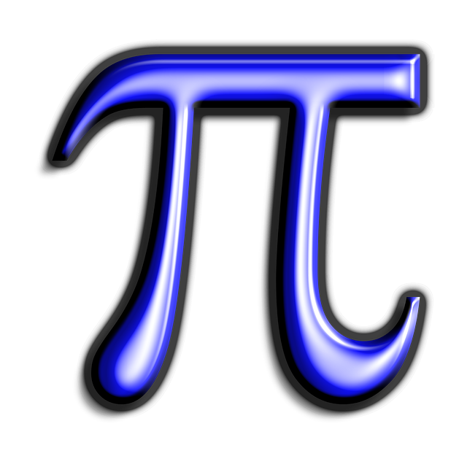
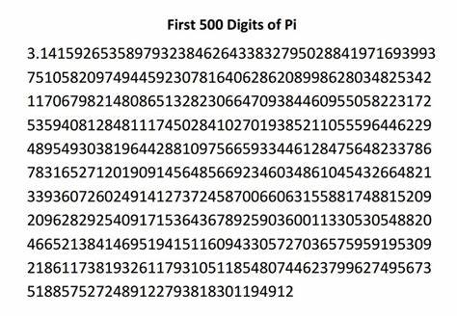
You will notice that your answers will always be somewhere in the region of 3.1
This ratio of circumference to diameter came to be given the Greek letter PI and it is probably the most well-known and irrational number in mathematics.
The STEM Cell

Slide 7
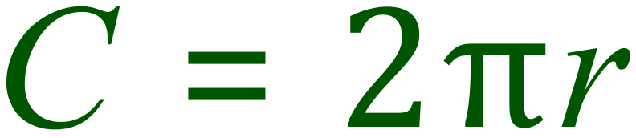
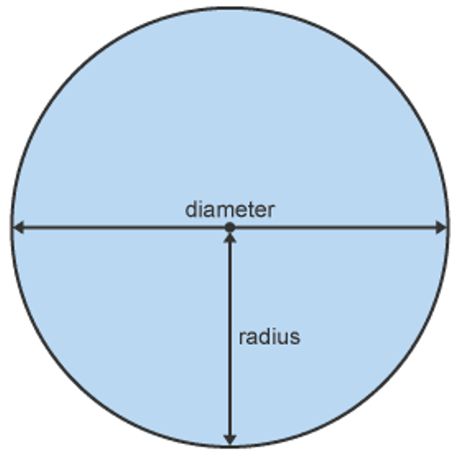

Now that we have identified this “magical multiplier” let’s see how to use it. We will look at some basic examples and lead onto some harder ones.
To calculate the CIRCUMFERENCE of a circle we use this formula:
You might see this version, possibly not too often though:
Can you see why they are the same thing? (discuss)
The STEM Cell

Slide 8


Calculate the circumference of a circle given these data:
Radius | Pi | Circumference
3cm | 3.142 | 18.852cm
12m | 3.142 | 75.408m
1.275 km | 3.142 | 8.0121km
400 miles | 3.142 | 2513.6miles
The STEM Cell

Slide 9
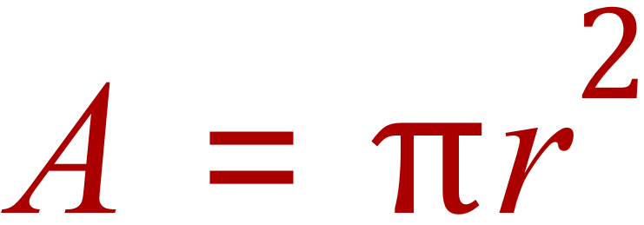
To calculate the AREA of a circle we use another formula containing Pi :
If we have the radius “r” we multiply it by itself (square it) and then multiply by Pi.
Example: what would be the AREA of a circle if it had a radius of 15cm?
Remember : AREA is 2 dimensional, the units are “Square Centimetres” or “Centimetres Squared”
The STEM Cell

Slide 10
Calculate the area of a circle given these data:
Radius | Pi | Area
3cm | 3.142 | 28.278cm²
12m | 3.142 | 452.448m²
1.275 km | 3.142 | 5.108km²
400 miles | 3.142 | 502,720miles²
The STEM Cell

Slide 11
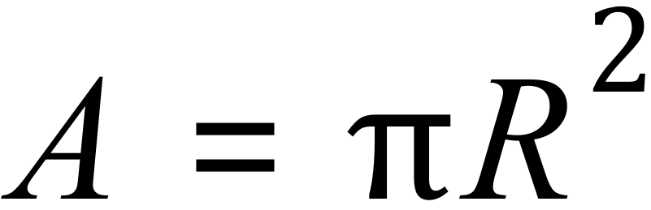
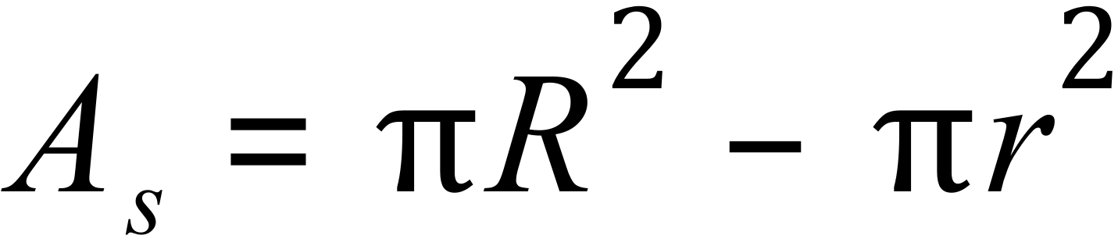
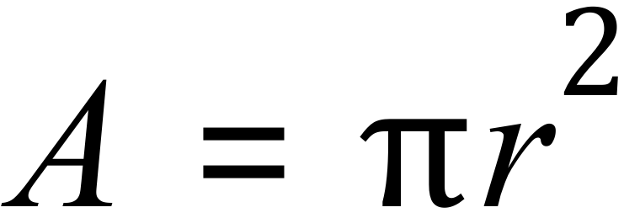
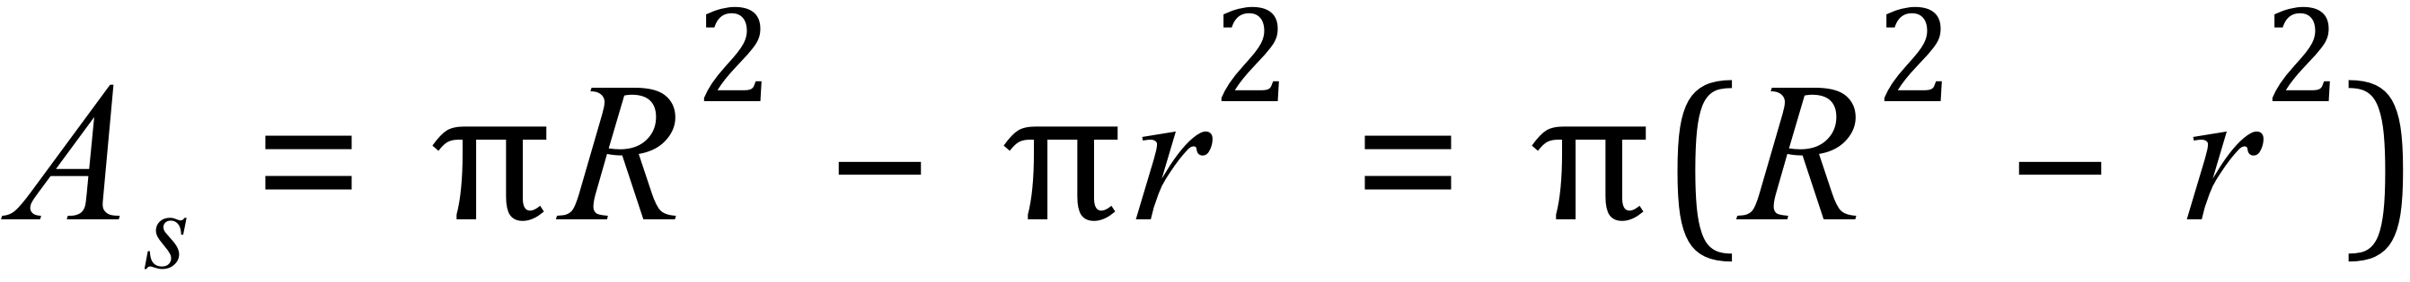
Calculate the area of the shaded section:
The area of the shaded section is the area of the BIG circle minus the area of the SMALL circle
R = 3 cm
r
r = 2.25 cm
R
Note that the area of the shaded section is also:
The STEM Cell

Slide 12

The radius of each circle is shown in arbitrary units (this means that you have a number, but the units are not stated, we just say a.u. in these cases)
1
1.25
COPY and COMPLETE the table, state your answers to 3 decimal places:
1.5
3
Object | Pi | Area (in a.u.²)
Green Circle | 3.142 in ALL cases | 3.142
Yellow Circle |  | 4.909
Purple Circle |  | 7.070
Blue Shaded Area |  | 13.157
The STEM Cell

Slide 13
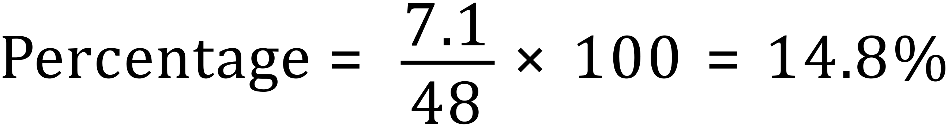
Calculate the area of the shaded section
(pi = 3.142, answers to 1 d.p.)
8cm
1. Calculate the area of the PINK shaded section. Note that the circle is taking up some of the area of the rectangle
3cm
2. What percentage of the rectangle is being covered by the circle?
6cm
Solution 1:
Solution 2:
The STEM Cell

