Slide 1

Transformations
Translation, Reflection, Rotation
And Enlargement – Part 1
The STEM Cell

Slide 2

Before we start
This slide carries a very important message
(c) Glasbergen.com
(Reproduced with permission)
The STEM Cell

Slide 3
Transformations
Translation, Reflection, Rotation
And Enlargement – Part 1
The STEM Cell

Slide 4
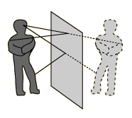
When we look at ourselves in a mirror, we see an entirely opposite image. Everything we see is reversed but remains the same size, shape and distance from the mirror.
Let’s call the mirror the “reflecting plane” so that everything in front of it is reflected identically but reversed.
Now we will look at a simple 2D object reflected in a plane, adding some numbers to show where certain points are (coordinates) it will be easier to see what we are trying to explain.
This is best shown on “gridded” paper such as simple graph paper.
The STEM Cell

Slide 5
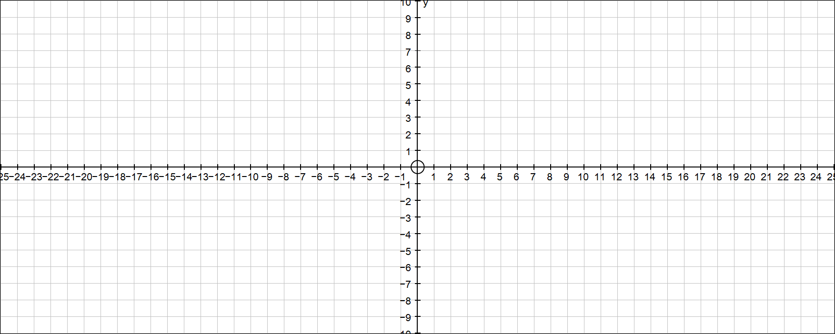

The red square lies at a set distance from the “x” and “y” axes
Take the “y” axis as the reflecting plane, where would the square be located on this side?
(-6,5)
(-3,5)
(3,5)
(6,5)
Each corner can be identified by an (x,y) coordinate – remember “x” first!
ONLY the “x” values change as the reflection is in the “y” axis.
(-6,2)
(-3,2)
(3,2)
(6,2)
(3,-2)
(6,-2)
Now take the “x” axis as the reflecting plane, where would the square be located this time?
Heavy stuff eh? – Remember to stop and ask if you’re a bit lost.
(3,-5)
(6,-5)
ONLY the “y” values change as the reflection is in the “x” axis.
The STEM Cell

Slide 6
Reflect the purple trapezoid in the “x” axis?
(-10,7)
(-7,7)
Now take the “y” axis as the reflecting plane, where would the trapezoid be located on this side?
(-11,4)
(-6,4)
(-11,-4)
(-6,-4)
(6,-4)
(11,-4)
ONLY the “y” values change as the reflection is in the “x” axis.
ONLY the “x” values change as the reflection is in the “y” axis.
(-10,-7)
(-7,-7)
(7,-7)
(10,-7)
The STEM Cell

Slide 7
(-19,6)
(-21,3)
(-17,3)
(-21,-3)
(-17,-3)
(17,-3)
(21,-3)
(-19,-6)
(19,-6)
Exercise: Reflect the above triangle in the “x” axis, then the “y” axis and enter all coordinate pairs.
The STEM Cell

Slide 8
Rotating the shape around a point means that the whole shape “revolves” around the fixed point
Rotate the trapezoid 90º clockwise about point “P”
P
The STEM Cell

Slide 9
PLENARY EXERCISE
Rotate the trapezoid 180º anticlockwise about point “P”
P
Now rotate the trapezoid 90º clockwise about point “P”
Reflect the trapezoid in the line “x = 10”
R
Finally rotate the trapezoid 90º anticlockwise about point “R”
Annotate your finished diagram with all coordinates of the corners of each trapezoid
The STEM Cell

Slide 10
PLENARY EXERCISE
(2,9)
(6,9)
(-1,6)
(21,6)
(-11,6)
P
(9,6)
(3,3)
(18,3)
(-8,3)
(-4,3)
(2,-1)
(18,-1)
(11,-4)
(-1,-4)
R
(21,-4)
(14,-7)
(18,-7)
Annotate your finished diagram with all coordinates of the corners of each trapezoid
The STEM Cell

