Slide 1
The Human Lungs

Slide 2
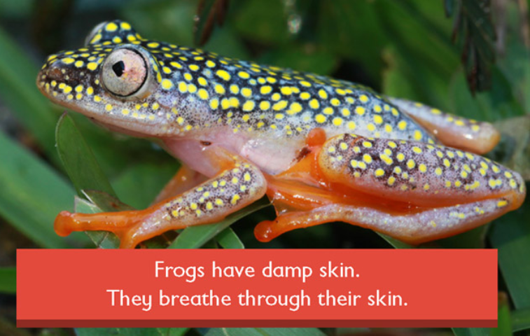
The Human Lungs
Some organisms can breathe through their skin, or to put it in a more scientific way, they have a large surface area to volume ratio and so their body cells can obtain enough oxygen to support cellular growth and replication by diffusion through the skin.
The scientific name for this is CUTANEOUS RESPIRATION and in some organisms it is the PRIMARY method of obtaining oxygen.
Some organisms can breathe normally as they also have lungs (or their equivalent) but may also use cutaneous respiration to obtain additional oxygen.
Cutaneous Respiration is possible with organisms with a large surface area to volume ratio as the oxygen absorbed does not have far to travel from skin to where it is needed.

Slide 3
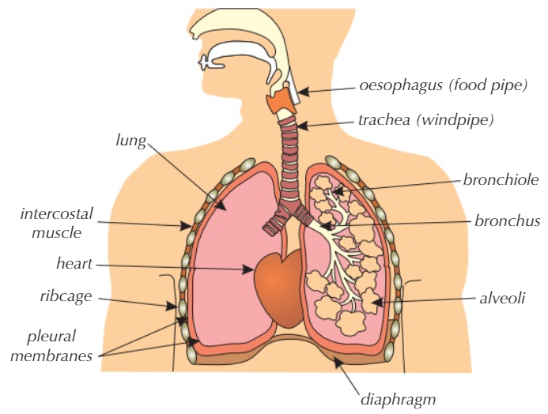
The Human Lungs
Humans, as well as certain other organisms, have too much body “volume” to provide oxygen for, so diffusion through the skin would not be able to supply sufficient oxygen to support cellular need.
Oxygen is collected in the lungs, and waste gases expelled from them.
The lungs work in conjunction with the Cardiovascular System to feed the body with sufficient oxygen to support cellular growth and replication.

Slide 4
The Human Lungs
The “Surface Area to Volume” Ratio needs to be very high for our oxygen needs to be adequately handled with simple diffusion.
Because we have a relatively low SA:V ratio we need a more efficient gas exchange system, so we have lungs.
Let’s take a look at a close up view of the internal workings of the human lung, and look at the parts.

Slide 5
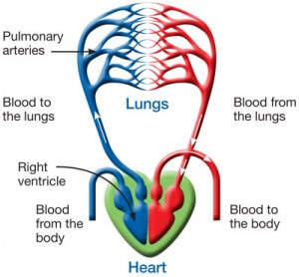
The Human Lungs
The Bronchiole is fed oxygen from the Bronchus which is in turn fed by the Trachea (Windpipe)
Pulmonary arteries carry blood to the Alveoli where they give up waste gases such as carbon dioxide by diffusion to be expelled (breathing out)
Alveoli allow oxygen to diffuse into the Pulmonary veins.
Pulmonary veins carry oxygenated blood to the Heart where it is pumped through the Aorta to circulate around the body.

Slide 6
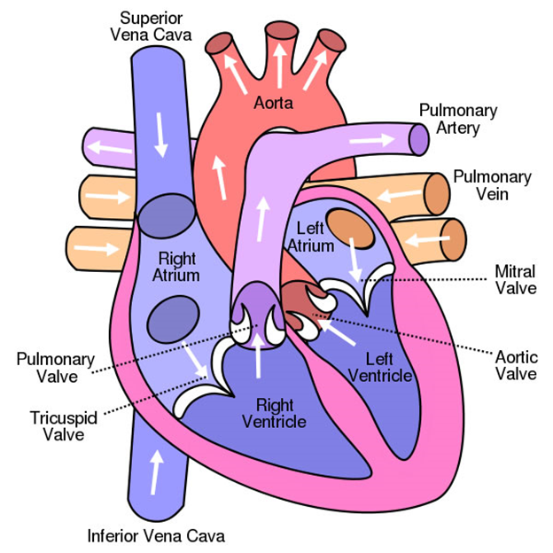
The Human Lungs
The Bronchiole is fed oxygen from the Bronchus which is in turn fed by the Trachea (Windpipe)
Pulmonary arteries carry blood to the Alveoli where they give up waste gases such as carbon dioxide by diffusion to be expelled (breathing out)
Alveoli allow oxygen to diffuse into the Pulmonary veins.
Pulmonary veins carry oxygenated blood to the Heart where it is pumped through the Aorta to circulate around the body.

Slide 7
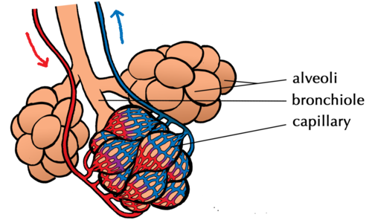
The Human Lungs
Let’s have a closer look at an ALVEOLUS:
The capillaries are a fine network of blood vessels which surround the alveolus and allow gas exchange across the membrane (which is only 1 cell thick ) by diffusion

Slide 8
The Human Lungs
There are around 400-700 Million alveoli in our lungs
One cubic millimeter of lung tissue contains around 170 alveoli.
While the total number can vary from one person to the next, there are literally millions within the human lungs spanning a surface area of roughly 70 square metres.

Slide 9
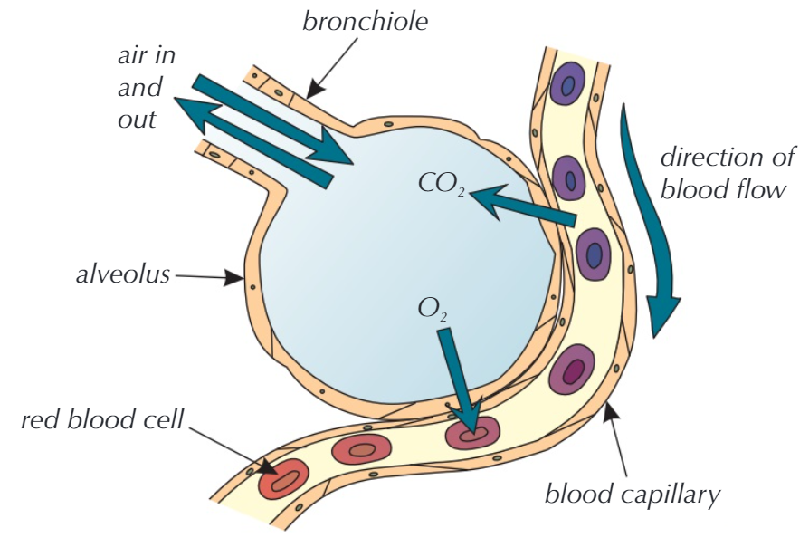
The Human Lungs
DIFFUSION of the gases is from HIGH to LOW concentration so you can see why O₂ diffuses IN to the BLOOD and CO₂ diffuses OUT of the BLOOD (discuss)

Slide 10
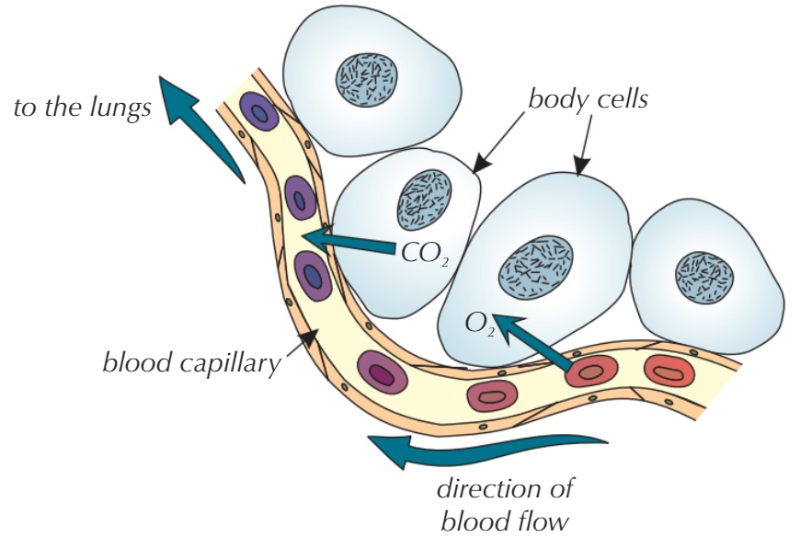
The Human Lungs
When the oxygenated blood arrives at its destination, it once again enters the cells by diffusion (high to low) and waste gas CO2 leaves the cell by the same method.
Blood which has been enriched with CO2 eventually returns via the venous system to the alveoli where once again, diffusion occurs to expel it fom the lungs.

Slide 11
The Human Lungs
Q1. The tube that leads from the throat down into the lungs is the >
TRACHEA
BRONCHI
Q2. The tube named above splits into two tubes called > leading left and right.
Q3. The gas exchange between the air sacs in the lungs takes place by what process? >
DIFFUSION
Q4. The air sacs are called what? >
ALVEOLI
Q5. What is the name of the gas expelled from the blood into the alveoli? >
CARBON DIOXIDE
FALSE (ARTERIAL)
Q6. True or False: Blood enters the lungs through the venous system?>
ONE CELL
Q7. Approximately how thick is the membrane through which diffusion occurs? >
Q8. True or False: Humans need lungs because of our high surface area to volume ratio >
FALSE (LOW)

